Slide 1

What is climate change?

Slide 2
Outline
What is climate change?
Signs of a changing climate
Why plan and prepare for climate change?
Resources for learning about CC
CC videos for communicating

Slide 3
What is Climate Change?

Slide 4
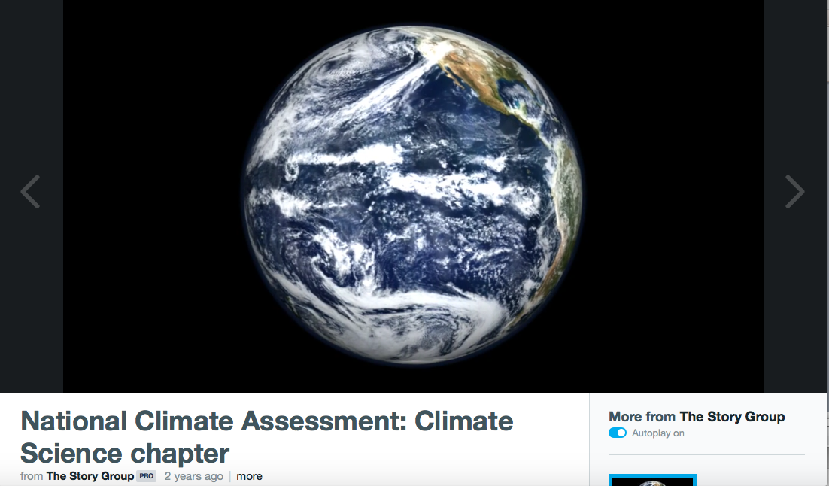
What is Climate Change?
Notes:
Video from the Climate Science chapter of the third National Climate Assessment (2014) – intro to climate change (~2 minutes)
https://vimeo.com/99942068

Slide 5
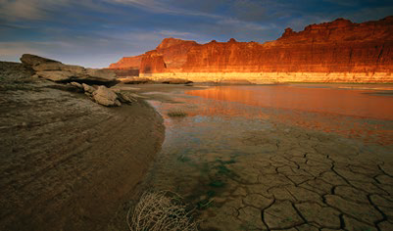
What is Climate Change?
© Peter Essick/Getty Images
Climate Change is defined as the change in global or regional climate patterns due to increased atmospheric gases such as CO2

Slide 6
Weather, Climate, Climate Change
Weather: short-term changes in temperature, precipitation, humidity
Climate: typical weather over longer-time periods
Climate change is a shift in
typical weather.
Notes:
Weather is what conditions of the atmosphere are over a short period of time, and climate is how the atmosphere "behaves" over relatively long periods of time.
Weather is what happens when a batter is at the plate for a single bat, climate is the batting average
Weather is mood, climate is our personality
Climate is what you expect, weather is what you get
Weather - short-term changes we see in temperature, clouds, precipitation, humidity and wind in a region or a city. Weather can vary greatly from one day to the next, or even within the same day.
Weather: What’s going on in the atmosphere at a given place in time. Observable, measurable, tangible, physical. Batter at the plate for a single at-bat. Outfit of the day. Mood.
Climate: The accumulated information about weather over a length of time. Not as easy to see/observe/feel (though drought is the most visible). Statistics and descriptions, including averages, trends, and variation. Batting average. Clothes in closet. Personality.

Slide 7
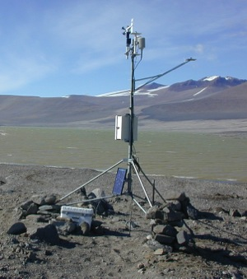
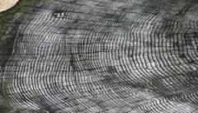
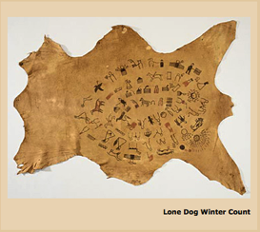

How do we know the climate is changing?
Instrumental Evidence
Distant Past – Paleo-evidence
Community & traditional knowledge Historical evidence
Tree Rings
Ice Cores
Waniyetu Wówapi
Winter Counts
Notes:
There is a variety of evidence that indicates that the climate is changing.
In the relatively recent past, we have instrumental data – temperature data may go back to the 1880s.
We also have historical evidence and community & traditional knowledge
Historical evidence can include narrative accounts and pictorial representations such as those found in Winter Counts. Such counts were kept by various bands of Plains Indian tribes. One picture was chosen to represent each year and recorded on, for example a buffalo skin. In some cases these pictures represented extreme climate events. Some of the counts date back to as early as the 1600s. Community knowledge can include stories that our parents and grandparents tell us about things they used to do – when the lake froze solid and things like that. Traditional knowledge can include, for example, observations of plant phenology and the timing of fish runs.
For the really distant past, we have what is known as paleo-evidence in which information about different climate-related variables such as carbon dioxide levels, temperature, and drought are stored in natural archives like tree rings and ice cores.

Slide 8
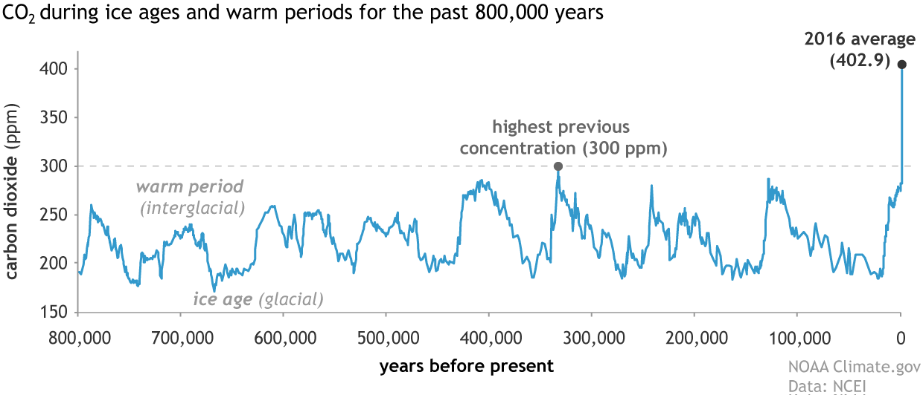
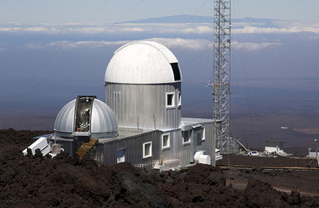
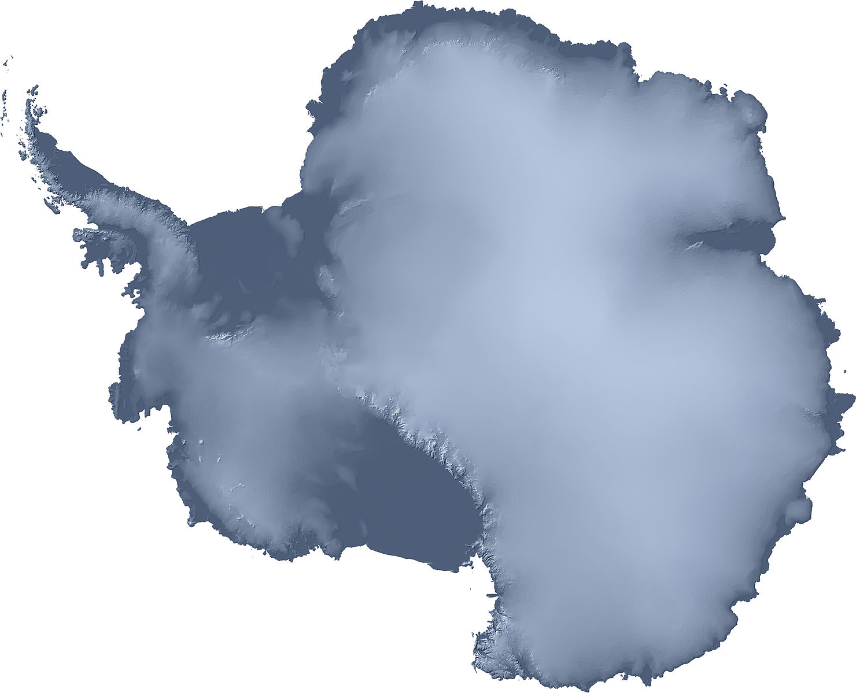
Is what is happening unusual?
2018 peak at Mauna Loa: 411 PPM
Instrumental Data from Mauna Loa Observatory
Paleoevidence from Dome C ice core, Antarctica
Instrumental Data from Mauna Loa Observatory, Hawaii
Notes:
This graph shows carbon dioxide levels through time for the past 800,000 years. The data have been reconstructed from an ice core from Dome C, Antarctica.
The longest direct measurements of carbon dioxide in the atmosphere are from the Mauna Loa Observatory in Hawaii and were started in 1958. In 2018, at Mauna Loa, the “monthly average for carbon dioxide (or CO₂) exceeded 410 ppm for the first time in April. The average for May peaked at 411.25 ppm.” Source: https://research.noaa.gov/article/ArtMID/587/ArticleID/2362/Another-climate-milestone-falls-at-NOAA’s-Mauna-Loa-observatory
The graph shows that current carbon dioxide levels are at the highest that they’ve been in the past 800,000 years and that they are increasing at a faster rate that ever before during that timeframe.
Source of graph: NOAA - https://www.climate.gov/news-features/understanding-climate/climate-change-atmospheric-carbon-dioxide
Another potential website of interest: NOAA – Trends in Atmospheric Carbon Dioxide - https://www.esrl.noaa.gov/gmd/ccgg/trends/

Slide 9
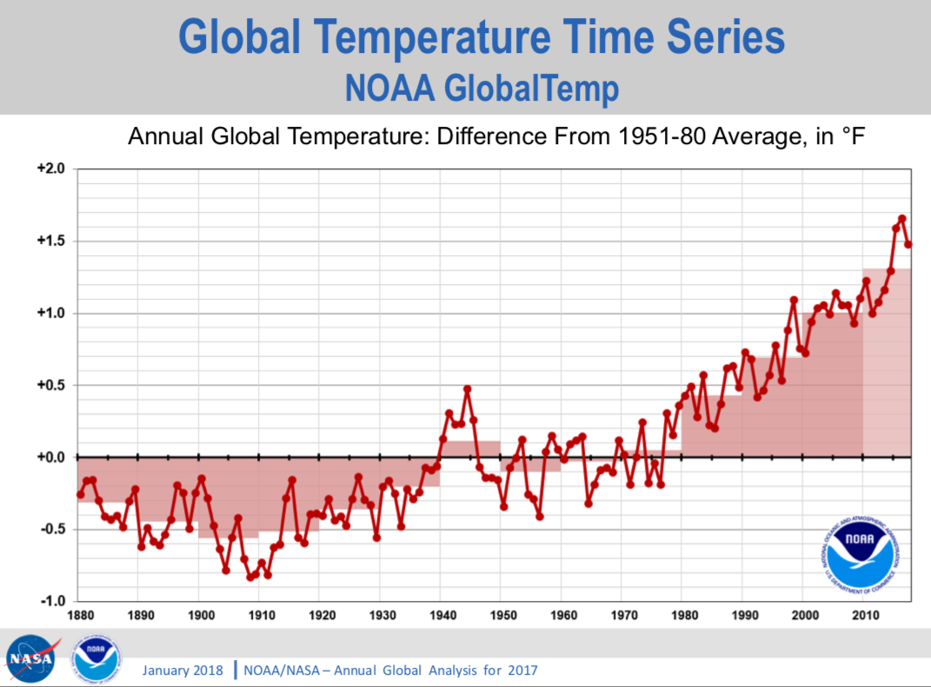
Is what is happening unusual?
Global temperatures are increasing
Notes:
Source of graph: https://www.nasa.gov/sites/default/files/atoms/files/noaa-nasa-global_analysis-2017.pdf
2017 was the second warmest year on record according to NASA and third warmest year on record according to NOAA. http://www.noaa.gov/news/noaa-2017-was-3rd-warmest-year-on-record-for-globe
17 of the 18 hottest years on record have occurred since 2001 according to both NOAA and NASA - https://climate.nasa.gov/vital-signs/global-temperature/; https://www.nytimes.com/interactive/2018/01/18/climate/hottest-year-2017.html

Slide 10
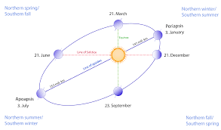
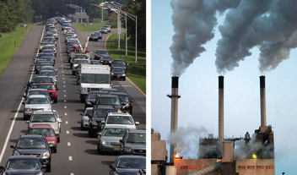

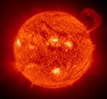
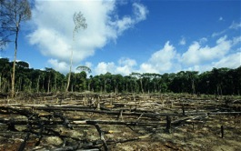
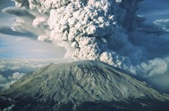
Causes of Climate Change
Natural Factors
Human Factors
Burning of fossil fuels (coal, oil, gas) Deforestation
Earth’s Orbit
Photosynthesis
Sunspots
Volcanic Eruptions
Notes:
The climate is always changing.
Some causes are natural and include changes in the earth’s orbit, the start of photosynthesis, sunspots that contribute to variation in the energy produced by the sun, and volcanic eruptions.
However, human factors are the predominant cause of recent climate change. Humans factors include the burning of fossil fuels, which emits greenhouse gases such as carbon dioxide and methane. Humans also contribute to climate change through deforestation and the removal of trees that absorb carbon dioxide.

Slide 11
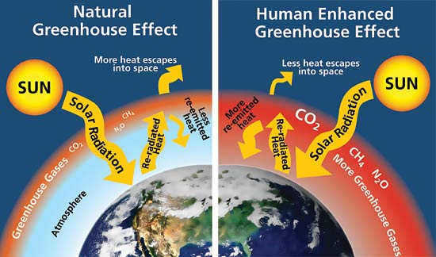
Greenhouse Gas Effect
Greenhouse gases absorb heat (solar radiation)
Radiate heat back to Earth’s surface
Natural greenhouse effect is necessary for life on Earth
Concern: Human activities are enhancing the greenhouse effect, trapping more heat
Slide courtesy of Barbara Boustead, National Weather Service
Notes:
The sun radiates vast amounts of energy onto Earth. Most of the energy bounces off the surface of the planet and returns to space. But some of the energy is trapped by greenhouses gases, like carbon dioxide and methane, which form a sort of buffer around the planet. The heat-trapping effect is vital for life to exist because it keeps the planet far warmer than it otherwise would be. Without greenhouse gases, the planet would be far too cold to inhabit.
Naturally occurring levels of greenhouse gases allow life to flourish on Earth. Yet over the past two centuries, certain human activities have caused an overabundance to build up in the atmosphere. Carbon dioxide, a by-product of burning fossil fuels, is one major contributor to climate change. This problem is intensified by deforestation: cutting down the trees that use carbon dioxide to grow.
As greenhouse gas concentrations increase, too much heat is trapped around the planet. This leads to rising global temperatures, and countless other associated effects.
July 2016 was the hottest month in recorded history, the 10th record hot month in a row, according to NASA.

Slide 12
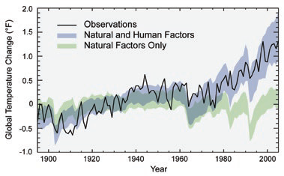
Human factors are the main cause of current climate change
Source: IPCC
Notes:
Text explaining graph - “Models that account only for the effects of natural processes are not able to explain the warming observed over the past century. Models that also account for the greenhouse gases emitted by humans are able to explain this warming.” Source of text: https://19january2017snapshot.epa.gov/climate-change-science/causes-climate-change.html.
Source of graph: Fig. 34.15, 2014 National Climate Assessment - https://nca2014.globalchange.gov/report/appendices/faqs#graphic-38788

Slide 13
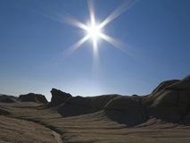
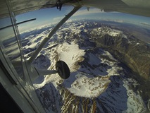

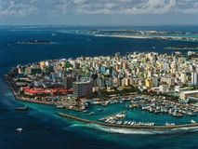
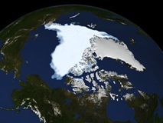
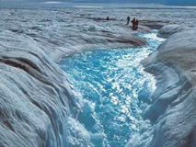
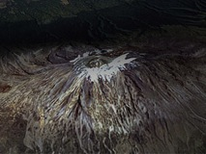
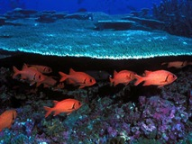
Global Climate Change Indicators
Global Temperature Rise
Decreased Snow Cover
Extreme Events
Sea Level Rise
Declining Arctic Sea Ice
Shrinking Ice Sheets
Glacial Retreat
Ocean Acidification
From: NASA, http://climate.nasa.gov/evidence/

Slide 14
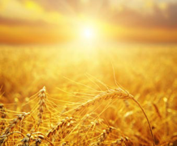
Signs of a Nationally Changing Climate
Average temperature has increased by 1.3°F to 1.9°F since 1895; most of this increase has occurred since about 1970. Temperatures in U.S. are expected to continue to rise.
Length of frost-free season (and corresponding growing season) has increased nationally since the 1980s.
Average U.S. precipitation has increased since 1900, but some areas have had decreases.
Source: 2014 U.S. National Climate Assessment

Slide 15
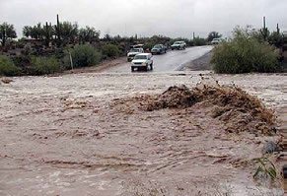
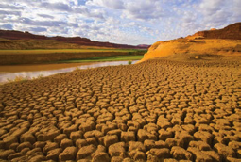
Signs of a Nationally Changing Climate
Heavy downpours are increasing nationally. Increases in frequency and intensity of extreme precipitation events are projected for all U.S. regions.
Heat waves have become more frequent and intense, especially in the West. Cold waves have become less frequent and intense across the nation.
Flash Flooding: Cave Creek, AZ
(Photo credit: Tom McGuire)
© Momatiuk - Eastcott/Corbis
Source: 2014 U.S. National Climate Assessment

Slide 16
Signs of a Changing Climate
(MT, KS, OK, NM)
Montana is warming. Between 1950 and 2015 annual average air temperatures have increased between 2 and 3ºF.
Maximum temperatures have increased most in spring.
Kansas is warming. Over the past century, annual average air temperatures have increased in most parts of the state by at least 0.5 ºF; last decade one of warmest on record
Soils are becoming drier.
Rainstorms are becoming more intense & flooding more severe.
Most of Oklahoma has not shown a warming trend over the past 50-100 years; Temperatures in the past decade have been higher than in the previous 40 years
Soils are becoming drier.
Rainstorms are becoming more intense.
New Mexico is warming. Between 1970 and 2014, annual average air temperatures have risen by about 2.7 ºF average
The last decade has been the warmest on record for the state, with increasing trends in both extremely hot days and warm nights.
Sources: Montana Climate Assessment, USEPA Climate Change Fact Sheets, NOAA State Climate Summaries

Slide 17
Signs of a Changing Climate
Current Data
State Climate Summaries: https://statesummaries.ncics.org/node/1
USEPA Climate Change Indicators: https://www.epa.gov/climate-indicators/climate-change-indicators-us-and-global-temperature
NOAA National Climate Trends: https://www.ncdc.noaa.gov/temp-and-precip/us-trends/tavg/ann#us-trends-select

Slide 18
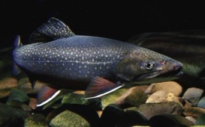
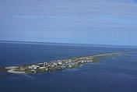
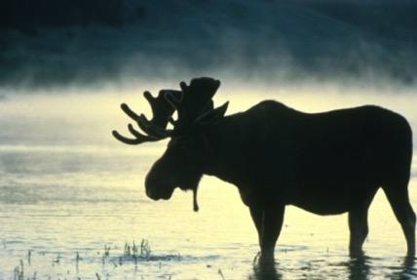
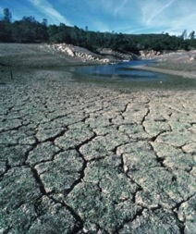
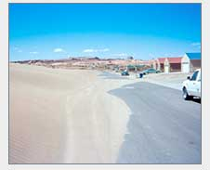
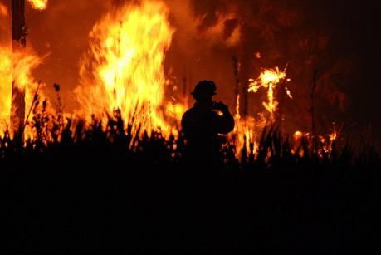
Tribes in the U.S. & world have begun to experience climate change impacts
Brook trout. Photo credit: USFWS
Kivalina, Alaska. Photo credit US Coast Guard/ Lt. Cdr. Micheal McNeil
Photo credit: M. Lockhart/USFWS
Sand dune migration on Navajo Nation. . Photo credit: M. Hiza, USGS
Photo credit: USDA NRCS
Photo credit: Josh O'Connor/USFWS
Notes:
Moose – the Grand Portage Band of Chippewa in Minnesota is observing climate-related declines in moose populations, which are a subsistence species
Kivalina Alaska is facing high rates of erosion. Decreased sea ice and associated wave action on the shores are contributing to this. The community has voted to relocate.
Native fish species are dying off due to rising water temperatures so some tribes are starting to farm fish species that can adapt to changing water temperatures. This in turn ensures some economic security.
Sand dune encroachment stemming from decreased precipitation and destabilizing the earth due to lack of plant growth or regeneration. Dunes are hindering travel routes for rural tribal communities or families that live far from urban areas thus decreasing access to health and other services.
Lack of consistent rain fall or snowmelt causing watering holes for livestock and wildlife to decrease effecting animals survivability during dry, hot months.

Slide 19
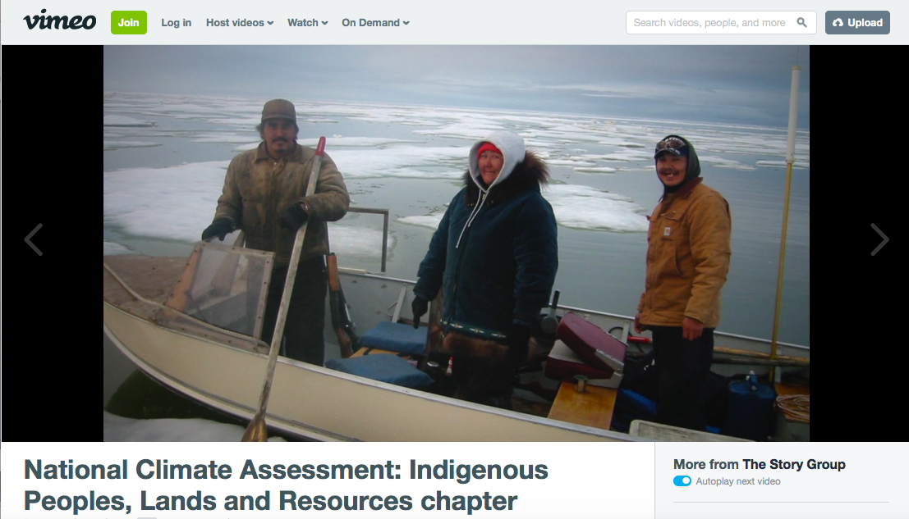
What is Climate Change?
Notes:
Video from the Indigenous Peoples chapter of the third National Climate Assessment (2014) (~2 minutes)
https://vimeo.com/100528198

Slide 20
Next Steps – Learn about Potential Climate Change Impacts
4th National Climate Assessment (NCA4) Expected December 2018:
https://www.globalchange.gov/nca4
3rd National Climate Assessment (NCA3) (2014) (shorter, by region & sector): http://nca2014.globalchange.gov/
Indigenous Peoples Chapter of NCA3: http://nca2014.globalchange.gov/highlights/report-findings/indigenous-peoples
NCA3 Technical Input Reports (bigger, more info, by region & sector): https://www.globalchange.gov/engage/process-products/nca3/technical-inputs
ITEP’s Tribes and Climate Change Website: http://www7.nau.edu/itep/main/tcc
U.S. Climate Resilience Toolkit: https://toolkit.climate.gov/

Slide 21
Potential VIDEOS to show
EPA: Climate Change Basics https://www.youtube.com/watch?v=ScX29WBJI3w (~3 minutes, 2015)
Inter-Tribal Youth Climate Leadership Congress (climate change impacts on tribes around the U.S.) https://www.youtube.com/watch?v=kHH85HcsHI4 (7.5 min., 2015)
ITEP: Adapting to Climate Change: https://vimeo.com/118150835 (~11 min., 2014)
National Climate Assessment, Climate Science Chapter (~2 minutes, 2014) https://vimeo.com/99942068
National Climate Assessment, Indigenous Peoples Chapter https://vimeo.com/100528198 (~2 minutes, 2014)

