Slide 1
Mansel Nelson
Program manager institute for tribal environmental professionals
Alheli Baños-Keener
Indoor environments and asthma coordinator
USEPA Region 9
Developing a Tribal
Indoor Air Program
June 2, 2021
Notes:
Thank you joining us today. My name is Alheli Banos Keener and I’m the indoor environments and asthma coordinator for Region 9.
When we prepared this presentation, our goal was to share resources with you so that when you hopefully decide to embark on developing an indoor air program, or a different component in your current air program, you have some good tools to start you off.

Slide 2
  “You could go days without food and hours without water, but you would last only a few minutes without air”
  The Plain English Guide to the Clean Air Act

Slide 3
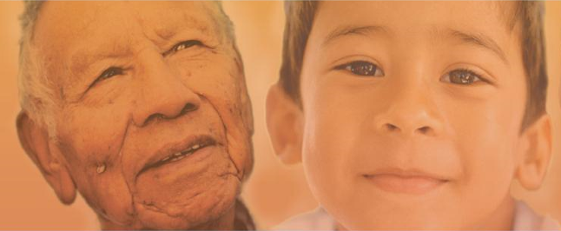
Indoor Air Quality and Health
EPA studies show that indoor air pollutants can be two to five times— and occasionally more than 100 times— higher than outdoor levels
Source, EPA Report on the Environment: https://www.epa.gov/report-environment/indoor-air-quality
Sensitive groups:
Elders
Those suffering
from heart and
lung disease
Asthmatics
  Children:
Breathe more than adults, relative to their body weight
Children are rapidly growing and developing
Less developed natural defenses
Spend more time close to the floor, where contaminant levels can be higher
Childhood exposures can have life-long effects
Notes:
It is estimated that people spend approximately 90% of their time indoors…and that indoor air can be 2 to 5 times more contaminated and sometimes up to 100 times more contaminated than outdoor air. The quality of our indoor air affects us all, but especially the most vulnerable ---the elderly, people with health conditions such as asthma, heart and lung disease-- and especially children because they’re still growing and their organs still developing.

Slide 4
Indoor Air Quality and Health cont.
Indoor air pollution can have immediate effects
  trigger asthma
  irritation of the eyes, nose, and throat,
  headaches, dizziness, and fatigue
Indoor air pollution can have long-term effects
  occur years after exposure
  after long or repeated periods of exposure
  respiratory diseases, heart disease and cancer
Indoor air quality affects your health even if symptoms are not immediately noticeable
Source, EPA indoor air quality webpage:
https://www.epa.gov/indoor-air-quality-iaq/introduction-indoor-air-quality#health

Slide 5
Asthma in Tribal Communities
Protecting the health of the next generation
  12% of people living in tribal communities – nearly double the current national average of 7.7%.¹
  10.2% of American Indian/Alaska Native children compared to 7.5% of children in the U.S.²
1. https://www.cdc.gov/nchs/fastats/asthma.htm
2. https://www.cdc.gov/asthma/most_recent_national_asthma_data.htm
Notes:
asthma is a huge issue in Native American communities, affecting 12% of people living in tribal communities, which is almost double the current national average of 7.7%.
10.2% of Native children are affected by asthma, compared to 7.5% of the children in the US

Slide 6
Health Connections for COVID
Air Pollution results in poor outcomes for COVID
1 microgram/m3 PM
=
8% to 15% increase in COVID death
Study Conclusions: A small increase in long-term exposure to PM_{2.5} leads to a large increase in the COVID-19 death rate. Despite inherent limitations of the ecological study design, our results underscore the importance of continuing to enforce existing air pollution regulations to protect human health both during and after the COVID-19 crisis.
Study link: https://projects.iq.harvard.edu/covid-pm/home

Slide 7
COVID Science Understanding Evolving
Asymptomatic carriers
Surface transfer lower risk
Primarily airborne transfer
COVID Variants?
Vaccines
Vaccines are working!
Much of COVID science has become highly politicized

Slide 8

Risk Reduction
Actions - COVID
Wear mask
Distancing
Ventilation and Filtration
Wash Hands
Cleaning with non-toxic cleaners
Avoid crowded, poorly ventilated indoor spaces
Notes:
MANSEL WILL REPLACE

Slide 9
Re-Opening Schools
Every reasonable effort should be made to identify, fund and remedy HVAC systems in schools
A) Support a culture and related policies that encourage and accommodate staff and students to stay home when sick;
B) Maximize the proportion of fresh air coming into our schools to the extent outdoor AQ allows and the HVAC systems can sustain;
C) Increase filtration levels to the extent HVAC can sustain, supplementing with in-room filtration units as required; and
D) Measure ventilation using Carbon Dioxide measurements.

Slide 10
Developing a Tribal
Indoor Air Program through GAP
This is a voluntary program with limited regulations and statutes—unlike ambient air
Education and outreach is key in improving indoor environments and environmental health
Why work on this?
  To directly protect human health
  Immediate return – it’s practical and tangible
  You learn about your community, build relationships and help them in a way that is practical and real to them
Notes:
Prevention is the key and the purpose is to fix problems
Indoor air is not a regulatory program that has clear standards to follow, so sharing information with the community you serve, on what they can do to improve their indoor air—is extremely important.
We are hoping that you’ll consider adding indoor air activities to future workplans because it’s a direct way to protects human health, it’s something that is real to people, it can have an immediate impact, and personally, I believe it’s also very rewarding work, that allows you to build relationships with your community and help them in a way that is very important to them.

Slide 11
POLL
What funding source(s) do you anticipate using for IAQ activities?
GAP
CAA103
CAA105
HUD
Other
Notes:
Prevention is the key and the purpose is to fix problems
Indoor air is not a regulatory program that has clear standards to follow, so sharing information with the community you serve, on what they can do to improve their indoor air—is extremely important.
We are hoping that you’ll consider adding indoor air activities to future workplans because it’s a direct way to protects human health, it’s something that is real to people, it can have an immediate impact, and personally, I believe it’s also very rewarding work, that allows you to build relationships with your community and help them in a way that is very important to them.

Slide 12
GAP Eligibility and where to begin
A few examples
Notes:
We prepared this presentation as a resource that you can pull up as you are getting ready to put together a GAP workplan, or plan what you’d like to do related to indoor air, healthy homes and asthma outreach and education. I’m going to breeze through some of this information, but added a lot of detail so that you have it when you are getting ready to plan and build a workplan, or add some activities to a workplan.

Slide 13
General GAP Guidance
1.2 Program Priorities
“Funding is provided under GAP for the purposes of planning, developing, and establishing tribal environmental protection programs consistent with programs and authorities administered by the EPA”.
As further detailed in Appendix I (aka: Guidebook), GAP resources should support:
Developing and maintaining core environmental program capacities (administrative, financial management, information management, environmental baseline needs assessment, public education/communication, legal, and technical/analytical)
Notes:
As Mansel mentioned, education and outreach is the key when doing indoor air quality work. This excerpt from the GAP guidance just demonstrates that importance of education and outreach, identified here as a core environmental program capacity, and this includes doing a baseline needs assessment on different topics.

Slide 14
B: Building Core Environmental Protection Program Capacities
B.6 Establishing Core Public Participation, Community Involvement, Education, and Communication Capacities
Establishing public participation, community involvement, education, and communication core capacities includes assessing, modifying, or developing systems to ensure that the tribal environmental protection program can notify the general public of important events or information, publicize activities related to its projects and programs, engage community members to understand their environmental and public health concerns, educate the public on human health and environmental protection issues important to the tribe, and be responsive to concerns raised. These systems should identify the various routes or methods of disseminating information, and the time frame and particular audience that each method would reach.
Notes:
In the Guidebook, Education and outreach listed as Capacity B. You can develop a general environmental education component that focuses on a variety of education and outreach topics such as indoor air, healthy homes, asthma environmental outreach, etc. (since indoor air quality is so closely tied to COVID, the need to work on indoor air quality has never been more clear and necessary.
This includes setting up a system to notify the public of important events, publicize activities (such as your earth day events for example). It includes engaging the community so that they can tell you about their environmental or public health concerns, and it should also set up ways for you, as the Tribal Environmental Protection Program or Agency, to share information with the community on issues that are important to the tribe, and it should include how you will respond to those issues as well.

Slide 15
C: Building capacity on Air Quality from the GAP Guidebook
Air: “The first stage in developing an air quality management program is to develop the necessary expertise and skills to identify, address, and manage air quality issues. Tribal capacity-building activities should focus on assigning staff, acquiring initial training, compiling relevant data on which the tribe can make program development decisions, engaging the tribal community on air quality issues, collecting and analyzing new air quality data, and using this information to make decisions on further development of an air quality management program.”
Notes:
This comes directly form the Air Quality Section in the Guidance document – it reiterates that the most important thing to remember, is that the focus of the GAP program is for your Environmental Program to build capacity. The first stage is to develop the necessary expertise and skills, assign staff, acquire training, compile relevant data, engage the community and collect and analyze data so that you can further develop a program.

Slide 16
C: Building Tribal Ambient and Indoor Air Quality Program Capacities
C.3.1 Tribe has established a staffing plan (position description and recruitment/retention/promotion plan) for who will serve as tribal air quality/indoor air quality program coordinator(s).
C.3.3 Staff has completed appropriate indoor air quality training and acquired skills related to indoor air quality (e.g., Healthy Homes training)
C.3.5 Tribe is receiving funding under the CAA or other related EPA media specific program.
C.3.10 Tribe has completed an indoor air quality assessment and report.
C.3.11 Tribe has established a radon program that tests residential and other occupied structures for radon, identifies those above the EPA action level, and conducts outreach and education in the community.
Notes:
This capacity indicator, Indicator C, Is focused on building Tribal Ambient and Indoor Air Quality Program Capacities
I highlighted here some examples of program capacities that are eligible under this Indicator and I’ll just mention a few:
Doing an indoor air quality assessment and report
Establishing a radon program including outreach and education
Preparing recommendations on how to improve indoor air quality
Establishing a program to do indoor air quality outreach, education and or training for tribal government officials and also for community members

Slide 17
C: Building Tribal Ambient and Indoor Air Quality Program Capacities(cont.)
C 3.12 Tribe has prepared a report recommending actions to improve indoor air quality and reduce levels for radon, mold, moisture, and environmental pollutants.
C 3.13 Tribe has incorporated indoor air quality improvements or features as part of building renovation programs (e.g., weatherization and rehabilitation) and new construction.
C 3.31 Tribe has enacted green building codes, guidelines and/or protocols that promote healthier indoor air quality and apply these practices to new and retrofitted buildings.
C 3.32 Tribe has established a program to conduct indoor air quality outreach, education, and/or training for tribal government personnel and/or community members.
C.3.33 Tribe has with effective compliance assurance and enforcement provisions enacted indoor air quality laws, codes, and/or regulations

Slide 18
G: Building Tribal Chemical Safety and Pollution Prevention Program Capacities
G.3.4 - Tribe has completed an asbestos, pesticides, lead-based paint, and pesticides needs assessment that: collects and evaluates existing data on pesticide use and other relevant factors; assesses the need to develop related projects and/or programs; and evaluates short-term and long-term options to address those identified needs.
G.3.5 - Tribal staff has acquired necessary training/accreditation/certification to conduct lead-based paint hazard evaluations at pre-1978 tribal housing/pre1978 child occupied facilities.
G.3.7 Tribe has established community outreach/education programs.
G.3.8 Tribe has established mechanisms to provide meaningful opportunities for public participation/community involvement to identify concerns related to chemical safety and pollution prevention and/or solicit input on decisions.
G.3.9 Tribe has completed inventory of all pre-1978 target housing and child-occupied buildings and gathered information on the presence of lead-based paint and/or lead-based paint hazards in or around these buildings.
G.3.10 Tribe has completed an inventory of asbestos (in accordance with the AHERA), pesticides, and toxics in K-12 schools.
Notes:
The last indicator I wanted to point you to is indicator G which focuses on Chemical Safety and Pollution Prevention,—
This one is focused on asbestos, lead, pesticides and other toxics.
So again, doing assessments , establishing community outreach and education programs, establishing a public participation and community involvement programs, and other important work that will improve indoor air quality and environmental health.

Slide 19
GAP Guidance
FAQ’s answer many important questions that have come up over the years: https://www.epa.gov/tribal/frequently-asked-questions-about-indian-environmental-general-assistance-program-gap
The full, 2013 GAP Guidance is here: https://www.epa.gov/tribal/2013-guidance-award-and-management-general-assistance-agreements-tribes-and-intertribal
Notes:
I didn’t list all the capacity indicators, so please make sure to check out the gap guidance and look for more or other capacities to work toward achieving

Slide 20
First Steps
Work with your Project Officer to see if you need to modify your EPA-Tribal Environmental Plan (ETEP) to include indoor air quality, environmental health, education and outreach. This is your strategic planning document.
Reach out for technical assistance as needed:
  Mansel Nelson: Mansel.Nelson@nau.edu/928-523-1275, or Alheli Banos-Keener: banos.alheli@epa.gov/619-235-4767 and/or talk to your project officer
Create an indoor air baseline needs assessment
Notes:
This first item here is a requirement—making sure your EPA-Tribal Environmental Plan or ETEP has education and outreach in it. You can specifically add indoor air, pesticides, healthy homes to your ETEP if you’d like, discuss this with your project officer.
And please reach out to us for resources and technical assistance.
You can begin by doing a baseline needs assessment. This will help you organize your thoughts and plan.

Slide 21
EPA-Tribal Environmental Plan (ETEP)
The ETEP is a strategic planning document that covers 4-5 years and it can be updated as priorities change, or new priorities emerge. Talk to your project officer to see if modifications need to be made to your plan.
Minimum ETEP Requirements (see GAP Guidance, page 16 of 22)
Identification of environmental issues facing the tribe.
  Perhaps you don’t know yet and would like to build capacity to find out.
Identification of tribal priorities (roughly 4-10 priorities)
  Work with the Tribe and community to identify these. Is it all indoor air issues in tribal buildings, schools, daycares, homes, or specific issues such as housing deficiencies and how to address them? You may not know what the priorities are, so you want to build capacity, investigate and do a baseline needs assessment.
Notes:
I think most of you already have an ETEP in place, your ETEP might already contain general information on Air Quality work. Talk to your project officer to see if you need to update to add detail about focusing on indoor air quality.

Slide 22
EPA-Tribal Environmental Plan (ETEP) continued…
Long-term goal (4-5 years) for addressing each issue (with capacity indicators from the GAP Guidance and Guidebook)
Intermediate (1-4 year) plans for working towards long-term goals (rough timeline, and key milestones)
Funding and/or technical assistance needed (from EPA or otherwise) to achieve intermediate and long-term objectives.
R9 Sample ETEPs
R9 sample ETEP with an indoor air component

Slide 23
Needs Assessment
A few examples

Slide 24
Doing a needs assessment
Use a healthy homes checklists to guide you: HUD Tribal Healthy Homes Publications
High level needs assessment is done for a Tribe
  What resources and issues do you need to identify
  Talk to the health clinic, housing office, facilities managers, maintenance staff at schools, health department, nurses at the school, daycare, community health outreach workers
  Find out information and get feedback on asthma rates, housing maintenance needs (mold or leaky roofs), lead paint, wood stove usage (or drive around and see smoke coming from homes).
Check with your PO to see if you need to do a Quality Assurance Project Plan (QAPP). If you are collecting data, a QAPP may be needed.

Slide 25
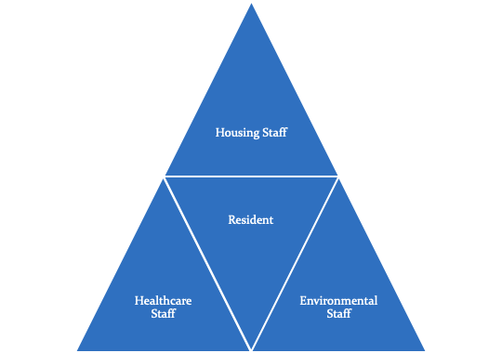
Partnerships
Environmental Staff
Housing Staff
Health Staff

Slide 26
From the GAP Guidebook Appendix II
Notes:
Here is that diagram from the GAP guidance that illustrates the steps a Tribe can take to identify and prioritize by doing a baseline needs assessment. This is Appendix 2 from the GAP Guidance. You can use this as you plan and prioritize, or you welcome to develop your own approach.

Slide 27
Possible Priority - COVID
Preparation for Re-Opening
CDC acknowledges COVID aerosol
Ventilation and filtration

Slide 28
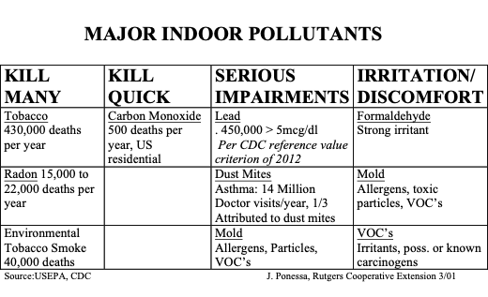
Possible Priorities

Slide 29


Quality Assurance Project Plans
A QAPP describes your plan for collecting and using environmental information and data.
QAPP QAPP

Slide 30
Quality Assurance Project Plan (QAPP)
Check with your project officer - Regional requirements can vary
Look into developing QAPPs, especially if you are going to be doing home assessments.
Plan early and prepare for a QAPP – avoid delays
The process for an IAQ QAPP is different from the traditional “TURBO QAPP” used for ambient air.
QAPPs are needed if you are doing observation and gathering/collecting information

Slide 31
Does My Project Need A QAPP?
In addition to your project officer, the regional Quality Assurance Unit will be a good place to begin, especially if this is a new project, or you are new to environmental project planning.
By law, any EPA-funded monitoring project must have an EPA-approved QAPP before it can begin collecting samples.
The purpose of this requirement is to ensure that the data collected by monitoring projects are of known and suitable quality and quantity.
QAPP CONTACT:
Josie Kamkoff- ITEP Josephine.Kamkoff@nau.edu
QAPP QAPP

Slide 32
Six Elements of Indoor Air Quality QAPP’s for Educational Outreach
1. Title and Approval Sheet
2. Project Description and Task Description
3. Data Quality Objectives and Criteria
4. Sampling Process and Network Design
5. Requirements for Analytical Methods
6. Requirements for Quality Control
QAPP QAPP

Slide 33
Developing a workplan
A few examples

Slide 34
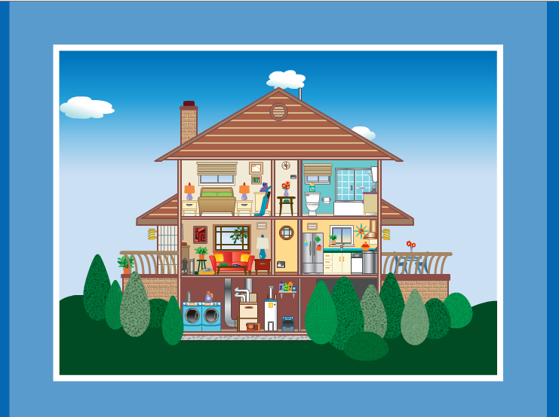
Healthy Homes
Keep It Dry
Keep It Ventilated
Keep It Safe
Keep It Pest-Free
Keep It Thermally Regulated
Keep It Contaminant-Free
Keep It Clean
Keep it Maintained
Notes:
Promoting the concept of healthy homes is another possibility. These are the 8 principles of a healthy home. There are many training opportunities available for training in healthy homes, ITEP does an extensive healthy homes training for Tribes that includes a schools walk through to identify indoor air issues.

Slide 35
Build Capacity on
Healthy Homes
Read: The Healthy Homes Program Guidance Manual
Read: HUD Tribal Healthy Homes Publications
Read: EPA/CPSC: The inside story a guide to indoor air quality – the three basic strategies are source control, ventilation, and air cleaning

Slide 36
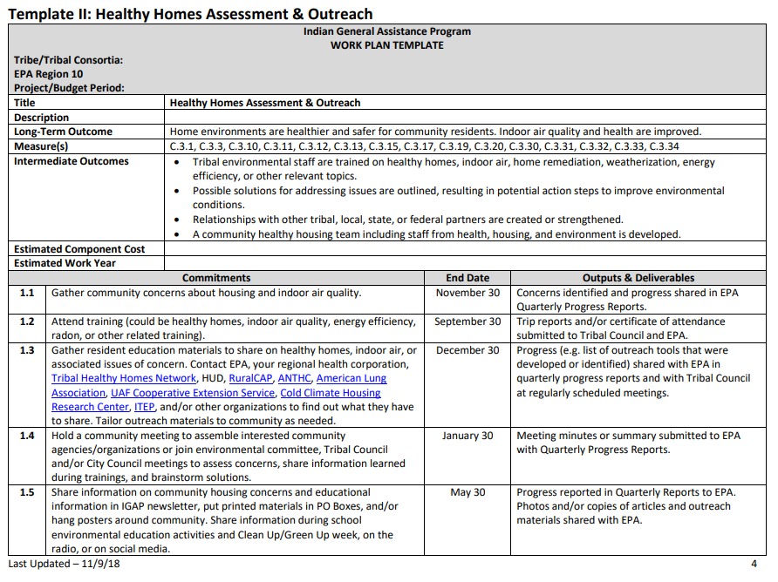
Healthy Homes Sample Workplan – R10
Make sure not to copy and paste, espe-cially since many of these links are specific to Region 10
Notes:
Here is a great sample template from Region 10. There are others templates there as well, on different topics. This shows activities that you can do, and please remember not to copy and paste directly to your workplan. Region 9 does not allow that, so make sure you modify the template so that it makes sense to you and goes along with the priorities specific to your Tribe, or the Tribe your work with. A lot of these links here are specific to Region 10, so they will definitely know if you copy and paste.

Slide 37
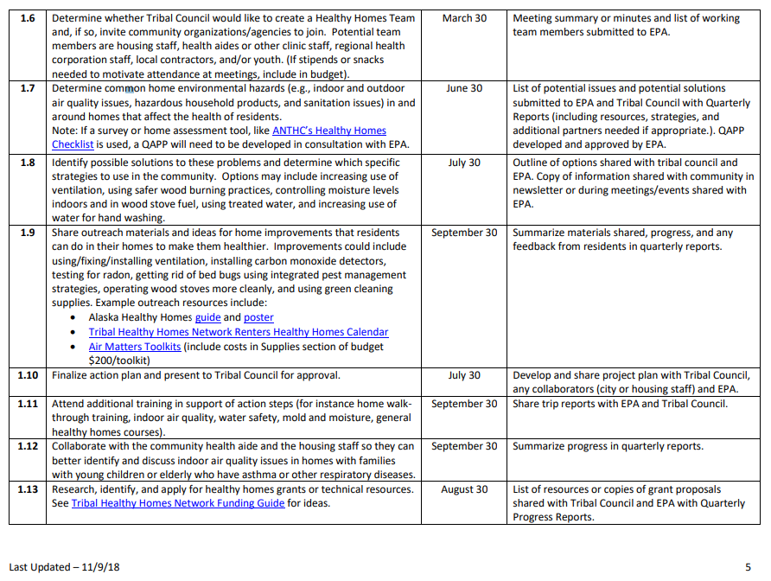
https://www.epa.gov/sites/production/files/2018-11/documents/r10-gap-tools-air-workplan-templates.pdf

Slide 38
Build Capacity on Asthma
Healthy Homes, indoor air and asthma trigger management go hand in hand.
Coordinate with health clinic/hospital staff, schools, rec centers, head start centers, childcare centers, senior centers and talking to the community
Next steps and actions? Use the healthy homes or asthma checklists to plan next steps.
  Referral program or coordination plan/program between the health center/clinic and the environmental program.
  Home visits – to help identify environmental asthma triggers and do personalized education and outreach
  Healthy home assessment, figure out how to mitigate (look into getting medicaid reimbursement)
Notes:
According to the US Department of health and human services Office of Minority health, American Indian/Alaska Native children are 60% more likely to have asthma as non hispanic white children. This is an alarming statistic!
Asthma is a condition that: • is chronic, meaning that it’s an on-going, long-term health condition; • produces recurring episodes of breathing problems called asthma episodes; • is potentially life-threatening; • can occur at any age; • is not contagious, meaning it cannot spread from one person to another; and • cannot be cured, but can be controlled.
As environmental professionals focused on protecting human health it’s important that we focus on indoor air quality because, as we said earlier, we spend 90% of our time indoors, indoor air combined with outdoor air pollution can be 5 and up to 100 times more contaminated than outdoor air. So an important way to protect human health is by addressing poor indoor air quality, especially if you live an poor ambient our outdoor air quality. (PM, smoke, traffic, pollen)
Asthma is critically important because it can be fatal, but it can be controlled by using medication properly and avoiding environmental triggers. Preventing asthma attacks is extremely important Especially for families who have children or adults with asthma, who are showing symptoms of uncontrolled asthma, and especially for those without reliable transportation, or that are living in rural areas that are far from medical facilities, or in places where rushing to the emergency room or calling an ambulance isn’t an option.
So this is where you come in. You can assist community members identify environmental asthma triggers and maybe even partner with local health clinics to help families figure out how to use medications. Please check the GAP guidance and talk to your project officer to discuss how much you can do in this area. Again, as Mansel mentioned this is the type of work that can be so helpful and rewarding. Very different from working to troubleshoot an air monitor or checking results, but equally important. So let’s talk about those environmental asthma triggers.

Slide 39
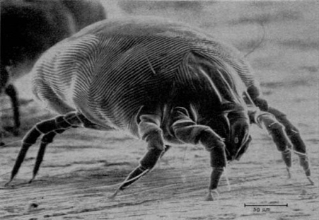
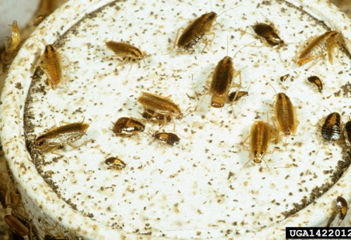
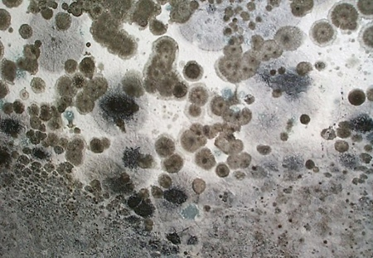
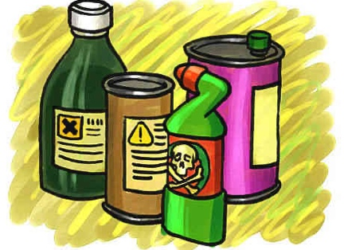





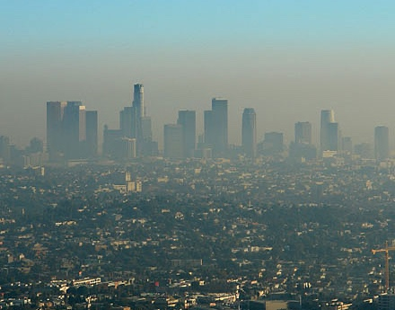

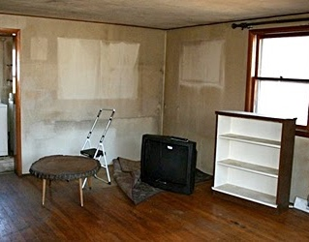
Household Environmental Asthma Triggers
dust mites
roaches and pests
mold/mildew
chemicals/cleansers
pet dander
cold air
scents and odors
pollen
nitrogen dioxide
outdoor pollution
smoke
thirdhand Smoke
Notes:
Everyone’s asthma is different, they react differently to triggers. There are also emotional triggers, crying, laughing, a scare—I’m not sure we’d classify this as an environmental asthma trigger, but definitely important information to share with folks trying to avoid asthma attacks. So your focus would be on environmental asthma triggers. I’ll go through each of them quickly:
-Dust mites – they are microscopic and form everywhere, and if they are a trigger, cleaning up dust with a wet rag, washing stuffed animals and bedding, using a vacuum with a HEPA filter
-Roaches – the droppings and body parts can trigger asthma. Urine from mice and dander can also be a trigger for some, healthy homes, keeping food put away, cleaning up crumbs, fixing leaky faucets (water source) will prevent pests from making themselves at home in your home
-Mold is probably one of the most well known of the triggers – can be held at bay by using bathroom fans, keeping your home dry and well ventilated, fixing leaks immediately
-Chemicals and cleansers, chemicals, strong odors, this is why using low odor products and recommend healthy cleaning which we will talk about in a bit—extremely important information to share now, with COVID, people are cleaning and disinfecting more than usual.
-Pet dander – our furry and feathered friends, if you have pets it is very important that you limit the time they spend where an asthmatic sleeps or spends a lot of time.
-Cold air – sensitive airways, hyper sensitive airways can constrict with cold air- keeping your house thermically controlled
--Scents and odors – another well known asthma trigger that can be easily controlled by not using scented products
--Pollen -
--Combustion by-products - Burning things release chemicals into the environment, stoves and cooktops, wood burning stoves, release particulate as well and contribute to pollution indoors. If your Tribe uses wood burning stoves, doing education and outreach is important. If you like to cook like I do, ventilation is the key here, using your hood vents is very important.
--Outdoor air pollution again, coming inside the home
Cigarette smoke – another well known trigger. Folks living in multi-unit housing are exposed to smoke – this could also be an aerosols from e-cigarettes, and

Slide 40
Asthma Resources
Visit the Indoor Air Quality Tools for Tribal Communities and review the Asthma Basics presentation for Tribal Environmental Professionals
Listen to this ITEP recommended pre-recorded webinar on asthma
American Lung Association has great training information and links to resources. Start with the Asthma Basics page
Effects of Wildfire Smoke and Asthma and other Webinars and information from Regional Asthma Management and Prevention (RAMP)
Familiarize yourself with the Asthma Checklist
Visit the CDC’s asthma page
Notes:
Here are some resources to get you started

Slide 41
Wood Stoves
Notes:
Here are some resources to get you started

Slide 42
Wood Stoves Resources
http://www7.nau.edu/itep/main/Training/Webinars_air2020
Notes:
Here are some resources to get you started

Slide 43
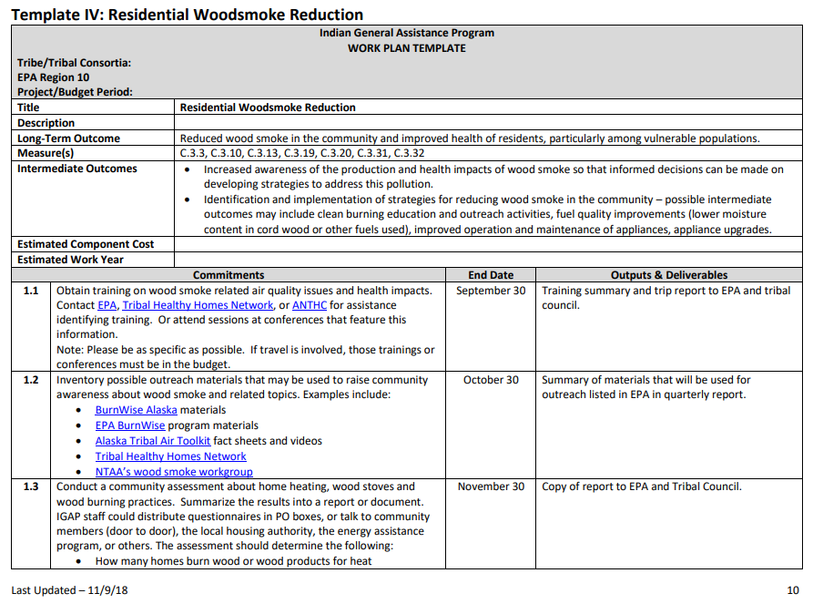
Residential Woodsmoke
Sample Workplan – R10
Make sure not to copy and paste, espe-cially since many of these links are specific to Region 10

Slide 44
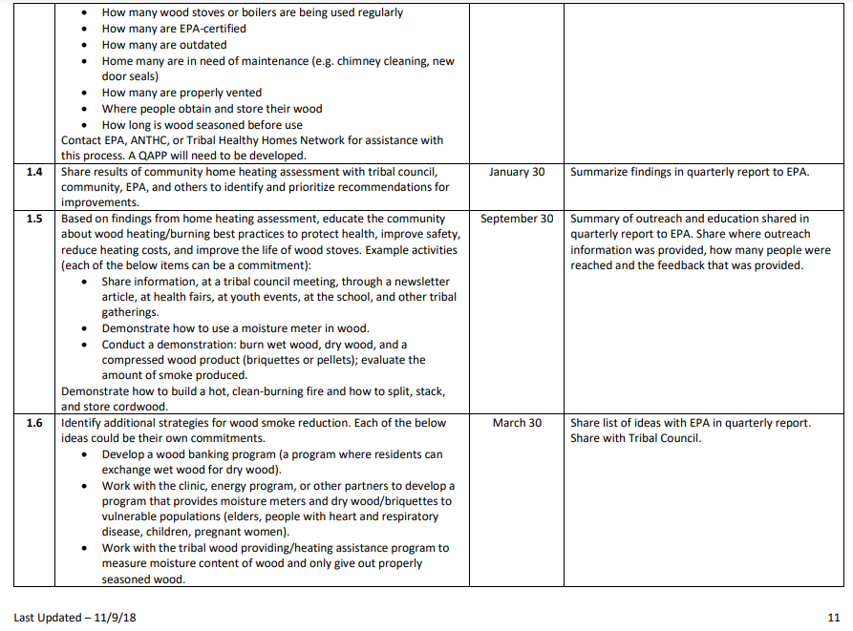
https://www.epa.gov/sites/production/files/2018-11/documents/r10-gap-tools-air-workplan-templates.pdf

Slide 45
Add a slide on IPM basics
RMSF –
Link to solid wate

Slide 46
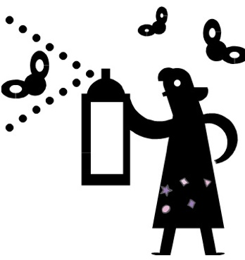
Integrated Pest Management
Who is in charge of pest management for the Tribe?
Research which pests are a problem in your community
Are residents using insecticides?
Research what can be done first, before resorting to pesticides.
Notes:
Integrated Pest Managements outreach to helping the community understand what to do before you reach for chemicals or pesticides…

Slide 47
Build Capacity on IPM
EPA resources: Introduction to Integrated Pest Management – an environmentally friendly, common sense approach to controlling pests.
Stop Pests – provides training for Tribal housing staff (tribal environmental staff can also attend): http://www.stoppests.org/
Reach out to those who understand pests in your area, Universities have local extension programs
National Pesticide Information Center: www.npic.orst.edu/ or 1-800-858-7378

Slide 48
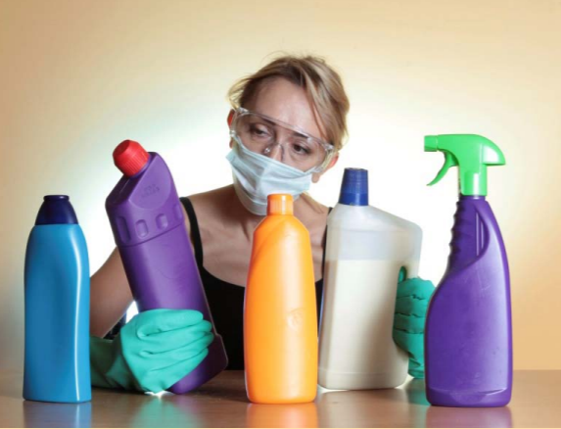
Healthy Cleaning
Cleaning that protects public health, without harming the health of staff, building occupants, and the environment
Prevent exposure to chemicals that either cause or are associated with:
Hormone disruption
Cancer
Headaches
Asthma attacks
Damage to lungs and brain
Unknown health effects
https://www.epa.gov/schools/green-cleaning-sanitizing-and-disinfecting-toolkit-early-care-and-education
Notes:
And of course, green cleaning, which focuses on eliminating the use of harmful chemicals.

Slide 49
Healthy Cleaning - COVID
Avoid toxic cleaners – not needed.
Empty Buildings >7 days – routine cleaning
CDC Surface transfer is lower risk
Soap and water will reduce hazards
Disinfection - List N / asthma friendly
  https://static.ewg.org/pdf/EWG_Tipsheet_COVID-CleaningProducts_PP01.pdf
Cleaning in schools
  https://acis.cals.arizona.edu/docs/default-source/community-ipm-documents/newsletters/april2021azschoolandhomeipmnewletter.pdf
Notes:
And of course, green cleaning, which focuses on eliminating the use of harmful chemicals.

Slide 50
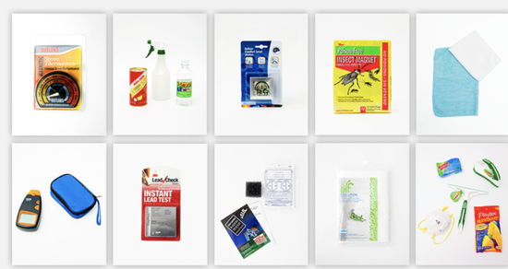
Air Matters Toolkit
Healthy Home Toolkit and Cue Cards
Education Tool for health fairs and one-on-one visits
Tools for change
Not an endorsement or recommendation – Examples
These items can be tailored to your community and region

Slide 51
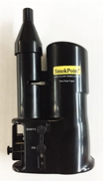




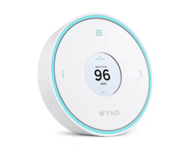
Basic IAQ Instruments
Smoke Puffer
Relative Humidity Meter
Carbon-monoxide Meter
Particulate Matter (PM) Meter
Combination Meter
More as needed
Not an endorsement or recommendation - Examples
Notes:
Part of needs assessment to determine what the focus is – purchase of instruments depends on needs sometimes
CO2 – ventilation
Decide why you need it first before you purchase instruments – some Regions require more planning before purchasing instruments

Slide 52
Summary
  Learn, investigate, train – it’s about building your knowledge base
  Identify needed skills, especially in the age of COVID
  Identify environmental health/indoor air priorities by meeting with the community
  Reach out to other Tribes and learn from them
  Call EPA, ITEP, NTAA and others for technical support and training needs
  Look into workgroups and consortia doing similar work
  Collaborate with local health department, IHS, HUD, Head Start, senior centers, and after school programs
  What tools do you need? Webinar platform, listserv, moisture meters?
Notes:
We hope this has been helpful– in summary it’s all about learning and building your capacity:
Expand your knowledge base is number one. Learn the issues so you can identify priorities as you plan your program.
Identify needed skills and training that you want to acquire to help you do a better job
Reach out to Tribal Councilmembers and other representatives- you always learn from speaking to others
Reach out to other Tribes doing similar work – if you don’t know who they are, ask me or your project officer and we can find out and get you contacts.
Again, call us at EPA if you need more information, you can also reach out to ITEP for training and technical assistance, and the National Tribal Air Association (NTAA) has an indoor air and woodsmoke workgroup that would really benefit from your participation, google them and check out their website. NAEPC, the Native Environmental Protection Coalition is a Consortia of Tribes and has training every year and asks for input on the type of training that is needed.
Collaborate and coordinate with others working in your Tribal community, local health centers, IHS, HUD, Head Start centers, senior centers and after school youth programs.
Also, identify what tools you need to do your work—a webinar platform in the age of COVID for example, or perhaps actual tools like Carbon Dioxide and Moisture meters which Mansel will talk about in his presentation.

Slide 53
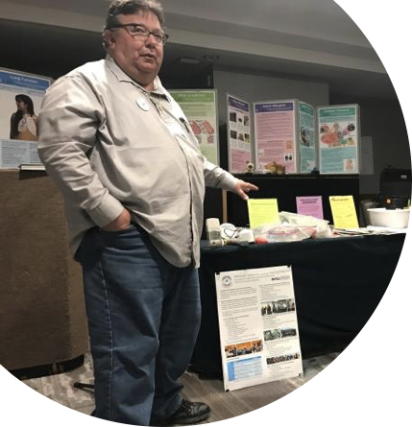

Contact information
Mansel A. Nelson
Program Manager
Institute for Tribal Environmental Professionals
Indoor Air Quality in Tribal Communities
mansel.nelson@nau.edu
928-523-1275
Alhelí Baños-Keener
Indoor environments and asthma coordinator
U.S. EPA Region 9
Banos.Alheli@epa.gov
619-235-4767

Slide 54
Tribal IAQ training and resource directory
Danni shannon: shannon.Danielle@epa.gov

Slide 55
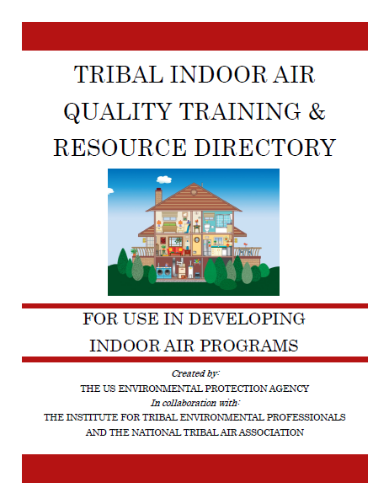
What is it?
A directory to connect tribal governments to resources that aid in the creation or expansion of IAQ programs

Slide 56
Topics Covered:
Asthma
Mold
Radon
Commercial Tobacco and Secondhand Smoke
Healthy Homes, Schools, and Buildings
Residential Wood Smoke and Other Combustion Hazards
Disaster Preparedness, Response, and Recovery
COVID-19 and Other Pathogens
Grants
Helpful IAQ Contacts

Slide 57
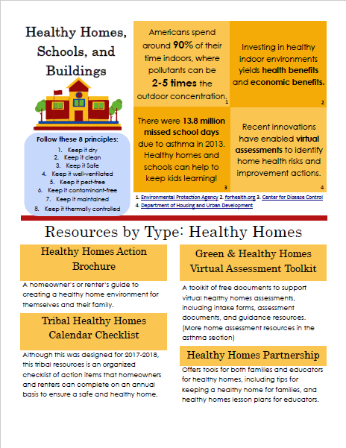
What are these resources?
High-quality sources of information
Distributable materials for various audiences
Examples of tribal policy
Toolkits and guides for various projects
Training webinars and materials
Protocols and assessment sheets
Program implementation examples
*When possible, the resources are specifically written for tribal audiences*

Slide 58
GET INVOLVED:
Would you like to help with this project?
Review or “test drive” the directory
To get involved, email:
shannon.danielle@epa.gov

