Slide 1

A Community Solar Project benefiting the
Wind River Reservation

Slide 2


Funding
EWR is funded by a Department of Interior Tribal Electrification Program grant. Our team’s pay, benefits, training, tools, equipment & vehicle funding has been secured and will be available for five years.
The current administration’s DOI team has our awarded but undisbursed construction funding “on hold pending review”.
We are actively identifying and applying for additional federal grants and in partnership with the Jackson Hole Center for Global Affairs exploring non-governmental funding to cover our solar systems & construction costs.
Contact Sophie Rockefeller - sophie.rockefeller@jhcga.org
www.jhcga.org

Slide 3

Fundraising
The Nature Conservancy has generously pledged $20,000 in support of the Energize Wind River solar project.
This funding will be used to hire a non-governmental fundraising specialist to coordinate with JHCGA and other allies to kick-start our pursuit of philanthropic support.
Monika Leininger – Director of External Affairs, Wyoming
Email: monika.leininger@tnc.org
Website: https://www.nature.org/en-us/

Slide 4



Invest Native Initiative
The Wells Fargo Foundation & Enterprise Community Partners have been flexible and responsive in offering assistance as our project has evolved.
They will be funding a Community Needs Assessment (CNA) which can be used to support future efforts to improve energy efficiency and sustainable electricity generation for the Wind River Reservation.
Invest Native video
We have partnered with the Building Performance Association, a national non-profit experienced in conducting CNA’s and building successful Weatherization programs from the ground up, for this purpose.
building-performance.org

Slide 5
Rural & Remote Challenges
The primary challenge we identified is child care. This isn’t unique to the Wind River Reservation by any means but the rural & remote nature of the community means potential solutions currently available are limited.
Reliable transportation from home to work and back again was quickly identified as the second most common hurdle, a problem made more acute by the regional winter climate.
We did advocate for direct solutions to both of these hurdles but ultimately were not allowed to use grant funds to directly address them.
Limited experience with solar in the community at large including our potential workforce as well as limited technology resources readily available were challenges we identified that our grant funding was able to directly address.

Slide 6
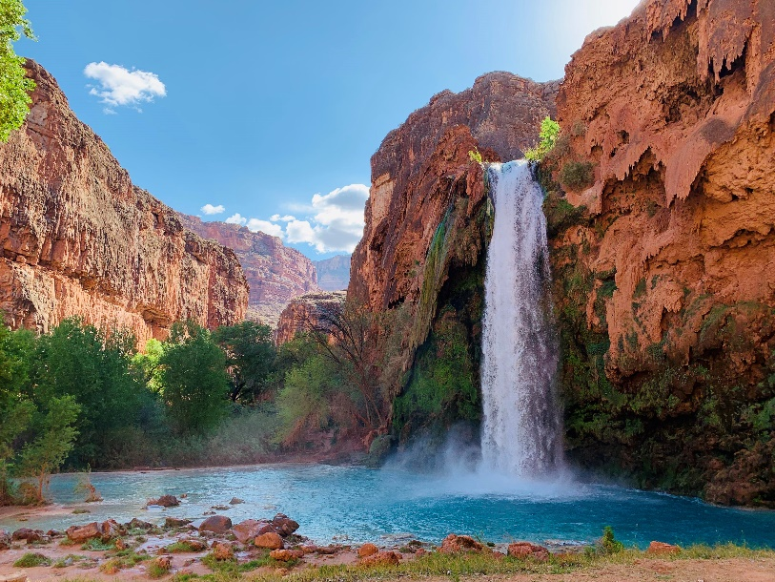
Rural & Remote Solutions
After a great deal of pondering based on feedback from community members, particularly current tribal employees, we concluded the following.
Emphasize Flexibility in all things. Be like water, use the path of least resistance and embrace change and transformation relentlessly.
Remote/Hybrid work options are a vital component to overcoming child care & transportation concerns. This solution also applies to field employees as we will be monitoring the PV systems we install actively and offer online training.
Networking & Outreach activities were assigned broad definitions in our Scope of Work. Our team members frequently attend tribal events representing our project but also learning about community needs/concerns. This raises awareness about our project while simultaneously demonstrating our commitment to local employment within the community.

Slide 7
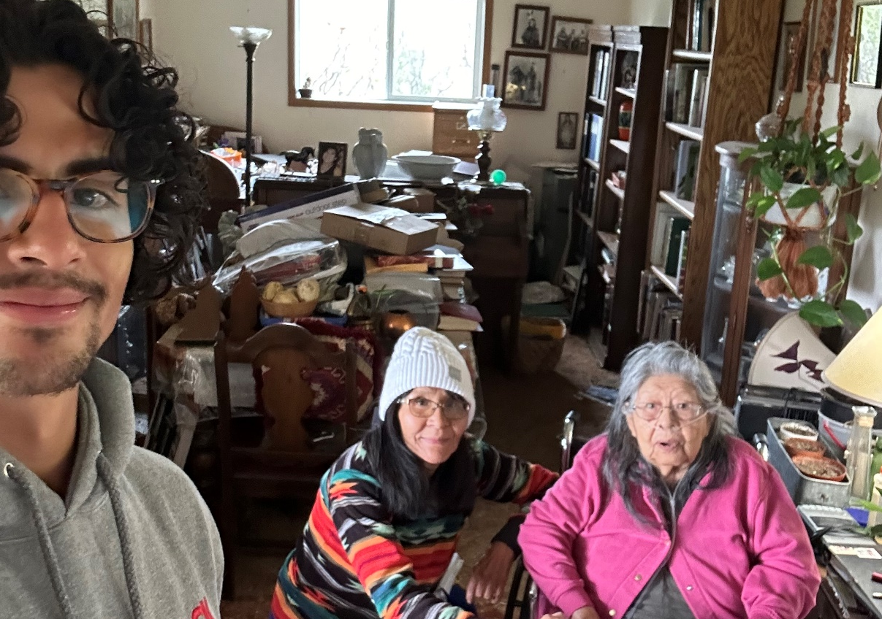

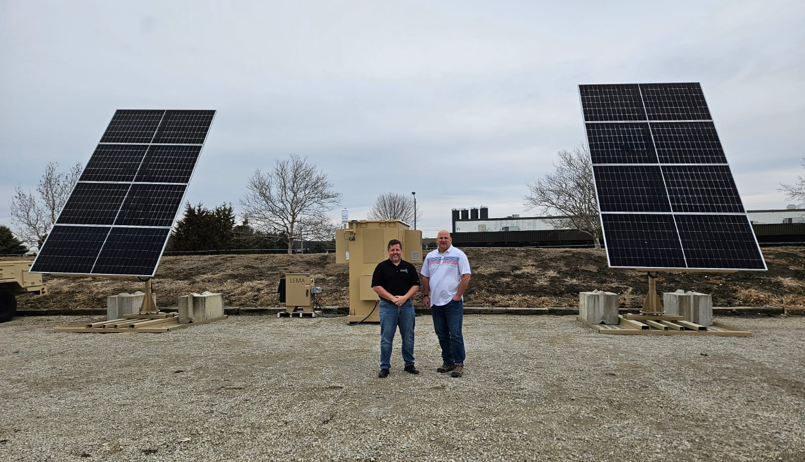
Indigenous
LEMA EWR video
American manufactured technology company.
Generously providing advice, support and technical knowledge.
Contact Info: Ezra Wells
Email: ezra.wells@lema.io
Website: www.lema.io/solutions

Slide 8

“Capacity Building”
Many programs start from a place where the traditional/business definition of capacity is a goal for down the road, identifying sustainable building blocks and foundations is truly where a project’s focus should revolve.
Our initial planning phase emphasized team building & training. However, after the recent election our administrative team decided to rapidly pivot prioritizing efforts to secure implementation funding in every conceivable fashion. Our team responded beautifully despite the increased pressure & uncertainty.
Still being addressed:
Fundraising efforts & grant applications are sadly often seen as a zero-sum game often creating an adversarial relationship between tribal organizations that could be ideal partners. Our team is striving to bridge this gap.

Slide 9
638 Contract, Looking Ahead
At the end of our 5 year grant funding, we are obligated to become a completely self-sustaining entity. While exciting this fact requires significant planning and careful consideration from multiple perspectives.
If we become a business, it is likely our field staff would need to be willing to spend extended time away from home/family. This would reduce two advantages our employees LOVE about working in their own community.
If we become a non-profit, we are likely going to be largely reliant on federal funding which can… fluctuate.

Slide 10
DOI, EPA, USDA no longer just DOE
The Biden administrations approach to IRA funding in particular created many opportunities for agencies to develop revolutionary solutions.
By empowering a wide variety of agencies nonprofits, states and tribes were given a wide range of grants to pursue with goals and objectives previously relegated to the realm of theory.
One example was the freedom to break the longstanding law of the land, “Savings to Investment Ratio” for the purpose of electrification.
A drawback to this approach was simply that it proved to be an overload.

Slide 11
Free online resources we use
Solar Resources
https://www.solarenergy.org/free-learning/
https://julius.live/mnenergy/
https://seia.org/initiatives/workforce-development/
Energy Efficiency & Electrification
https://building-performance.org/
https://www.usgbc.org/courses-and-events
https://www.energy.gov/scep/wap/weatherization-installer-job-aids-and-interactive-3d-houses
https://irecusa.org/career-maps/

Slide 12
Request for Proposals
We released four RFPs, one example of the invaluable support provided by the NAU technical assistance team, to ensure we received the specialized trainings needed to safely accomplish our objectives.
Deployment, Safety & Electrical Training
Meter & Monitor
Market Survey & Outreach
Concept Development, Design & Impact Studies
We received multiple proposals for each RFP and scored the following organizations responses as excellent.
LEMA, Creative Energies, Remote Energy

Slide 13
Thanks for your hard work!
Sean Henderson: DOI Tribal Electrification Program Manager
Congresswoman Betty McCollum: Representing the 4th District of Minnesota
Wyoming’s Governor, Mark Gordon
David Hess: Master Electrician & Owner of Boyle Electric
Bonneville Environmental Foundation
Northern Arizona University: Institute for Tribal Environmental Professionals
Simon Evans: Engineer, Heartland Consulting
Wyoming Outdoor Council

Slide 14
Thank you Tribal Leadership & Organizations!
Eastern Shoshone Business Council - easternshoshone.org/business-council
Tribal Employment Rights Office - www.windriver-tero.com
Wind River Development Fund - wrdf.org
Wind River Environmental Quality Commission - yufna@writc.org
Wind River Energy Commission - admin@wrencom.org

Slide 15
