Slide 1






Building Energy Resilient Tribal Communities Through Workforce Development

Slide 2



Who We Are
Angelica Wright
Choctaw Nation of Oklahoma
Director of Tribal Education and Workforce Development
Danita Ordaz
Jicarilla Apache
Tribal Workforce Specialist

Slide 3


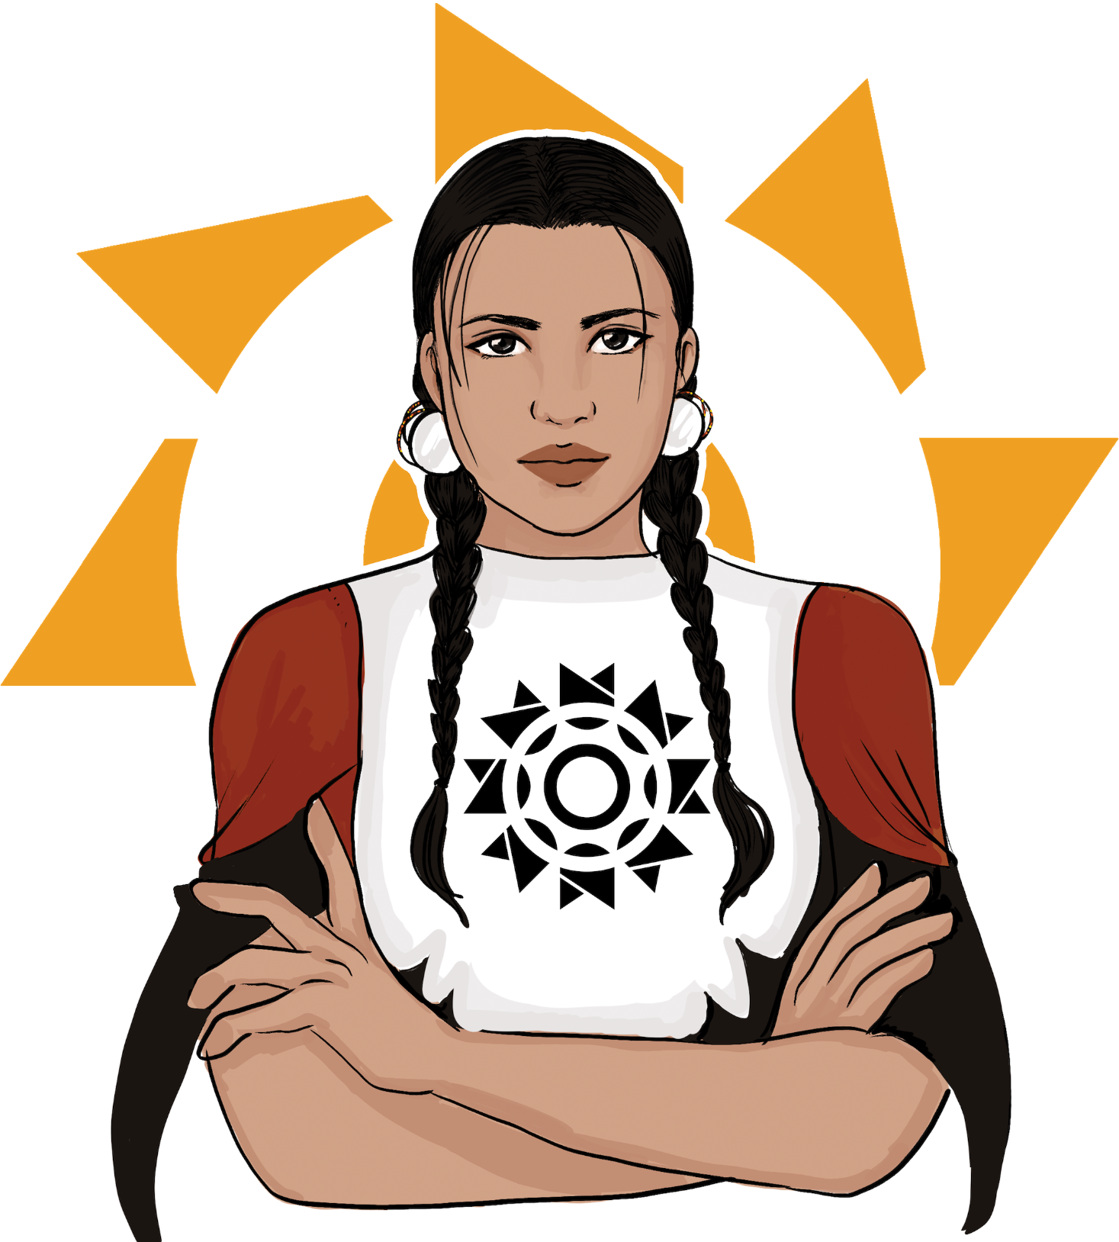
GRID Alternatives National Tribal Program
GRID Alternatives established the National Tribal Program in 2010 to partner with Tribal communities to provide and support the needs and readiness of individual tribal communities, while establishing a pathway for under-resourced tribal communities to develop critical energy infrastructure in a timely manner.
The Tribal Solar Accelerator Fund supports tribes in asserting control over their energy resources and focuses on making project implementation feasible by leveraging state and federal programs, philanthropic dollars, and partnerships with other tribes across Indian Country.
In April 2025 GRID’s National Tribal Program is expanding into Tribal Energy Alternatives as its own an affiliate office and Native led nonprofit organization.

Slide 4


National Tribal Program
Focus Areas
Partnership Development
Engagement with tribal community and leaders from a place-based approach that honors sovereignty.
Workforce Development/Education
Recruit Native learners from the tribes we work with to gain skills and industry experience in the renewable energy projects taking place in their own community and collaborate to create educational pathways and experiential learning opportunities
Solar Installation
Manage and implement projects that break away for the reliance on outside contractors for installation, and training
Notes:
Tanksi

Slide 5
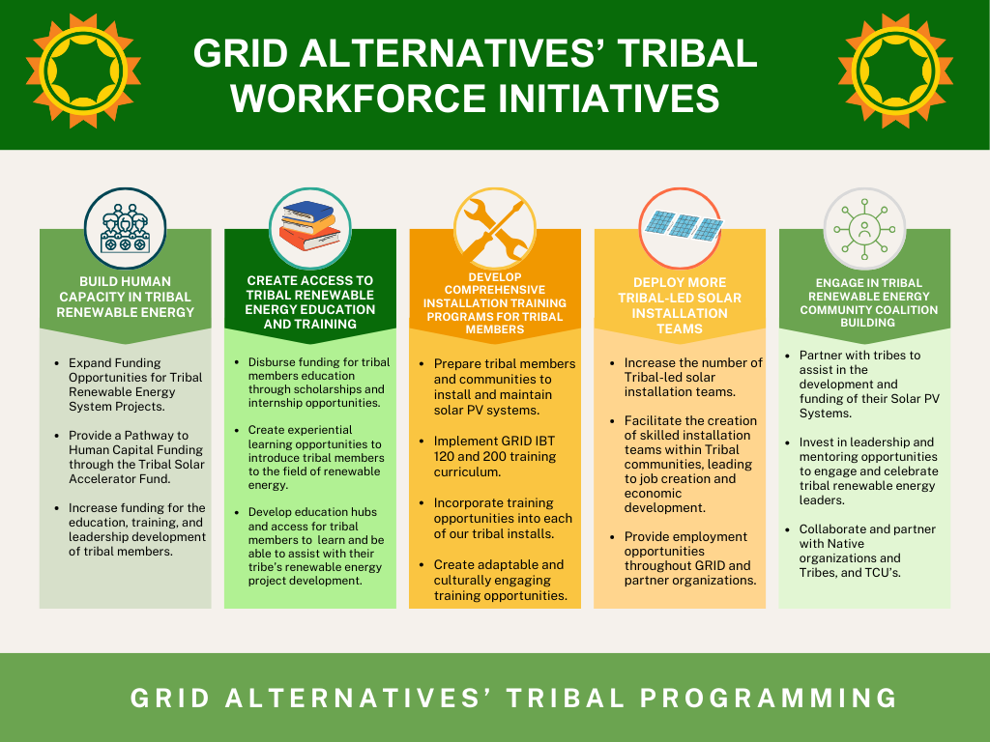

Slide 6
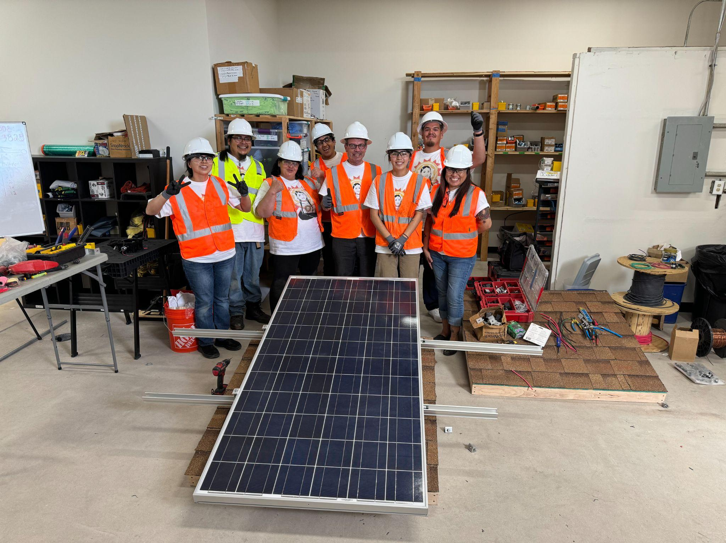
Education and Workforce Development Offerings
Installation Basic Training
Online Trainings
Tribal Energy Associates Program
Scholarships
Internships
Tribal Energy Innovator Fellowship
Career and Professional Development
TCU Renewable Energy Consortium
Tribal RE+ Workforce Consulting
Notes:
Overview of what the program is.
Go over IBT 120 and 200
Construction trainings and IBT 120
The overall impact and importance of the curriculum
The value of teaching
2-5 Minutes
Angel:

Slide 7
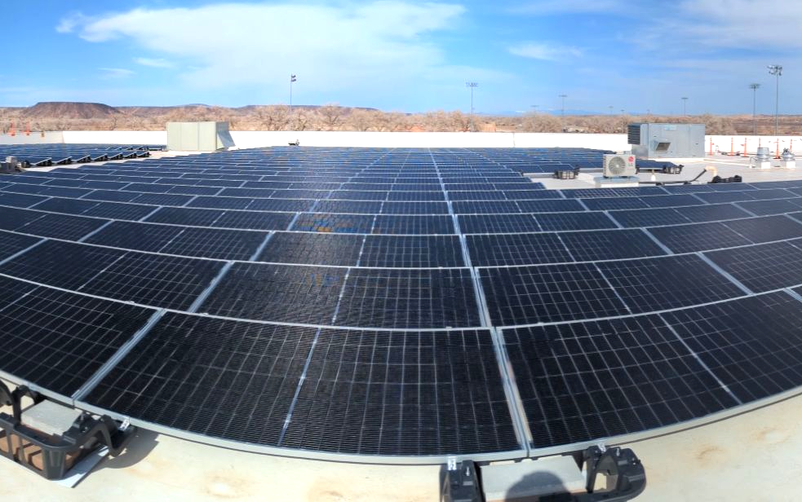
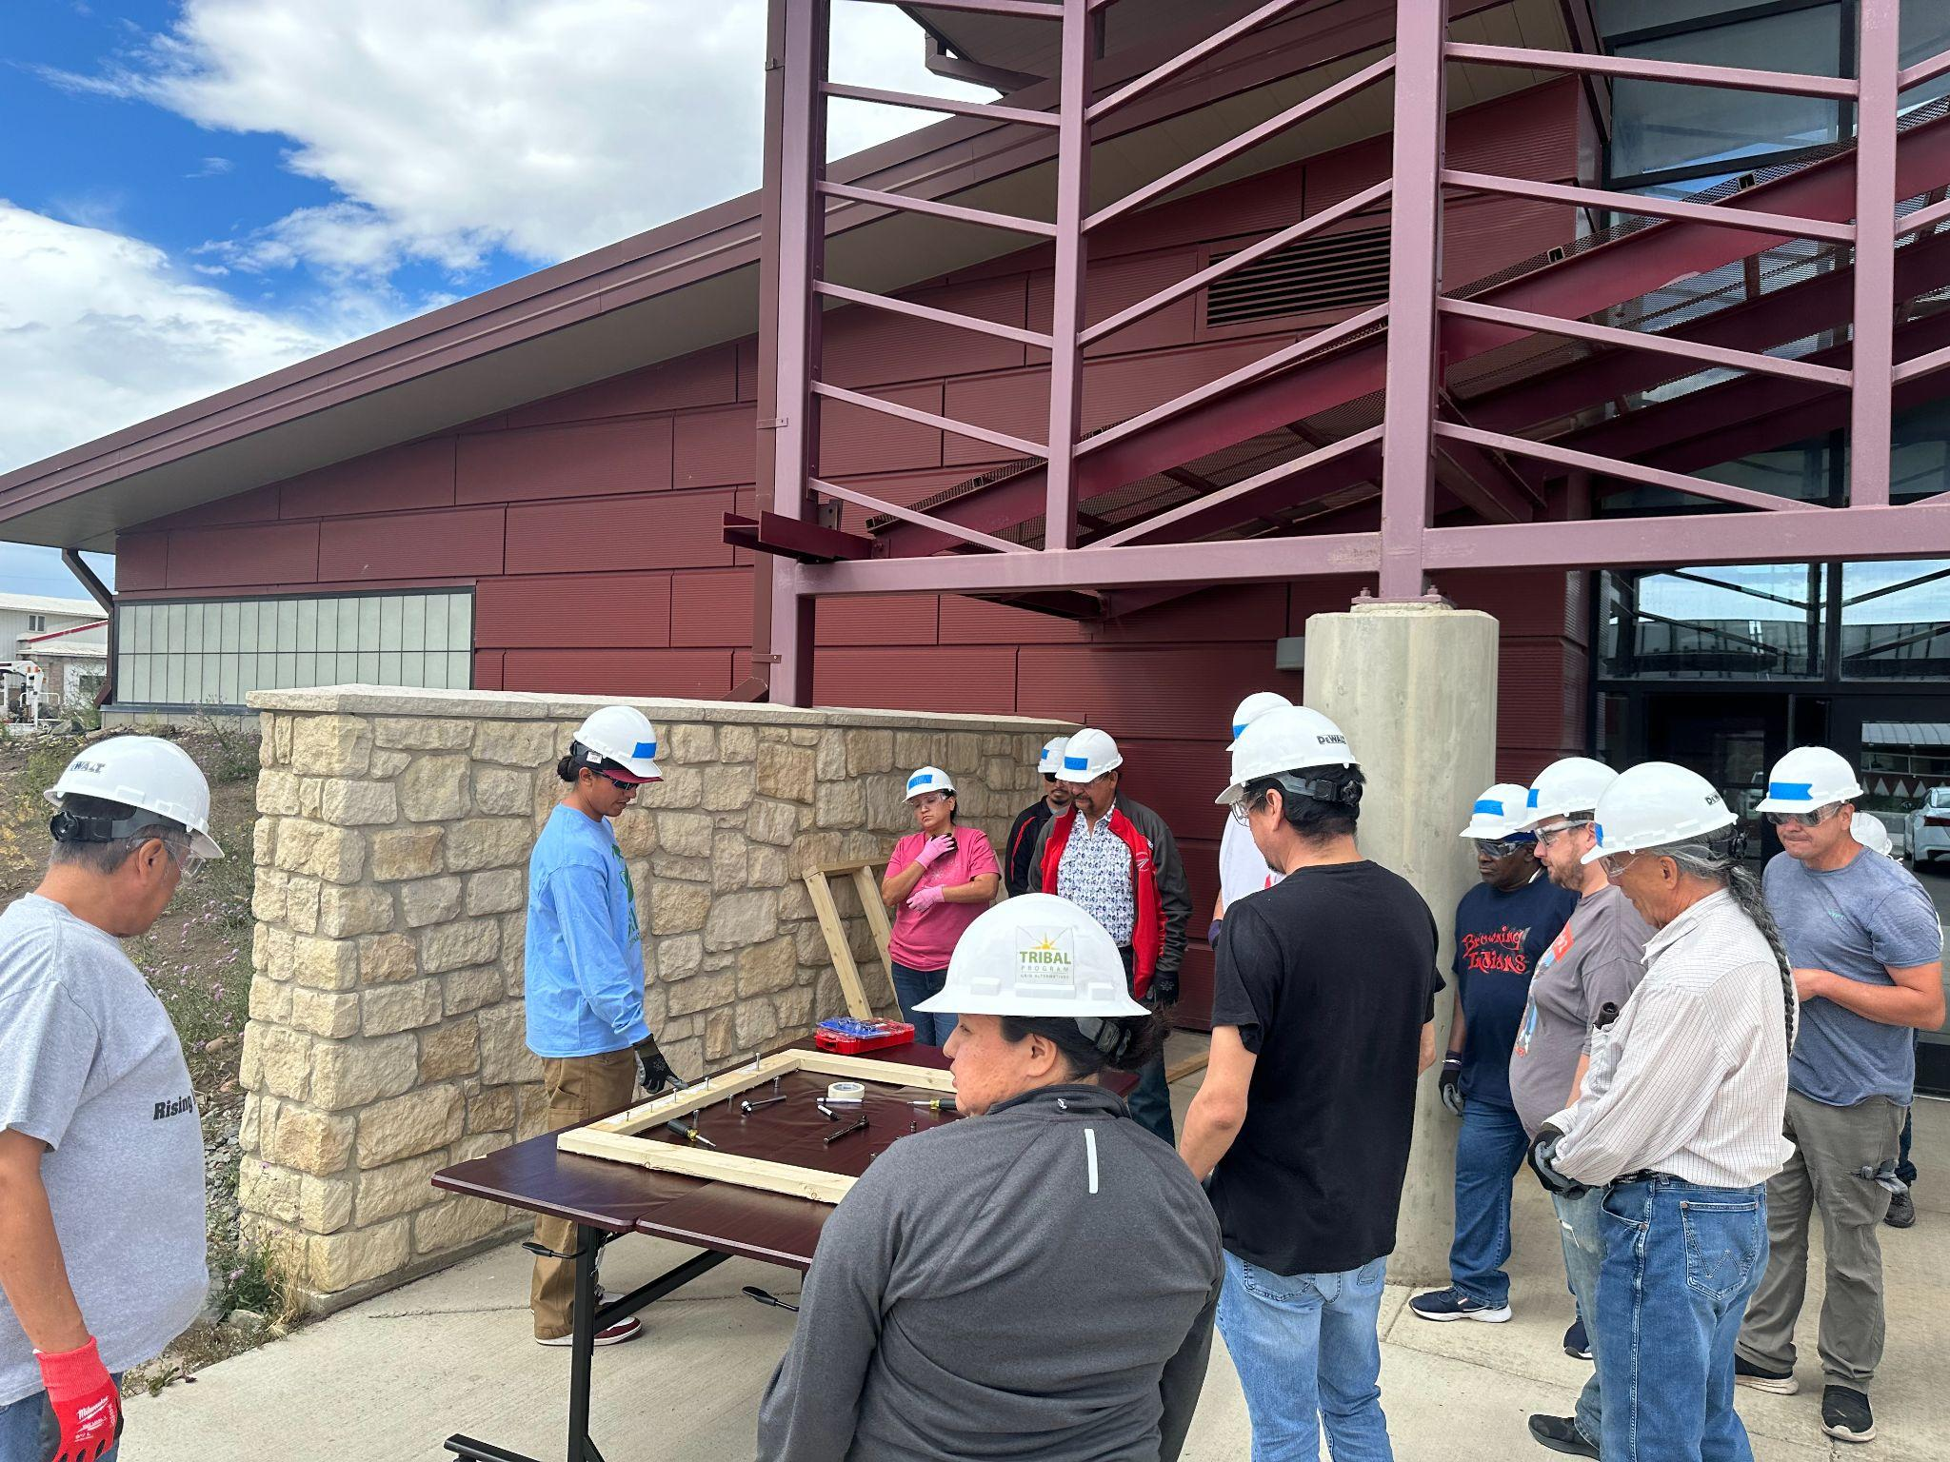
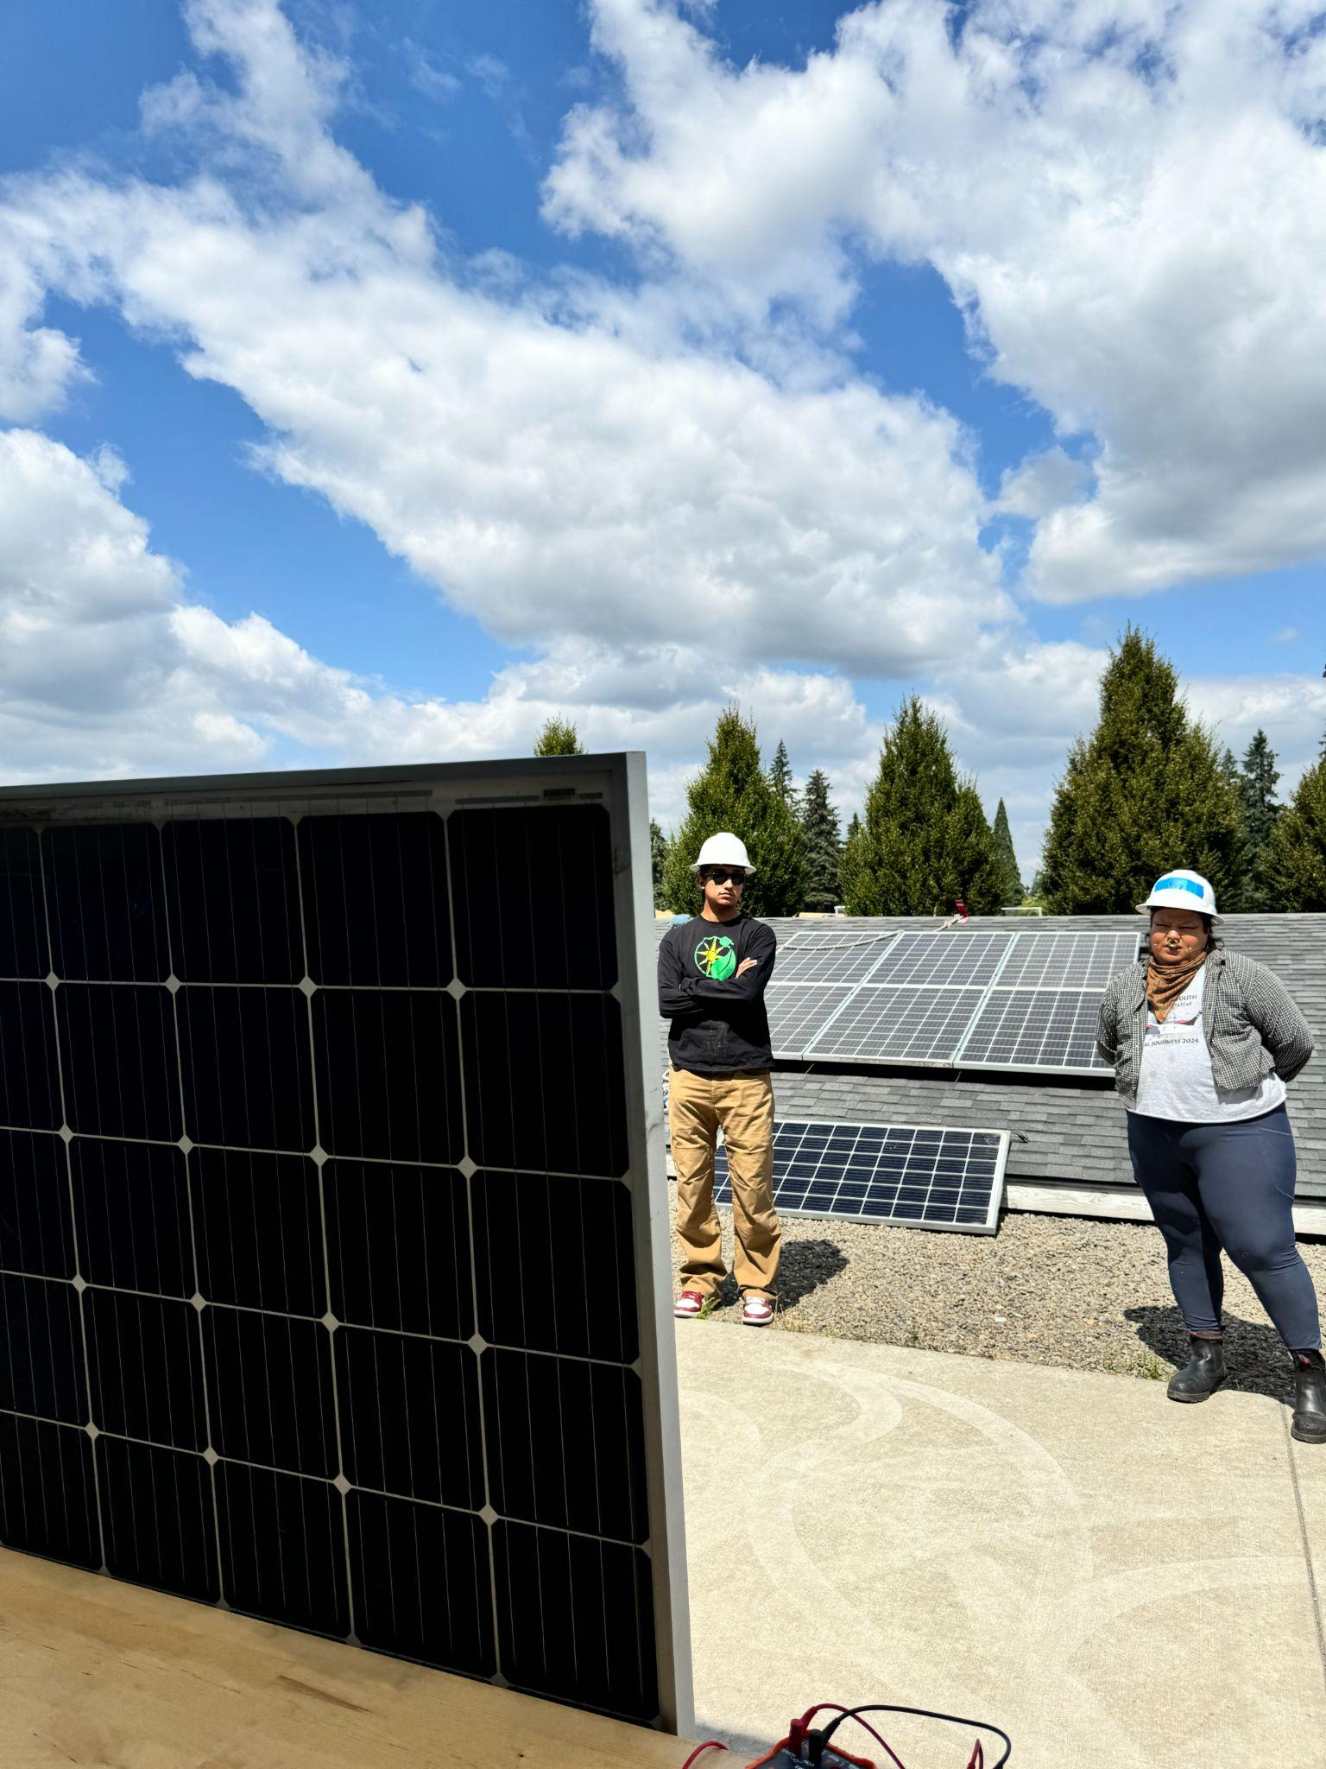
Planning Trainings Based off of Project Size and Community Needs
Pueblo of Santa Ana
Blackfeet Community College
Northwest Native Chambers and Portland Clean Energy Fund
Notes:
Elias:
Project overview
Per project Santa Ana trainee we had 6 and 2 became full time employees at GRID
Our TCU’s
PCEF
Testimonial story of working with a student
Recruitment: There is no one to do this work, but that not necessarily

Slide 8
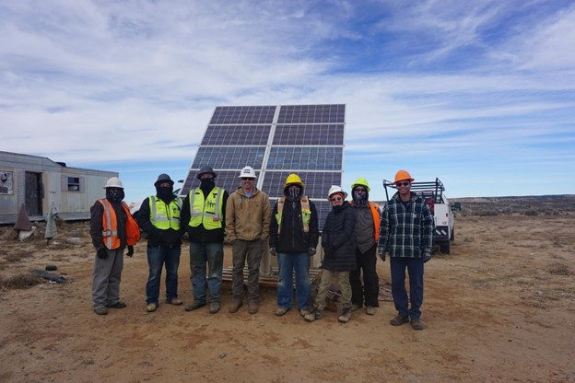



Workforce Development and Education as a Catalyst for Tribal Empowerment
What jobs do you think of when you think of renewable energy?
Meaningful jobs for Indian Country
Holistic workforce development creates an ecosystem
Investment in renewable energy results in direct benefit
Notes:
Placed based projects that include indigenous knowledge in development and design
Workforce/Education has to take a holistic approach to Nation building and enhancing sovereignty
Building capacity within community for jobs - When thinking about solar energy jobs which jobs come to mind? (Ask Audience?)
In order to create that just transition we are talking about we need folks in business, grant writing/ development/philanthropy, tribal administration, policy, or outreach/engagement/comms, along side of some of the more technical jobs that people mentioned. Even on the technical side we also need folks to be engaged with sourcing, sustainability or recycling.
When you ask a young child “What do you want to do when you grow up?” we want them to have working in the renewable energy field be an option
Must approach each Tribal nation with collaboration and flexibility to account for barriers to ensure success. Must collaborate within community to even be aware of what this looks like for each community
unique barriers
tribal policy
NCAI Tribal Workforce Toolkit

Slide 9
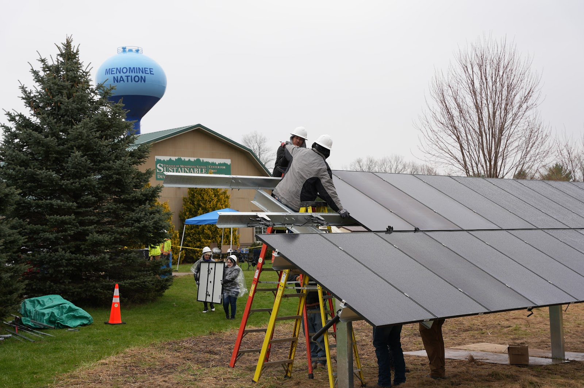
Importance of Partnering within Community
Building Capacity: Nation building is a large part of our framework
Engaging Tribal Members and Agencies: Working with Tribal organizations such as housing authorities, TERO/HR departments, or educational institutions.
Job Placement and Continuity of work: relationship building within community creates pathways for continued education or pathways.
Notes:
Focus on transferable skill sets and creating experiential learning opportunities
Collaborating with TCU’s, or engaging with community partners for job placement

Slide 10

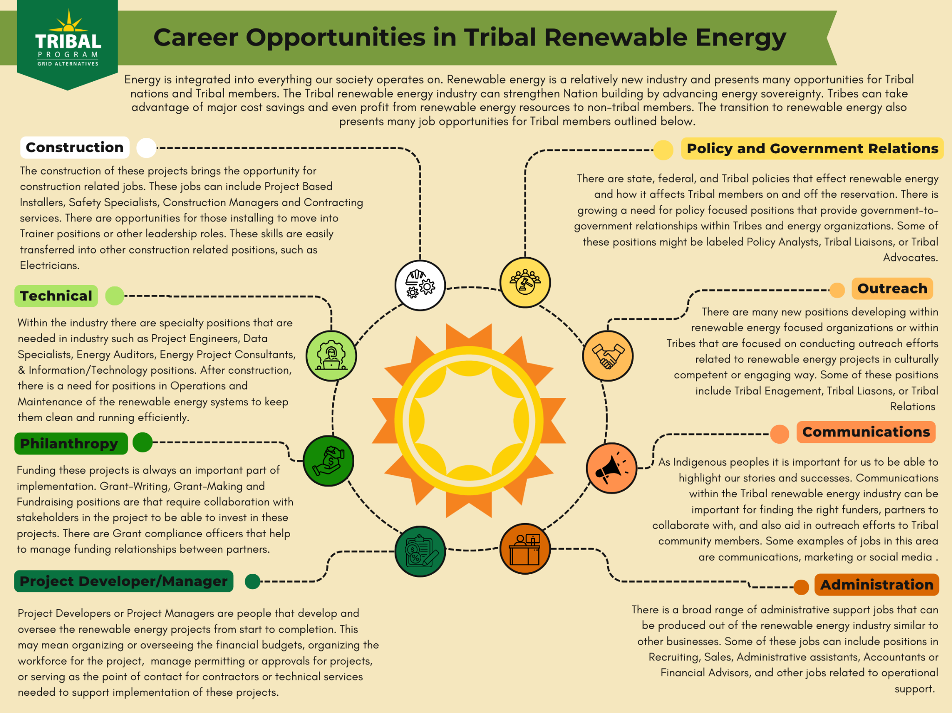
Career and Educational Pathways in Renewable Energy
Notes:
Potential careers in Tribal Renewable Energy

Slide 11
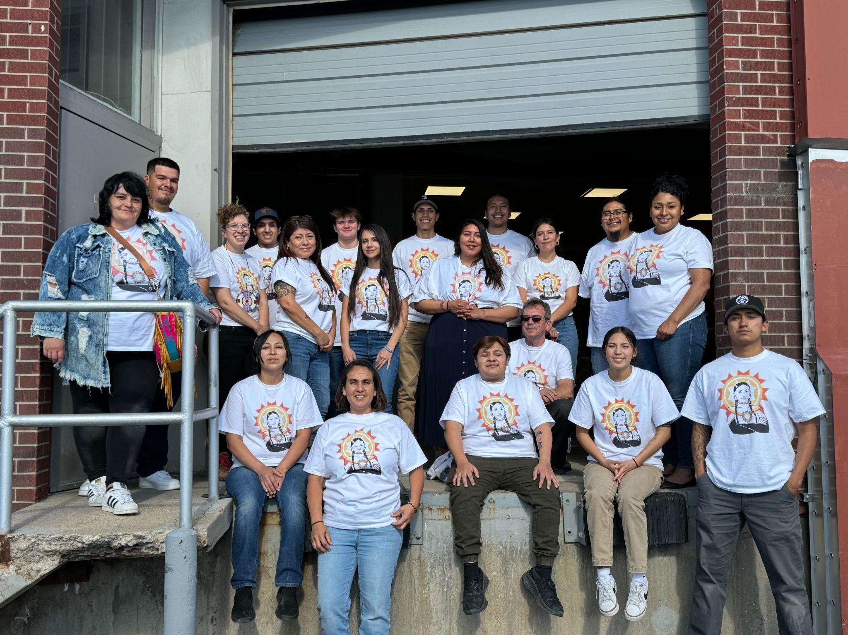
Upcoming Opportunities For Tribal Members
Tribal Energy Associates Program: 6 week paid online learning opportunity with optional in person invitation to our annual grantee convening.
App Open April 1 ($5000)
Tribal Training Scholarship
Training Scholarship available for tribal members in shorter term training i.e. apprenticeships, 4 week solar installation trainings.
App is Rolling (Up to $1500)
College Scholarships and Internships
Apps Closing August 15

Slide 12


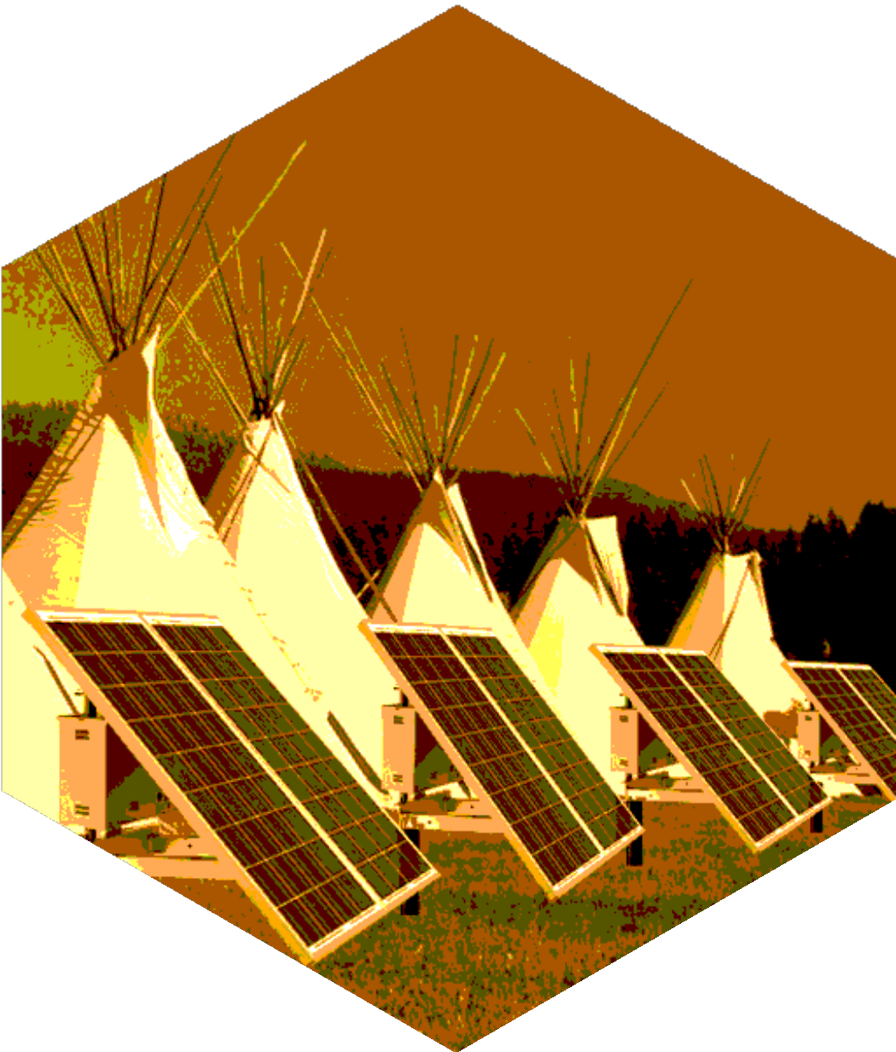






Questions?
Angelica Wright
awright@gridalternatives.org
Danita Ordaz
dordaz@gridalternatives.org
+123-456-7890
@tribalsolar
programs@gridalternatives.org

