Slide 1


Indigenous

Slide 2

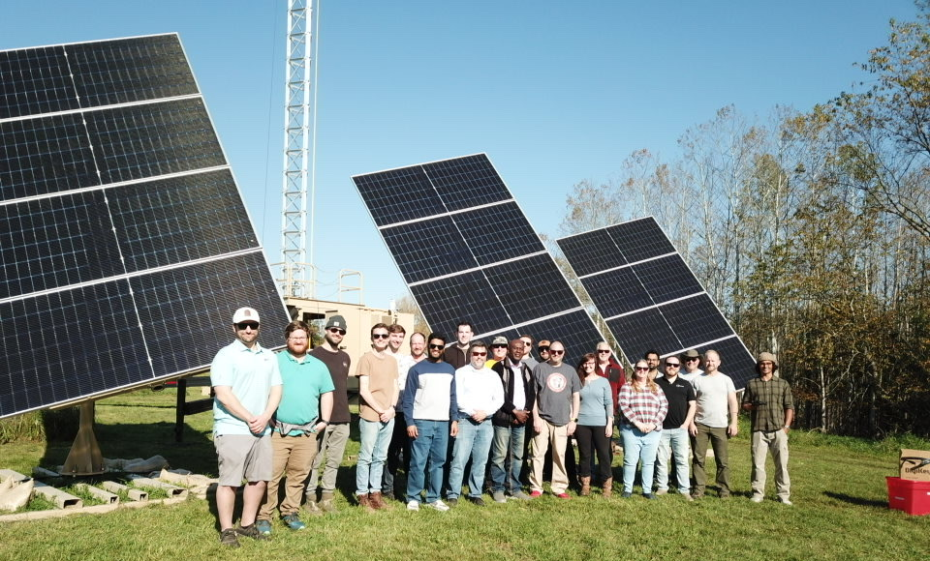
Background
LEMA
Indigenous
Impact
Defense
Indigenous

Slide 3
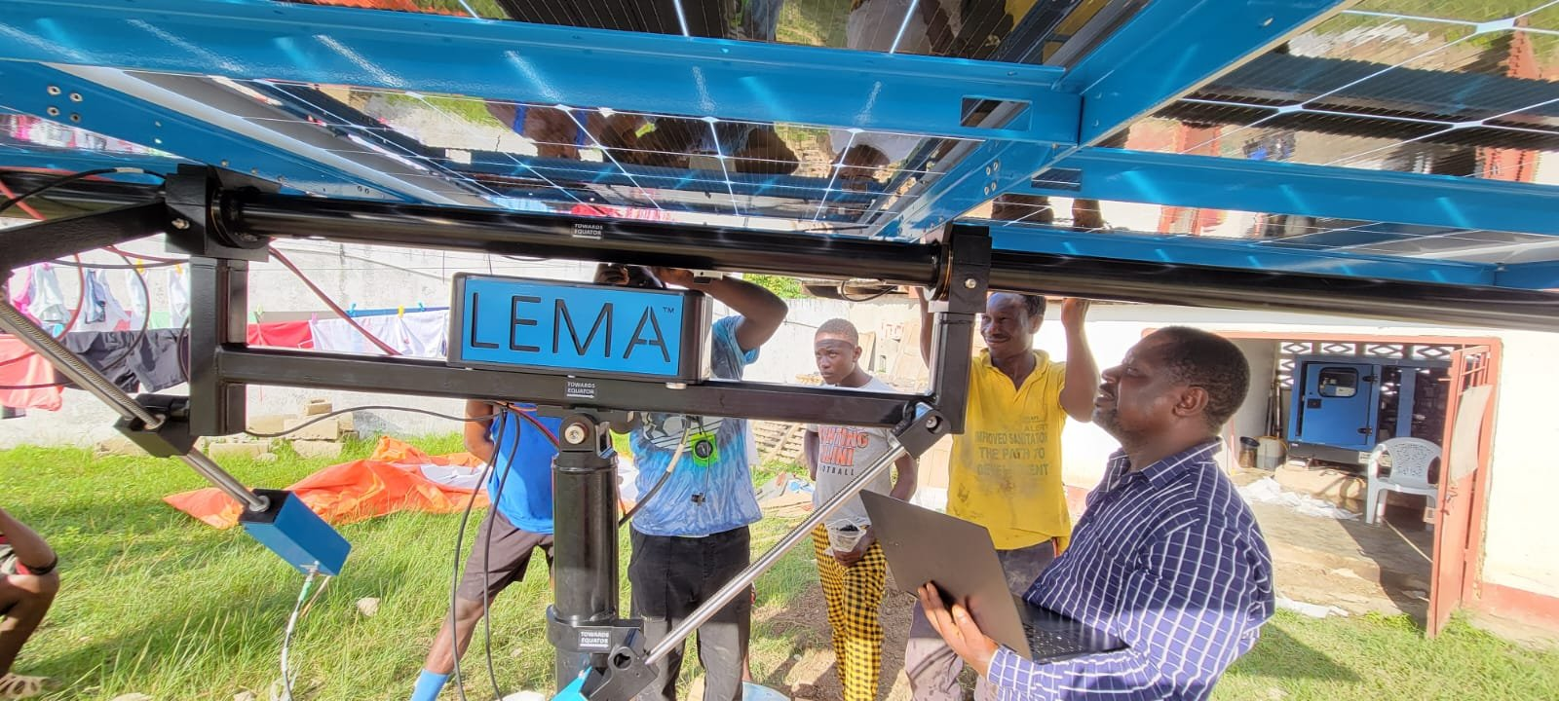
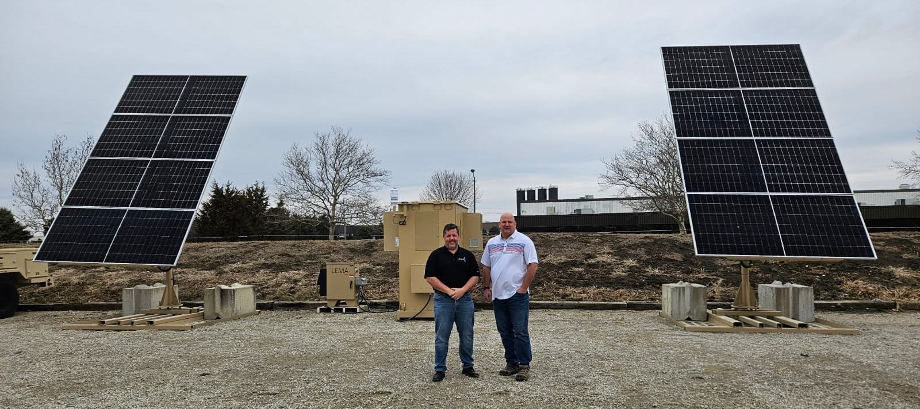
Training
Simple
Efficient
Effect
Indigenous

Slide 4
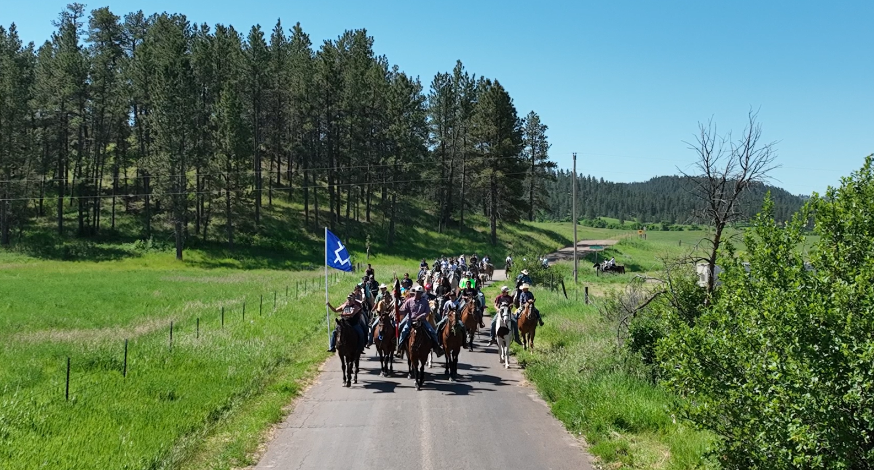
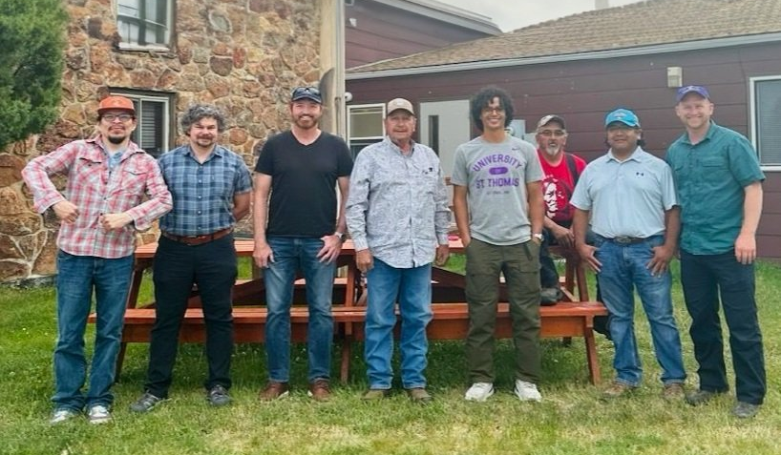
Impact
I Identify & Investigate
M Measure Demand & Feasibility
P Plan & Procure
A Activate Implementation
C Continuous Communication
T Transition & Train
Indigenous

Slide 5
Questions
Indigenous

