Slide 1
Chapter 18 | Northeast
Webinar: Fourth National Climate Assessment – Tribes and Indigenous Peoples
Hosted by the Institute for Tribal Environmental Professionals (ITEP)
Climate Change Program
Thursday, February 7
Chris Caldwell
Director of Sustainable Development Institute
College of Menominee Nation
Keshena, WI
Notes:
Posoh mawaw new weyak.
Eneq as weseyan, Chris Caldwell.
I serve as the Director of Sustainable Development Institute at the College of Menominee Nation, in Keshena, Wisconsin.
During the NCA 4 I had the opportunity to help tribes provide input into the process. I eventually ended up as an author for the northeast chapter which I will present, but will also talk about the Midwest chapter as well.

Slide 2
Ch. 18 | Northeast
Northeast Region
Key Messages
Key Message 1: Changing Seasons Affect Rural Ecosystems, Environments, and Economies
Key Message 2: Changing Coastal and Ocean Habitats, Ecosystem Services, and Livelihoods
Key Message 3: Maintaining Urban Areas and Communities and Their Interconnectedness
Key Message 4: Threats to Human Health
Key Message 5: Adaptation to Climate Change Is Underway
Notes:
As you can see our author team developed key messages that focused on addressing a wide ranging complex mix of terrestrial and aquatic ecosystems as well as the urban and rural communities that impact and are impacted in numerous ways.
The Northeast region is characterized by four distinct seasons and a diverse landscape that is central to the region’s identity, quality of life, and economic success.
It is both the most heavily forested and most densely populated region in the country. Residents have ready access to beaches, forests, and other natural areas for both economic and recreational activities.
threatened by declining snow and ice, rising sea levels, and rising temperatures.
By 2035, and under both lower and higher scenarios (RCP4.5 and RCP8.5), the Northeast is projected to be more than 3.6°F (2°C) warmer on average than during the preindustrial era.
This would be the largest increase in the contiguous United States and would occur as much as two decades before global average temperatures reach a similar milestone.
Yet, these same impacts will have different meaning for tribes in the region.

Slide 3
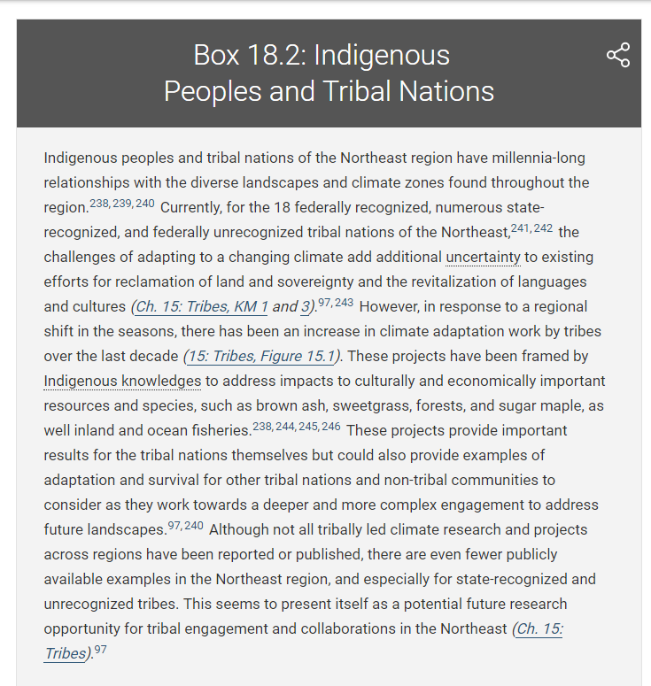
Northeast Region
Indigenous Peoples and Tribal Nations
“Currently, for the 18 federally recognized, numerous state-recognized, and federally unrecognized tribal nations…”
“…changing climate… …additional uncertainty to existing efforts for reclamation of land and sovereignty and the revitalization of languages and cultures.”
“…brown ash, sweetgrass, forests, and sugar maple, as well inland and ocean fisheries.”
“…provide important results for the tribal nations themselves but could also provide examples of adaptation and survival for other tribal nations and non-tribal communities.”
“…fewer publicly available examples in the Northeast region, and especially for state-recognized and unrecognized tribes… …potential future research opportunity for tribal engagement and collaborations in the Northeast (Ch. 15: Tribes).”
Notes:
As part of the team, we reviewed available publications to help add to the evidence focused on impacts to Indigenous peoples and Tribal Nations in the region.
That proved to be a limited amount of available resources. For sure, there were documents from NCA 3 focused on Tribal Nations, but not much had been published since then.
In addition to this, there is also a different history for Tribal Nations in this region compared to other regions for the fact that they have had a longer experience with colonialism. Sometimes the struggle wasn’t even just language and culture revitalization, but reclaiming their connection to their ancestral lands and obtaining federal recognition.
So, the story in box 18.2 takes into account these complexities and works from the vantage point that this could be a prompt for Tribal Nations in the northeast region to build this body of evidence.

Slide 4
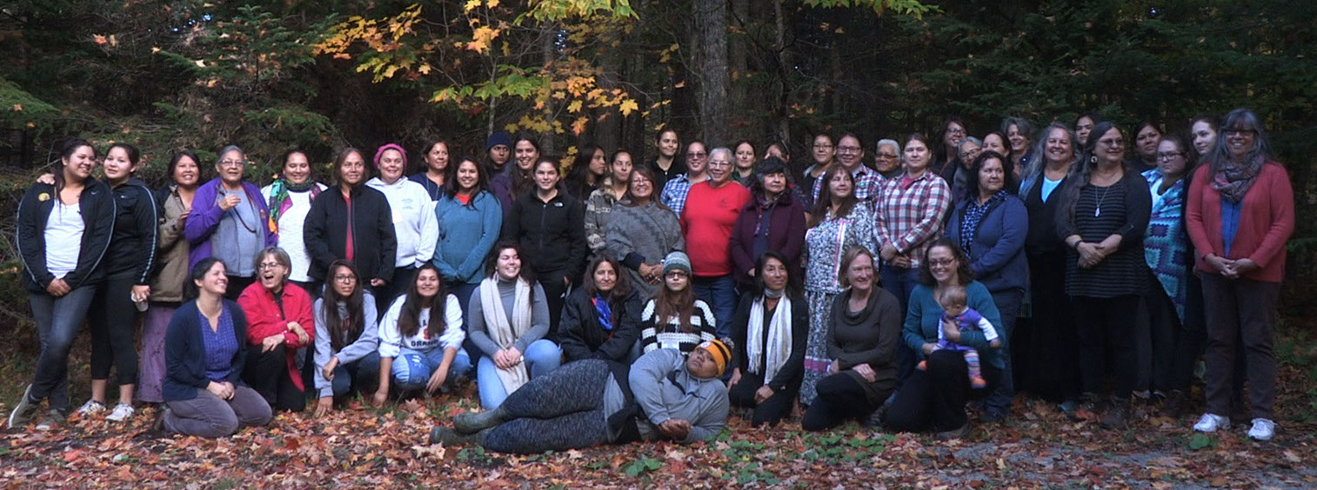
Ch. 18 | Northeast
Voices from Maple Nation: Indigenous Women’s Climate Change Summit.
VOICES FROM MAPLE NATION DECLARATION
https://www.maplenation.org/maple-nation-declaration
Notes:
Bozho! Nyawenha skanoh! Boozhoo! Chwent Awskenehe! Shekon Sewakwekon! Kulahsihkulpa!
We send greetings in the Indigenous languages spoken across the territories we call home, the expansive northeastern forests of Maple Nation that we share with our plant and animal relatives who are in need of our voices.
We are indigenous women of Maple Nation: grandmothers, mothers, daughters, sisters, and babies, gathered from many Indigenous Nations from the four directions. We come from different traditions, languages, roles and cultures. Yet, we all share in the traditional care-taking responsibility for the Maple Nation bioregion in which we live; the forests, medicines, fish, and wildlife, sacred rivers, springs, lakes and shorelines. We offer our gratitude for these generous gifts of Mother Earth.
The Haudenosaunee people view Maples as a leader among trees, for the ways they sustain us. They are ecological and cultural keystones in our cultures and a symbol of our region. Yet accelerating climate change threatens Maple Nation and the web of ecological relationships of which we are all a part.
Changing temperatures and unpredictable seasons place Maple forests and all of our non-human relatives at risk, when change comes faster than they can adapt. How will they regenerate in a world out of balance? Our plant medicines are moving away from us even as new species arrive. When shall we hold our ceremonies if the seasons they honor shift? How shall we tend our gardens and gather our foods, if the rains are unpredictable, if the temperatures wither the plants and the gardeners alike? What songs will we sing if the beings they sing of are gone? As we witness the suffering of Mother Earth, the emotional toll is high. The lands, waters, peoples and all beings of Maple Nation are suffering together. What we do to land, we do to ourselves. We feel their pain.
As Indigenous women, we carry special gifts and responsibilities to care for Mother Earth. Women are honored in our cultures as givers of life and caretakers of the land and water, gifted with special connection to the sources of life -- to seed, soil, water, and plants. Our work is guided by the wisdom of our ancestors and the expectations of our children. We stand together with shared purpose, strength and knowledge inspired by the presence of our first women, Grandmother Moon and Mother Earth. Our gentle gifts of compassion and healing are paired with fierce strength to defend all we love.
Our gifts as Indigenous women are connected to our responsibilities as culture keepers. We, side by side in balance with our men, are caretakers of ceremony, story, and song. We carry and nurture traditional ecological knowledge and environmental philosophies for caring for land. Our responsibilities encompass teaching, healing and leadership. As women, we carry authority for decision making on behalf of all life and we raise our voices for all beings. As inhabitants of this land since time immemorial, we have a deep understanding of change and the resilience it demands. We have weathered the shifting winds of history both environmental and political. Despite extraordinary threats, we are still here, carrying the wisdom that was entrusted to us. Our traditional teachings have been key to our survival in times of change. As our world is poised on the brink of climate chaos, the time to listen and act on those teachings is upon us.
We acknowledge that every one of us bears responsibility for the injuries to Mother Earth. Collectively Indigenous peoples have contributed little to the causes of climate disruption, yet we are especially vulnerable to its consequences. For us, climate change is more than an inconvenient truth. As Indigenous peoples, we are reliant on the gifts of land and water for subsistence and ceremony, our material and spiritual lives, as well as our health. Therefore, climate change threatens our very cultural survival.
We, the women of Maple Nation, raise our voices in response to these threats, on behalf of our beloved homelands and the generations yet to come. We will not stand idly by.
We commit ourselves to speak out on behalf of the wellbeing of Maple Nation, to take action to sustain the lands and waters that sustain us, and to support each other as we face these challenges. We will continue to lead our families, our communities and our Nations in resisting destruction and adapting to change.
We call upon our sisters, our brothers, all the peoples of Maple Nation and beyond to join us in this work guided by respect, reciprocity and reverence for generous Mother Earth who sustains us all.

Slide 5
Ch. 18 | Northeast
18
Acknowledgments
Technical Contributors
Zoe P. Johnson, U.S. Department of Defense, Naval Facilities Engineering Command (formerly NOAA Chesapeake Bay Office)
Amanda Babson, U.S. National Park Service
Elizabeth Pendleton, U.S. Geological Survey
Benjamin T. Gutierrez, U.S. Geological Survey
Joseph Salisbury, University of New Hampshire
Andrew Sven McCall Jr., University of Vermont
E. Robert Thieler, U.S. Geological Survey
Sara L. Zeigler, U.S. Geological Survey
USGCRP Coordinators
Christopher W. Avery, Senior Manager
Matthew Dzaugis, Program Coordinator
Allyza Lustig, Program Coordinator

Slide 6
Dupigny-Giroux, L.A., E.L. Mecray, M.D. Lemcke-Stampone, G.A. Hodgkins, E.E. Lentz, K.E. Mills, E.D. Lane, R. Miller, D.Y. Hollinger, W.D. Solecki, G.A. Wellenius, P.E. Sheffield, A.B. MacDonald, and C. Caldwell, 2018: Northeast. In Impacts, Risks, and Adaptation in the United States: Fourth National Climate Assessment, Volume II [Reidmiller, D.R., C.W. Avery, D.R. Easterling, K.E. Kunkel, K.L.M. Lewis, T.K. Maycock, and B.C. Stewart (eds.)]. U.S. Global Change Research Program, Washington, DC, USA. doi: 10.7930/NCA4.2018.CH18
https://nca2018.globalchange.gov/chapter/northeast

Slide 7
Chapter 21 | Midwest
Webinar: Fourth National Climate Assessment – Tribes and Indigenous Peoples
Hosted by the Institute for Tribal Environmental Professionals (ITEP)
Climate Change Program
Thursday, February 7
Chris Caldwell
Director of Sustainable Development Institute
College of Menominee Nation
Keshena, WI
Notes:
I wasn’t an author for this chapter, but there was a lot of involvement from members of the Great Lakes Indian Fish and Wildlife Commission (GLIFWC). They have been doing a lot of great work on climate with Ojibwe tribes and our organization.
But, as with the northeast chapter, the effort to incorporate

Slide 8
Ch. 21 | Midwest
Midwest Region
Key Messages
Key Message 1: Agriculture
Key Message 2: Forestry
Key Message 3: Biodiversity and Ecosystems
Key Message 4: Human Health
Key Message 5: Transportation and Infrastructure
Key Message 6: Community Vulnerability and Adaptation
Notes:
Two new Key Messages are introduced (Key Messages 3 and 6).
Key Message 3 recognizes the important role that ecosystems of the Midwest play in supporting a diverse array of species and providing important benefits such as flood control, crop pollination, and outdoor recreation.
Key Message 6 addresses how at-risk communities in the Midwest are becoming more vulnerable to climate change impacts and how they are working to build adaptive capacity. Tribal nations are especially vulnerable because of their reliance on threatened natural resources for their cultural, subsistence, and economic needs.
The four remaining Key Messages address improvements in the understanding of risks and responses to climate change since NCA3.
Key Message 1 on agriculture provides more specificity about the risk to agriculture by stating that agricultural productivity (the ratio of outputs to inputs) is projected to decline by 2050 to levels of the 1980s (that is, yields may increase but at the cost of substantial increases in inputs).
Key Message 2 on forestry illustrates the progress foresters and land managers have made in climate adaptation through their efforts to incorporate climate change risks into management decision-making.
Key Message 5 on transportation and infrastructure highlights a growing interest in green infrastructure—the use of plants and open space in storm water management—as an option for adapting to more frequent episodes of extreme precipitation.
Key Message 4 on human health identifies specific health impacts by naming expected changes in magnitude and occurrence of extreme events, exposures, and economic impacts. The message explicitly states public health actions that can be implemented to avoid or reduce the health impacts.

Slide 9
Ch. 21 | Midwest
Midwest Region
Tribal Vulnerability and Adaptation
Background: Portions of Michigan, Wisconsin, and Minnesota contain ceded territory of many tribes, and these are used for hunting, fishing, and gathering native plants, all of which play vital roles in maintaining cultural heritage. Projected changes in climate and ecosystems will have strong impacts on these activities.³⁹
KM 1: Wild rice is an annual plant harvested by tribes and others in shallow wetlands of northern Minnesota, Wisconsin, and Michigan. Stable production depends on a stable climate that maintains ecosystem diversity. Declines in production are expected, related to increases in climate extremes and climate-related disease and pest outbreaks as well as northward shifts of favorable growing regions.⁷³
KM 2: Changing climate conditions increasingly cause both cultural and economic impacts within the Midwest, and it is very likely these impacts will worsen in the future. For example, many tree species on which tribes depend for their culture and livelihoods—such as paper birch, northern white cedar, and quaking aspen—are highly vulnerable due to temperature increases.^{90,91,92,126}Populations of the emerald ash borer, a destructive invasive insect pest that attacks native ash trees, will increase due to warming winters in the region. Mortality of black ash trees, which are important for traditional basket-making for many tribes, is highly likely as winter temperatures continue to rise.¹²⁷
Case Study: Adaptation in Forestry (Menominee Tribal Enterprises and Oak Wilt Response and Regeneration)
Tribal Adaptation:
Climate change presents challenges to the Ojibwe tribes in co-managing these resources with other land managers; as the climate changes, various species utilized by tribes are declining and may shift entirely outside of treaty boundaries and reserved lands.^{127,309,310}
Adaptation to climate change might also mean giving up on something deeply embedded in tribal culture for which no substitute exists.³¹ A family sugarbush (a forest stand used for maple syrup), for example, cannot be replaced culturally, spiritually, or economically if the sugar maple range were to shift outside of treaty or reservation boundaries.
Projected changes in climate, particularly increases in extreme precipitation events, will have pronounced impacts on tribal culture and tribal people in the Midwest.²⁸³ Reservations often are located in isolated rural communities, meaning emergency response to flooding presents challenges in getting help to tribal citizens.
Additionally, in areas of the Midwest, infestations of the invasive emerald ash borer already are devastating ash tree populations and corresponding Indigenous cultural and economic traditions.¹²⁷
Across the United States, a number of tribal nations are developing adaptation plans, including in the Midwest (Ch. 15: Tribes, KM 3).²⁸³ These plans bring together climate data and projections with Traditional Ecological Knowledge ^{311,312} of tribal members. Within Indigenous oral history lies a complex and rich documentation of local ecosystems—not found in books—that can be used to understand and document the changes that are occurring.³¹³ Climate change effects are not typically immediate or dramatic because they occur over a relatively long period of time, but tribal elders and harvesters have been noticing changes, such as declining numbers of waabooz (snowshoe hare), many of which Scientific Ecological Knowledge has been slower to document. The Traditional Ecological Knowledge of elders and harvesters who have lived and subsisted in a particular ecosystem can provide a valuable and nuanced understanding of ecological conditions on a smaller, more localized scale. Integrating this Traditional Ecological Knowledge with Scientific Ecological Knowledge in climate change initiatives provides a more complete understanding of climate change impacts.¹³⁶ Community input to tribal adaptation plans ensures that Traditional Ecological Knowledge can be used to produce adaptation strategies trusted by community members.³¹⁴

Slide 10
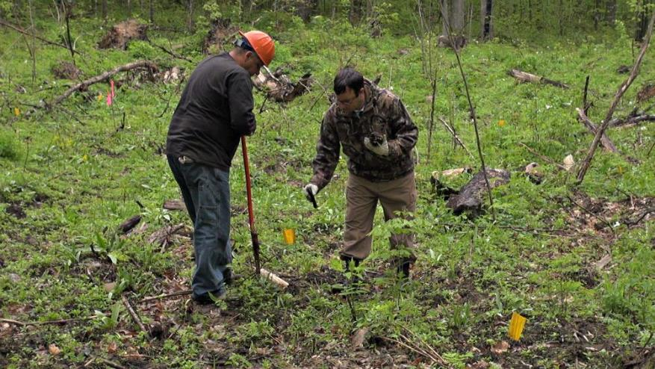
Fig. 21.4: Forest Diversity Can Increase Resilience to Climate Change
Ch. 21 | Midwest
The photo shows Menominee Tribal Enterprises staff creating opportunity from adversity by replanting a forest opening caused by oak wilt disease with a diverse array of tree and understory plant species that are expected to fare better under future climate conditions. Photo credit: Kristen Schmitt.

Slide 11
Ch. 21 | Midwest
21
Chapter Author Team
Federal Coordinating Lead Author
Chris Swanston, USDA Forest Service
Chapter Lead
Jim Angel, Prairie Research Institute, University of Illinois
Chapter Authors
Barbara Mayes Boustead, National Oceanic and Atmospheric Administration
Kathryn C. Conlon, Centers for Disease Control and Prevention
Kimberly R. Hall, The Nature Conservancy
Jenna L. Jorns, University of Michigan, Great Lakes Integrated Sciences and Assessments
Kenneth E. Kunkel, North Carolina State University
Maria Carmen Lemos, University of Michigan, Great Lakes Integrated Sciences and Assessments
Brent Lofgren, National Oceanic and Atmospheric Administration
Todd A. Ontl, USDA Forest Service, Northern Forests Climate Hub
John Posey, East West Gateway Council of Governments
Kim Stone, Great Lakes Indian Fish and Wildlife Commissions (through January 2018)
Eugene Takle, Iowa State University
Dennis Todey, USDA, Midwest Climate Hub
Review Editor
Thomas Bonnot, University of Missouri

Slide 12
Ch. 21 | Midwest
21
Acknowledgments
Technical Contributors
Katherine Browne, University of Michigan
Melonee Montano, Great Lakes Indian Fish and Wildlife Commission
Hannah Panci, Great Lakes Indian Fish and Wildlife Commission
Jason Vargo, University of Wisconsin
Madeline R. Magee, University of Wisconsin-Madison
USGCRP Coordinators
Kristin Lewis, Senior Scientist
Allyza Lustig, Program Coordinator

Slide 13
Angel, J., C. Swanston, B.M. Boustead, K.C. Conlon, K.R. Hall, J.L. Jorns, K.E. Kunkel, M.C. Lemos, B. Lofgren, T.A. Ontl, J. Posey, K. Stone, G. Takle, and D. Todey, 2018: Midwest. In Impacts, Risks, and Adaptation in the United States: Fourth National Climate Assessment, Volume II [Reidmiller, D.R., C.W. Avery, D.R. Easterling, K.E. Kunkel, K.L.M. Lewis, T.K. Maycock, and B.C. Stewart (eds.)]. U.S. Global Change Research Program, Washington, DC, USA. doi: 10.7930/NCA4.2018.CH21
https://nca2018.globalchange.gov/chapter/midwest

