Slide 1
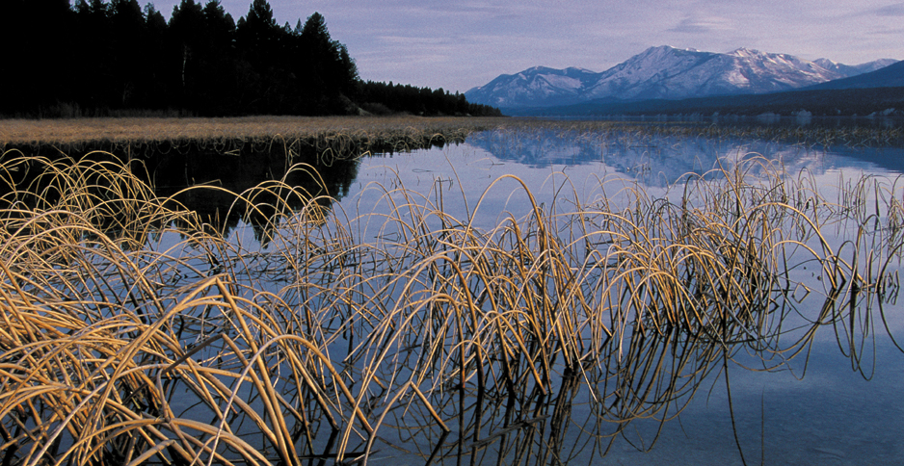

Climate Change Impacts on Columbia River Treaty Tribal Resources Columbia River Inter-Tribal Fish Commission
1

Slide 2
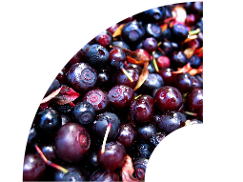
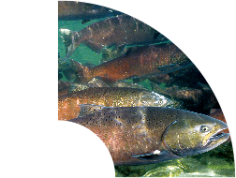
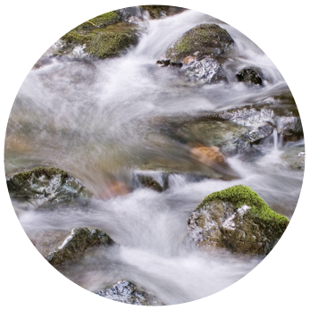
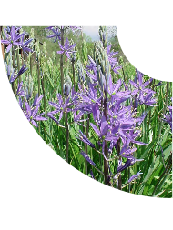
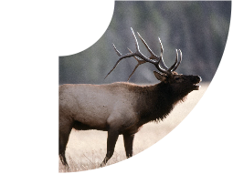
First Foods
Salmon
Berries
Water
Game
Roots

Slide 3
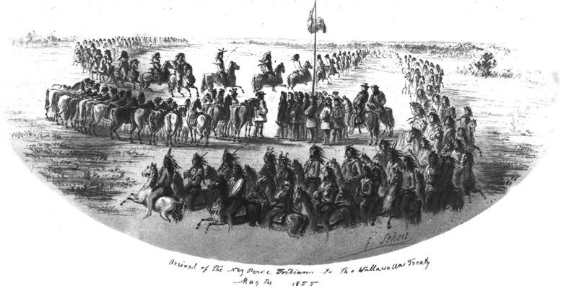
“…the right of taking fish at all usual and accustomed places, in common with the citizens of the Territory, and of erecting temporary buildings for curing them: together with the privilege of hunting, gathering roots and berries....”
—1855 Treaty with the Yakima

Slide 4
CRITFC Mission Statement
To ensure a unified voice in the overall management of the fishery resources, and as managers, to protect reserved treaty rights through the exercise of the inherent sovereign powers of the tribes.

Slide 5
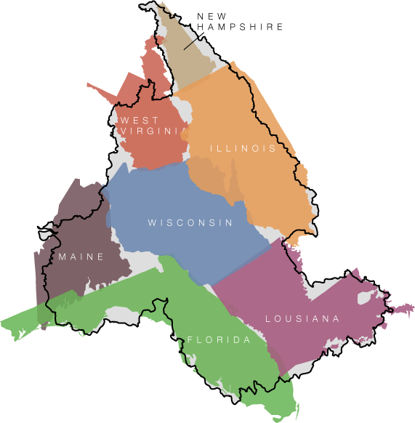
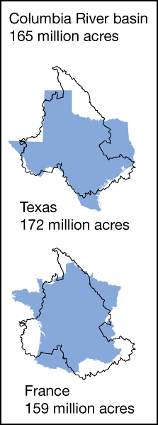
Columbia River Basin

Slide 6
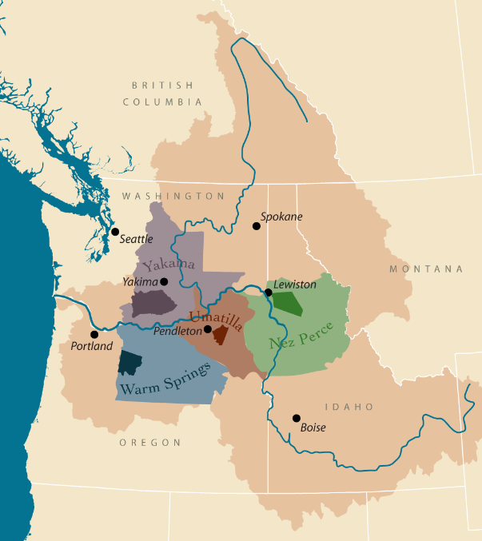




Four Tribes’ Ceded Lands
Combined ceded area:
66,591 square miles
More than 25% of the entire Columbia Basin
55% of the rivers and streams that are still accessible to salmon
Includes almost all of the salmon habitat above Bonneville Dam
13

Slide 7
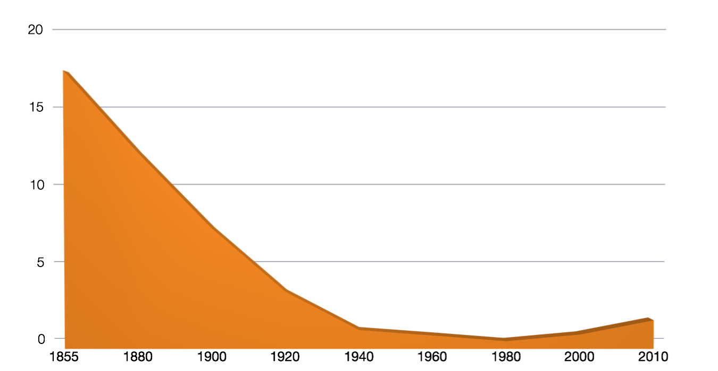
Salmon Decline Returning Columbia River salmon (chinook, steelhead, sockeye, coho)
Estimated Average 17 million
Tribes believe it to be as
high as 34 million
millions of fish
1,754,334

Slide 8
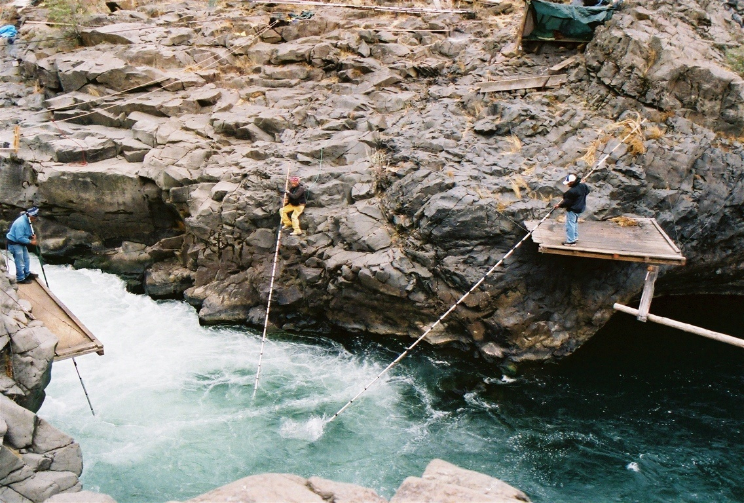
Wy-Kan-Ush-Mi Wa-Kish-Wit “Spirit of the Salmon” - 1995
Goal of 4 million salmon returning by 2020

Slide 9
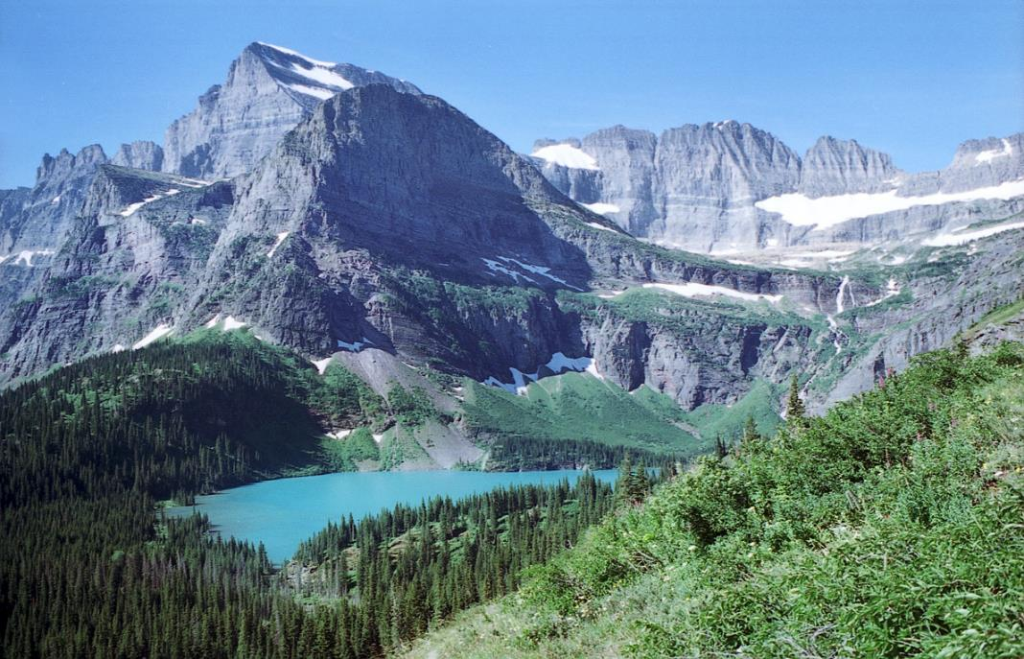
Climate Change, Snowpack, Stream Flow, and Water Temperature on Tribal Lands

Slide 10
Temperature Difference from 1950-1999 average (from Rupp 2014)
Notes:
MACA multi-model ensemble mean, min, and max have been smoothed with a Gaussian filter, st. dev. = 3 yrs. Darker lines show the multi-model mean for each RCP.
Dashed line is the average for the last half of the 20th century. Note that by 2030, annual temperature will always be above what we’ve grown accustomed to.

Slide 11

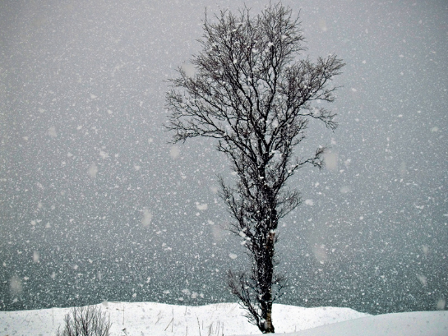

Increasing Temperatures mean some areas will change…
Snowfall Dominated
Rainfall Dominated

Slide 12
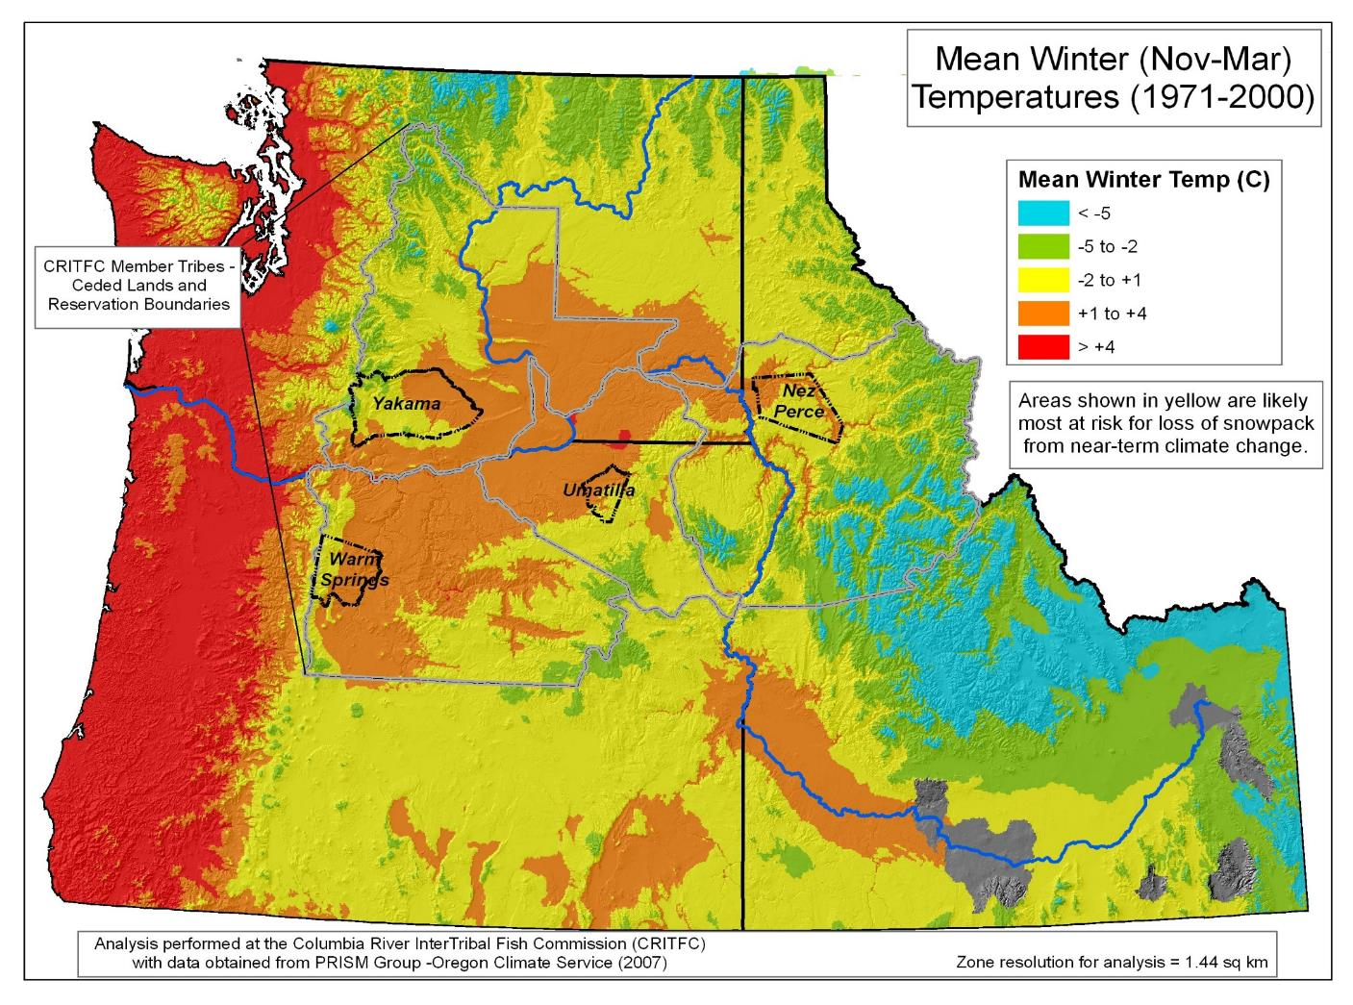

Slide 13
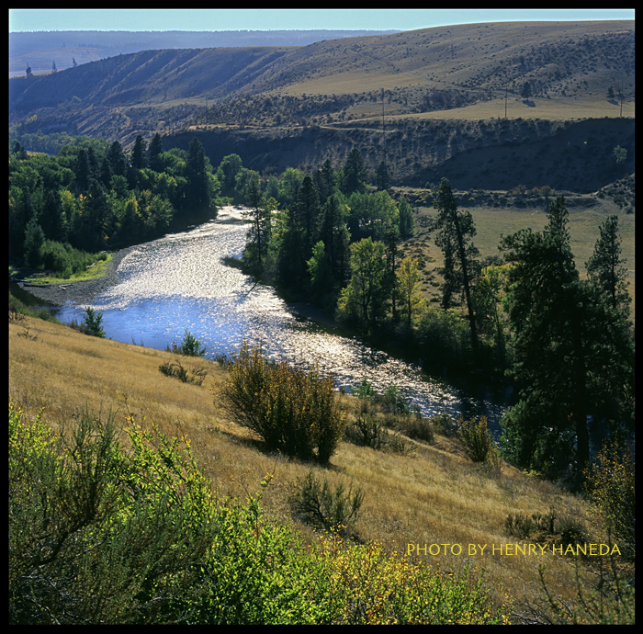
Yakima River, WA
Photo Credit: Henry Haneda

Slide 14
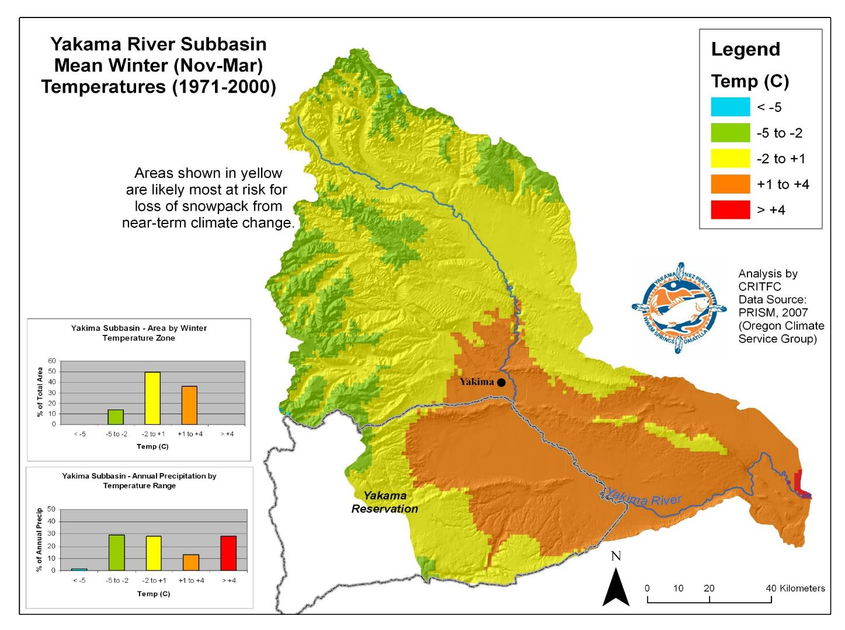

Slide 16
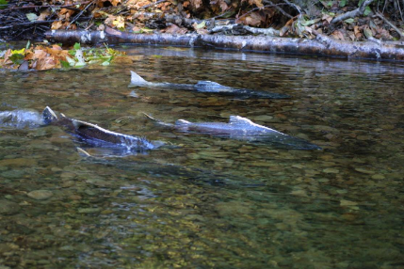
Tributary Effects on Salmon and Steelhead:
Increasing frequency and severity of winter flooding – eggs and overwintering juveniles
Summer Low Flows – Migrating/Spawning Adults
Higher Water Temperatures – will stress migrating adults, and may disrupt growth and downstream migration timing of juveniles

Slide 17
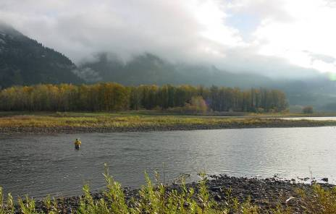
Water Temperature Modeling for Future Climate Change Scenarios
2010/2011: Satus and Toppenish Watersheds (Tributaries of Yakama Basin) – Part of Larger Cooperative Project with the USGS
2011/2012: Upper Grande Ronde River Basin
2012/2013: Clearwater River Basin

Slide 18
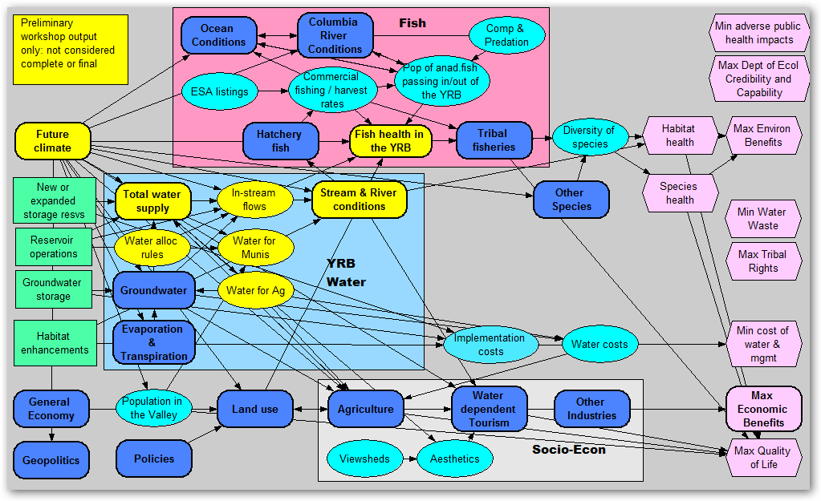
Yakima Basin Stakeholders’ Workshop
Conceptual Model
Notes:
Pink on right are the stakeholders broad objectives, green on left are the possible actions everything in middle are the inner connections and relations that need to filled out in order to connect all of the pieces.

Slide 19
Yakima Basin Chapters
Climatic Change Special Issue
Stakeholders’ workshp & conceptual model (Jenni, Consult.)
Mainstem temperature modeling (Voss, WaWSC)
Tributary temperature modeling (Graves, CRITFC)
Temperature and bioenergetics of juvenile steelhead and Chinook salmon (Hardiman & Mesa, WFRC)
Hydrograph and available species- & life-stage-specific habitat (Hatten, WFRC)
Estimating the effects of CC on the social & economic life of the Yakama Tribe (Montag, FORT)
Notes:
We have three manuscripts in review at the journal Climatic Change from the Yakima work

Slide 20
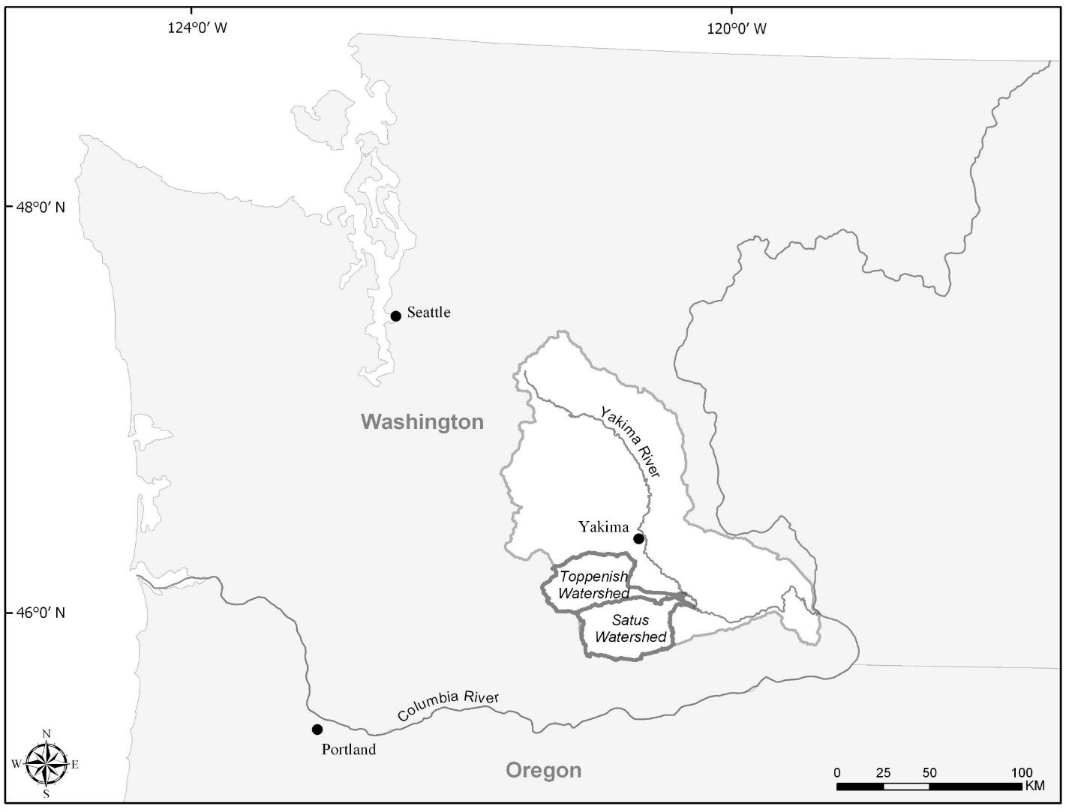

Slide 21
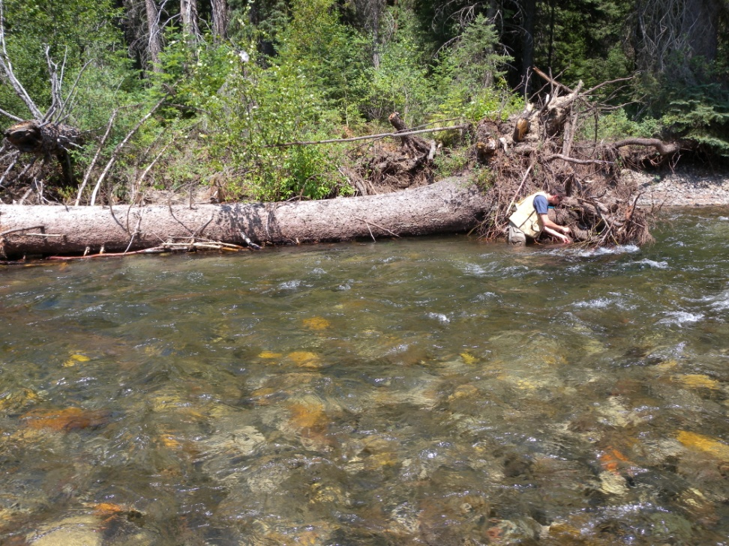
Upper Grande Ronde Basin Water Temperature Model

Slide 22
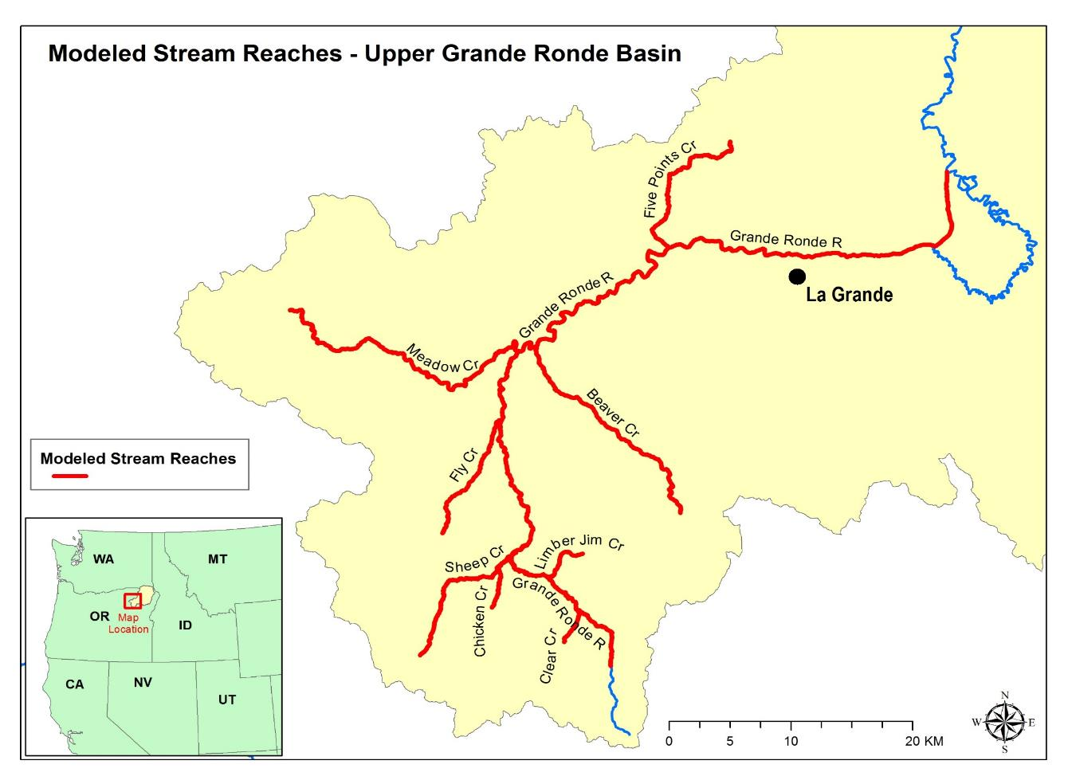

Slide 23
Simulated Mean Temperature
Simulated Maximum Temperature

Slide 28
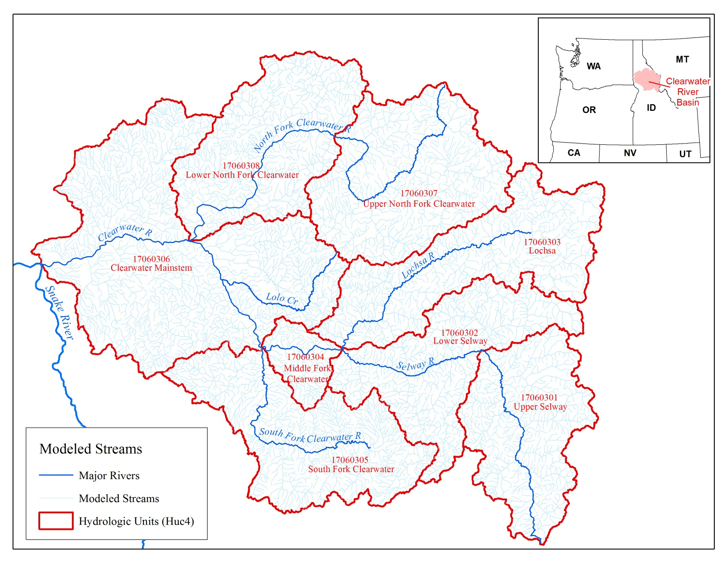
2080s

Slide 29
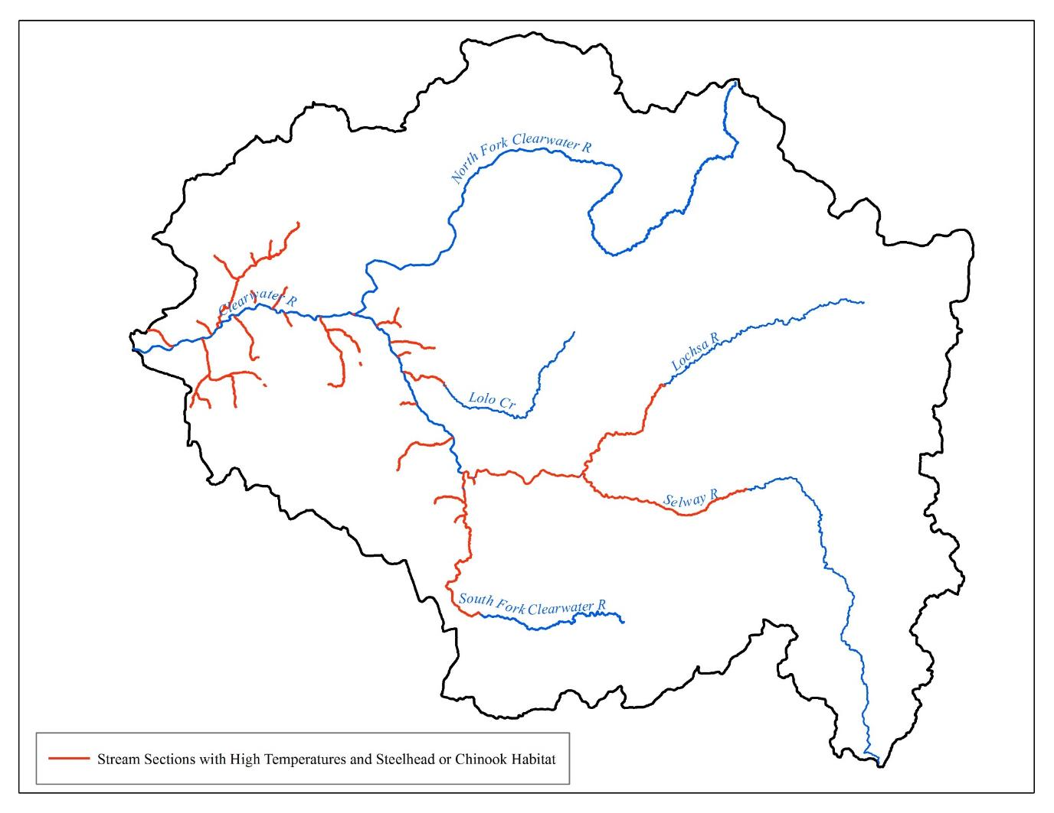

Slide 30
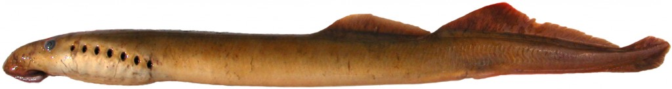
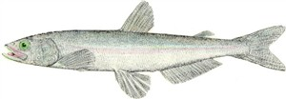
Current Project: To Evaluate Climate Change Impacts on Pacific Lamprey and Eulachon

Slide 31
Climate Change Impacts in the PNW
Summer temperatures increasing and snow pack continues to decline.
Streams have less summer flow, more winter flooding and are warmer.
More and longer droughts.
Increased inundation and erosion.

Slide 32
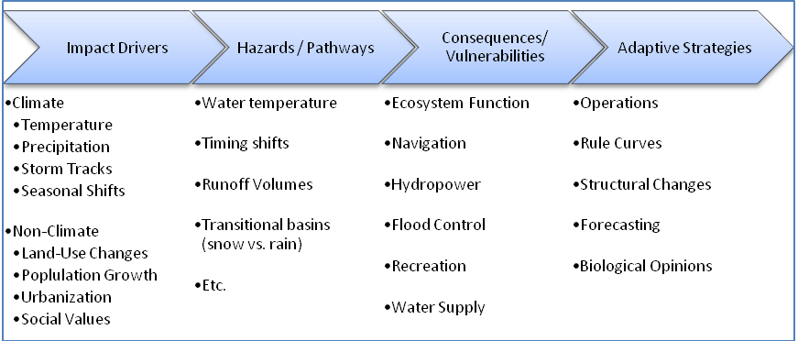
Identify and Assess Climate Change Impacts on Tribal First Foods
Climate impact and non-impact pathways linking drivers and adaptation solutions
( From Brown et al. 2010 "A New Angle on Adaptive Management - Reducing Plausible Vulnerability in the Upper Great Lakes" )
Notes:
Impact drivers affect hydrology and water quality which in cause vulnerabilities to numerous river uses. Note that climate impact drivers become synergistic with non climate drivers that already highly impact ecosystem function- i.e. 13 fish species already ESA listed in the Col Basin.

Slide 33
Develop Information and Tools to Assess Climate Change and Other River Use Impacts on First Foods
Collaborate with other regional, national and international forums to obtain robust climate change and ecosystem science to develop analytical framework
Develop and Enhance CRITFC Information System (CIS)
Notes:
Project objective to develop the most robust information possible to build analytical tools to assess climate impacts on first foods- this is CIS role.

Slide 34
2014 International Columbia Basin Climate and Hydrology Assessment Workshop
Explore and if possible, quantify differences between Canadian and U.S. climate change assessment methods.
Develop a protocol for use of recent global climate models at a CRB scale.
Establish a coordinated, collaborative framework for future trans boundary climate change assessment including a synthesis of the state of Columbia Basin hydrologic models.
Establish coherent messages about climate futures for managers even if there are differences in analytical approaches and technical modeling methods.
Participants: NOAA, COE, BPA, CRITFC, OCCRI; UW CIG; PSU; BOR; PCIC; BCH; ONA; Nat Ctr Atm Res;NWPCC.
Notes:
This workshop was the first ever conducted in the basin and follow workshop and reports are planned. Other workshops and conferences such as the EPA regional stream temperature workshop held in November 2014 contribute additional information that is being incorporated into CIS.

Slide 35
CRITFC Information System Model (CIS)
Simulates ecosystem function, hydrogeneration, flood risk metrics from numerous river operations scenarios quickly from over 100 basin river index sites
Integrates climate change meterology/hydrology with river operations from over 100 basin sites
Creates ecosystem function metrics through modeled river operational alternatives under future climate change scenarios
Identifies vulnerabilities and ecosystem resilience through alternative modeled scenarios
Contains or has in development sub models (i.e. water quality, water particle travel time, spill, fish survival, daily time steps)
Notes:
Ecosystem function metrics include water quality, anaddromous and resident fish productivity, stable reservoir ecosystem to protect cultural resources

Slide 36
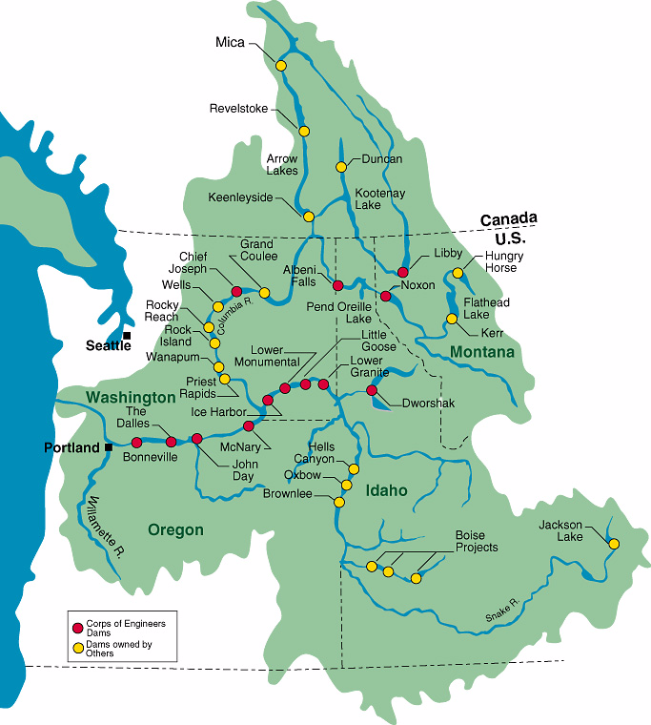
Columbia River Basin
Notes:
Path of Columbia River; 9 run-of-river dams; Location of Chief Joseph and Grand Coulee dams; Location of Keenleyside (Arrow) and Brilliant dam. Mica, Arrow and Libby were built under the Col River Treaty and highly influence river flows especially in dry years.

Slide 37
CIS Model Input Data
Bonneville Power Administration HYDSIM Model converted into database libraries (e.g. 70 and 80 year historical flows and volume forecasts, dam operational criteria, hydro-generation loads).
Corps of Engineers’ flood risk rule curves
Tribal/ecosystem rule curves
Federal Columbia River Biological Opinion flow and spill requirements
Pacific Northwest Coordination Act requirements
Canadian Columbia River Treaty Operations
100 plus climate hydrological data sets UW Climate Impacts Group (Hamlet et al. 2010), RMJOC, Columbia River Treaty Review

Slide 38
Climate Data Processing Into CIS
Global/Regional Climate models
Downscaling and bias correction
Hydrological models
Flow routing
Bias correction of flows
model
calibration
CRITFC
INFORMATION
SYSTEM
Global/Regional Climate scenarios
Notes:
Sequence of steps needed to produce data from global climate models to be integrated into CRITFC Information System model analysis to assess impact to tribal first foods. Hydrologic models may be statistical or dynamic (based upon local meteorological inputs).

Slide 39
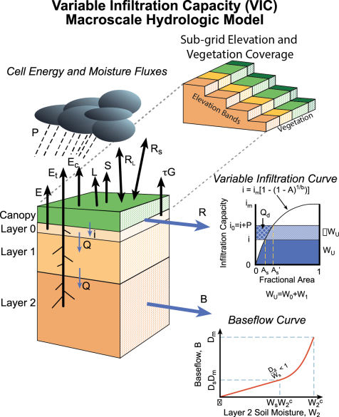
Hydrologic Submodel for Climate Change Input Data into CIS
(from Nijessen 2014, UW Land Surface Hydrology Group)
Notes:
Dynamic downscaling using hydrological models creates more robust estimates than statistical downscaling to create hydrologic models.

Slide 40
Fish Survival Relationships for Fish Survival Submodel (from McCann 2011)
Survival
Fish Travel Time
Steelhead*
Steelhead*
* Statistically significant at α=0.05 level
Yearling Chinook*
Yearling Chinook*
Notes:
Fish survival submodel relationships to be integrated into CIS. Dam spill reduces fish travel time and increases survival in river and adult returns.

Slide 41
CIS Model Outputs
Hydrographs at numerous basin dams, reservoir elevations, flood risk metrics, hydropower generation and fish impact metrics
Results are quickly presented in both tabular and graphic form with the integrated Data Management Tool (DMT) for multiple scenario comparison

Slide 42
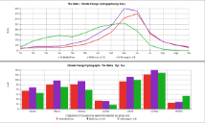
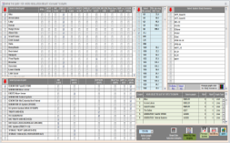
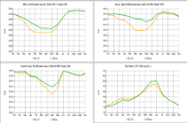
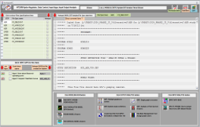
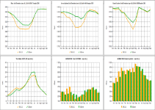
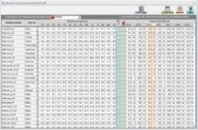
CRITFC Information System Framework
(Access Data Base Platform)
DATA BASE LIBRARIES
INTEGRATED SOFTWARE TOOLS/MODULES
GRAPHICAL USER INTERFACES (Data Management Tool)
ON-SCREEN RECEPTACLES
Climate Change Flows
Modified Flows
Hydsim input TXT files
Hydsim Master File
Study Results
Climate Change Data Processor
HYDSIM
Daily Modulator
Data Management Tool Graphics
Excel Apps (Ecosystem Rule Curves)
Excel, Notepad
Water Particle Travel Time
Fish Passage, Survival *
Water Temperature*
Daily Hydro-Regulation *
RESSIM, Volume Forecasting
*Future
Notes:
The CIS contains various data libraries, tools and modules that are selected and the GUI that facilitates comparative tables and graphs.

Slide 43

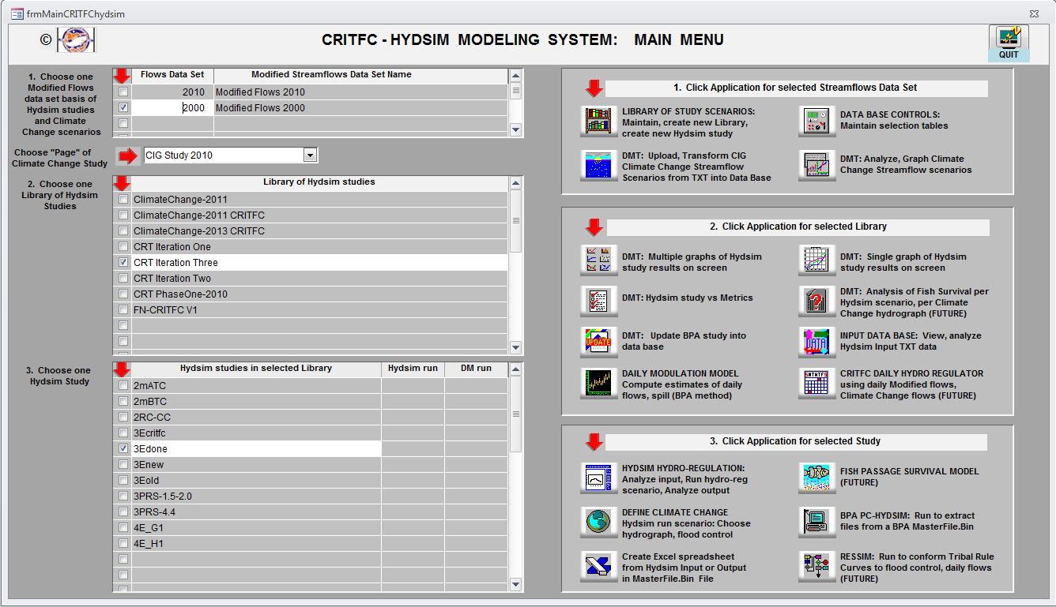
CIS Control Platform (Master GUI or Main Menu)
1. Data Base Library
2. Software Apps, GUIs
Notes:
Overview of CIS model platform screen.

Slide 44
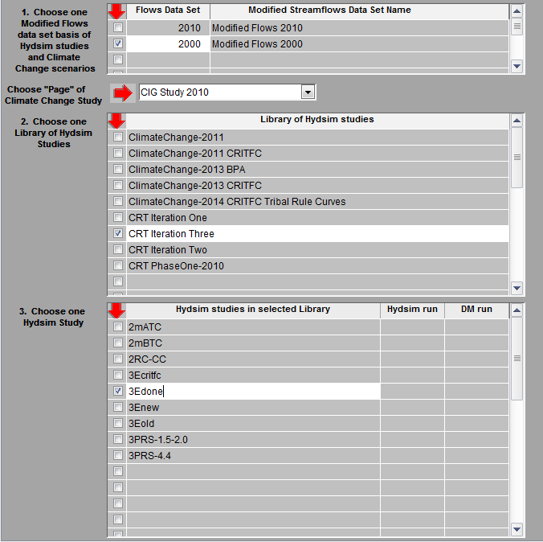
LAYERS OF DATA (Data Base)
1. Modified Streamflows Data Set.
2. Specific Climate Change (CC) studies per data set.
3. Libraries of Studies per data set, per Climate Change Study page.
4. Studies per data set, per CC page, per Library
One study layer contains TXT inputs to Hydsim, streamflow data used in study, Master.BIN, study results.
Your selected Data Set, CC Page, Library, and Study exposes data layer to software and GUIs.
Notes:
A flow library is first chosen, then a study library such as a particular climate change data set and finally one study under the study library is chosen.

Slide 45
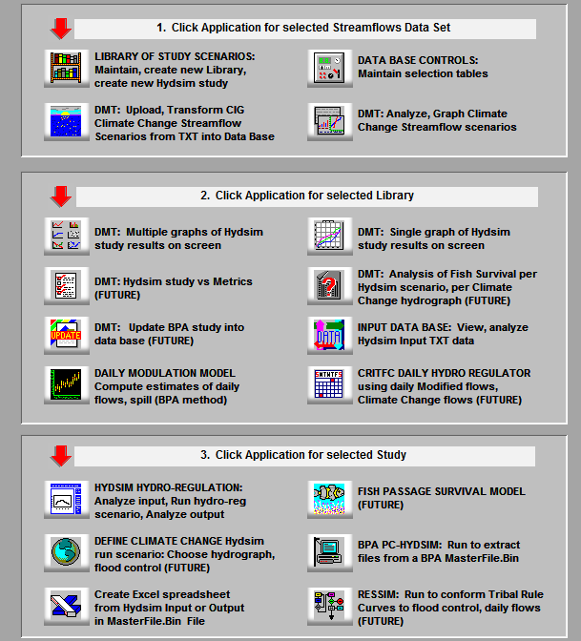
SOFTWARE APPLICATIONS
What function do you want to perform ?
Each button describes the best fit Apps to your modeling intention.
What happens when you click Apps button?
If desired Data Layer already selected, then a secondary GUI displays. In this GUI, you select other criteria that meets your intentions.
Your interaction with GUI tells which query system to run and deliver your expected data.
Notes:
Finally an application is chosen under the particular study, then specific metrics can be analyzed (fish BiOp flows, reservoir elevations, hydrogeneration, flood risk)

Slide 46
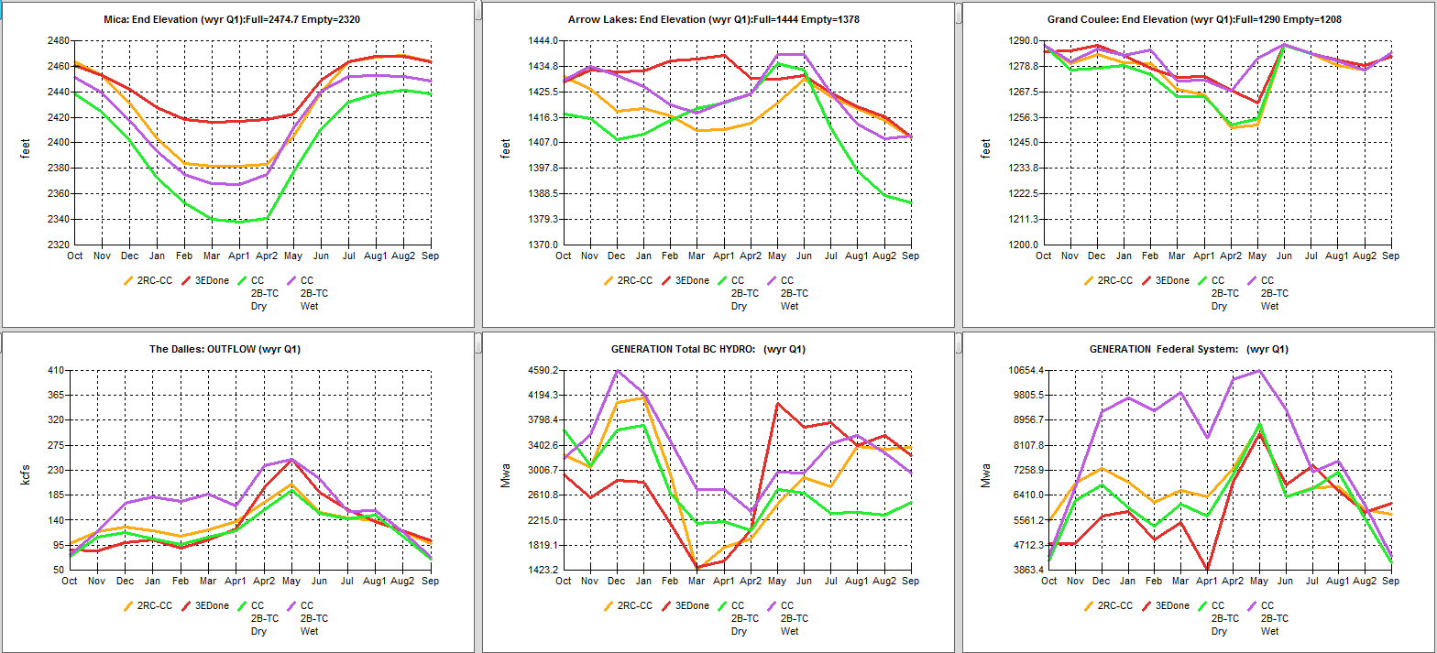
CRITFC Information System hydrograph outputs from wet and dry climate change scenarios from Columbia River Treaty studies using
2010 UW Climate Impacts Group (CIG) data
Notes:
100+ scenarios of 2010 UWCIG climate change data output can be accessed and transformed quickly into river operation metrics. This allows users to quickly assess different climate change scenarios on mainstem river operations and impacts on flood risk, hydrogeneration and fish and other ecosystem function metrics.

Slide 47
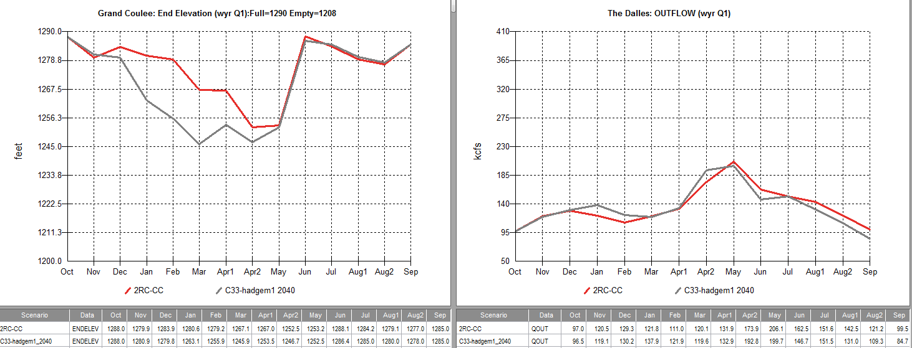
CIS Projection of 2040 Dry Future Climate Scenario vs Current River Operations
Notes:
Comparison of reservoir elevations at Grand Coulee Dam and flows at The Dalles Dam under the current condition (red) under historically dry flows and the same operations under a dry 2040 climate change scenario (gray). Note that the peak hydrograph at The Dalles occurs sooner under the dry climate change scenario and that additional drafting of the reservoir is necessary to maintain hydrogeneration loads.

Slide 48
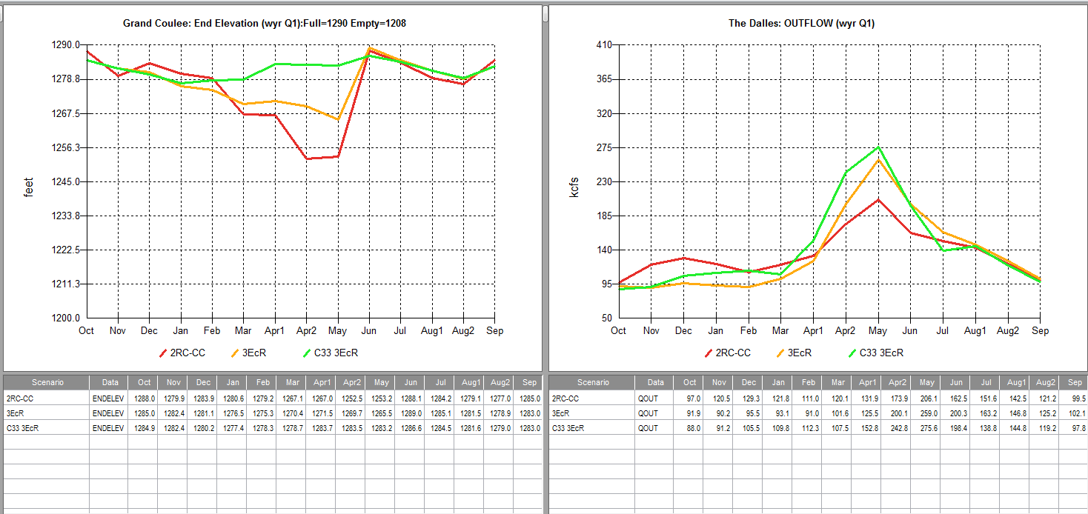
Climate Scenario (2040) Adjusted for Ecosystem Function
Notes:
Figures show reservoir elevations at Grand Coulee Dam and The Dalles Dam flows for current condition (red), current condition adjusted for ecosystem flow (yellow), and a 2040 climate scenario adjusted for ecosystem flow (green).

Slide 49
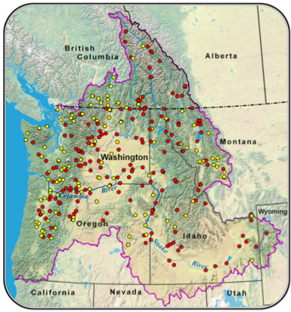
CIS- Next Steps
Continue to obtain latest and most robust climate/hydrological model projections and integrate into CIS (CMIP5, Integrated Scenarios Project; RMJOC II Project)
Improve CIS capacity in collaboration with
other regional entities (BPA, Corps, NWPCC,
BOR)
Integrate water temperature submodel
Integrate fish survival model from existing
regional fish survival models
Seek CIS publication in peer-reviewed literature
Utilize CIS in devising adaptation strategies to provide resilience for tribal first foods (i.e. Post 2024 Columbia River Treaty evaluations)
Hamlet et al. 2010

Slide 50
Columbia River Treaty (CRT)
(U.S.-Canada)
Treaty Signed in 1964 for 60 years
Primary purposes- flood control and hydrogeneration
Ecosystem function values and tribal resources not considered
Either country can send each other notice of treaty termination within 10 years
U.S. 2013 Regional Recommendation to modernize treaty by adding ecosystem function and addressing climate change impacts/ adaptation
Notes:
The treaty created three large dams and reservoirs- two in Canada and one in the US. Coordinated river operations between the US and Canada are planned to optimize flood control and hydrogeneration by selective use of more than 20 million acre feet of Canadian reservoir storage.

Slide 51
U.S. Coalition of 15 Basin Tribes Advocate Ecosystem Management in Columbia River Treaty
Restore and preserve tribal natural and cultural resources
Restore spring freshets:
Restore estuary, mainstem habitat functions
Increase fish migration survival- reduce travel time
Minimize draw downs at upper reservoirs
Restore fish passage to all historic locations.
Notes:
The basin tribes came together in 2010 in a historical coalition to establish ecosystem function as a third “leg of the stool” with respect to modernizing the Columbia River Treaty. Addressing climate change in the future modernized Treaty is a fundamental objective of the CRITFC Climate Change Project.

Slide 52
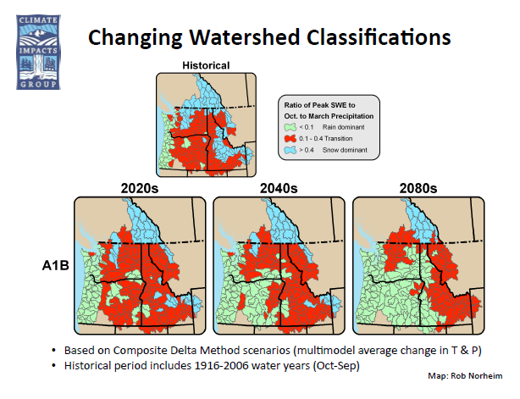
Regional Climate models concur that Canada will remain snow dominated while the U.S. will change from transient to rain dominant, no matter which precipitation scenario is chosen
Notes:
52
52
Reintroduction of salmon over Grand Coulee Dam to the cooler waters in the Canadian portion of the Columbia Basin could be an important climate change adaptation measure.

Slide 53
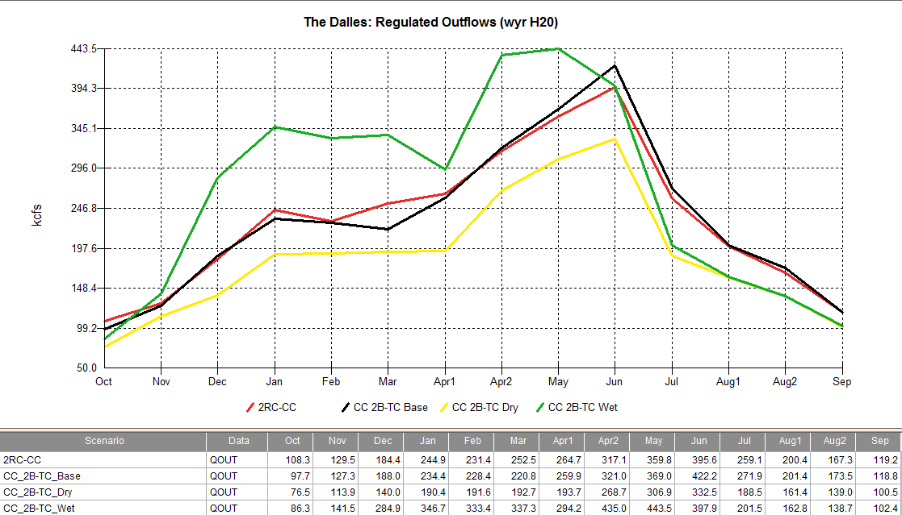
Columbia River Treaty (CRT) Climate Modeling Outflows – 20% High Yrs (Two CC scenarios compared to current condition)
2B-TC wet produces unusual freshet in late April (about 118 kcfs higher than 2RC-CC which peaks in June)
2B-TC wet and 2B-TC dry produce lowest late summer flows (28 kcfs lower than 2RC-CC)
Notes:
Climate change modeling with the CIS for the Columbia River Treaty indicates that wet years may result in two hydrograph peaks (green) while dry years may become drier with lower spring peaking hydrographs and lower fall and winter flows.

Slide 54
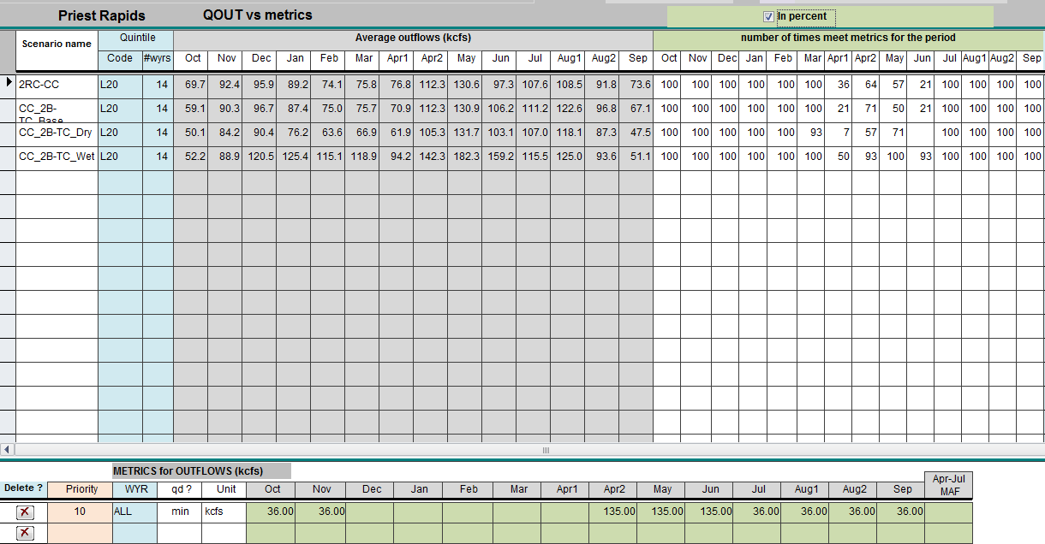
CRT CIS MODELING: PRIEST RAPIDS FCRPS Salmon BiOp Flow Objective- 20% Low Wyrs
April 10 – June 20 = 135 kcfs at Priest Rapids
2RC-CC meets metric 21% of 14 low water years
2B-TC base meets metric 21% of low 14 water years
2B-TC dry meets metric 0% of 14 low water years
2B-TC wet meets metric 93% of 14 low water years
Notes:
Example analysis of flows under a dry climate scenario indicates that critical Hanford Reach Fall Chinook salmon flows are not met at all in the driest quintile of historical dry years- a drop from the current 21%.

Slide 55
CRITFC Climate Change Project Objectives
Support advancement and implementation of improved runoff forecasting techniques using advanced statistical methods, and enhanced monitoring.
Encourage, monitor, and promote public awareness of basin-wide climate change research/adaptation planning.
Develop and implement qualitative and quantitative frameworks to analyze climate change impacts and foster river management adaptation.
Collaborate with regional, national and international agency and science networks.

Slide 56
CRITFC Climate Change Project Objectives
Assess impacts of climate change on ecosystem function, flood risk management and hydro generation in Columbia River Treaty (CRT) and Non-Treaty water management planning and implementation.
Integrate climate change adaptation into CRT assured operating plans and detailed operating plans beginning in 2020.
Determine if climate change impacts to ecosystem function may be influenced by changes in regional hydro generation and flood risk. Create adaptation measures to address vulnerabilities and resilience.
Notes:
Non-Treaty refers to additional storage created in Canadian reservoirs above and beyond that established under the Columbia River Treaty. Assured Operating Plans and Detailed Operating plans are constructed through negotiations between the US and Canadian Entities that do not presently include tribes. Tribes are calling for a “seat at the table” for the future treaty.

Slide 57
Next Steps
Continue qualitative/quantitative assessments in collaboration with regional entities via workshops and development and enhancement of system models/tools.
Begin to develop adaptive management strategies with member tribes with the CIS model.

Slide 58
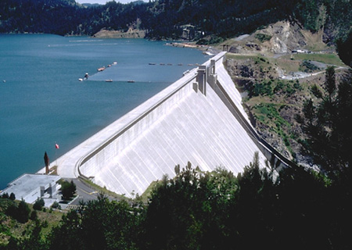
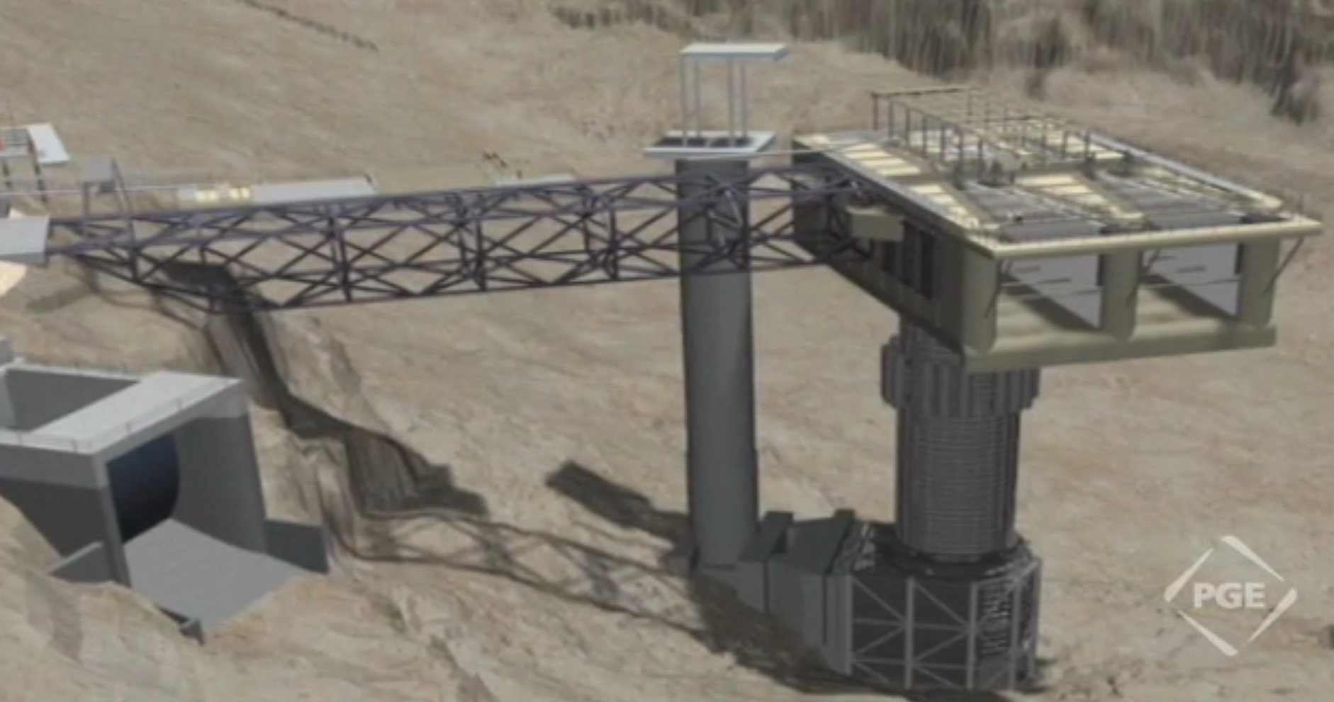
Possible Mainstem Adaptation Strategy: Selective Water Withdrawal for River Temperature Control (Dworshak and Round Butte Dams
Notes:
Structural and operational examples showing potential adaptation for climate change impacts on mainstem temperature to tribal fishery resources.

Slide 59
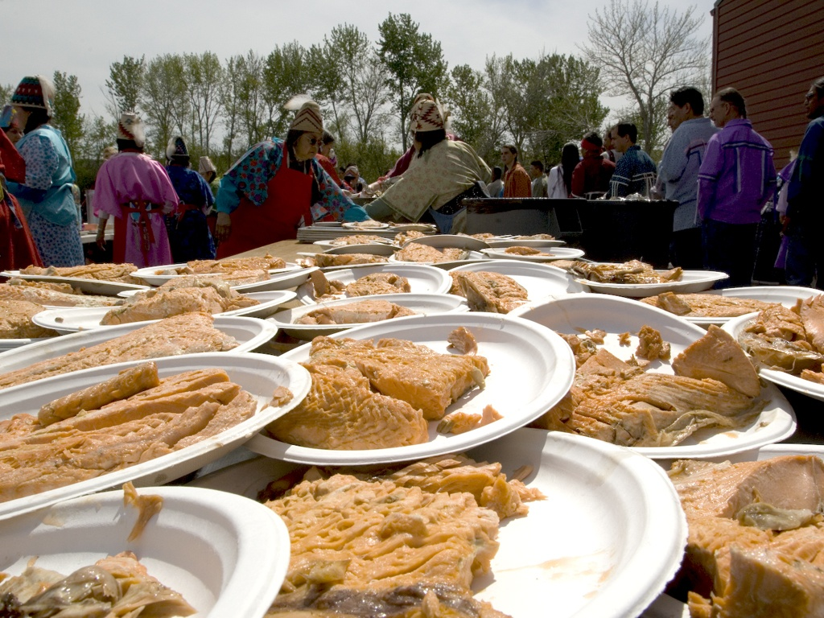
Contact Information:
David Graves-(503)238-0667,grad@critfc.org
Bob Heinith-(503)729-3798,bheinith@comcast.net
Laura Gephart - (503) 238-0667,gepl@critfc.org

