Slide 1



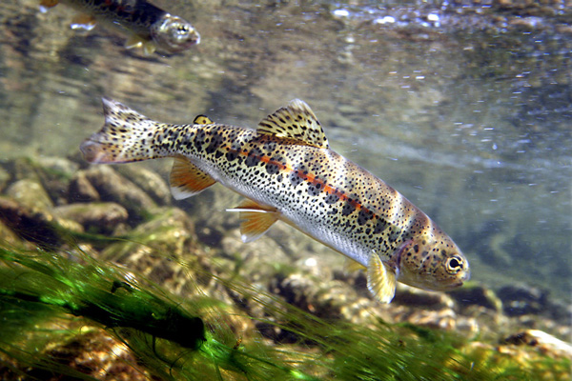
Adaptation of Salmonids to Climate Change
Dr. Shawn Narum
Columbia River Inter-Tribal Fish Commission
University of Idaho
Pat Clayton

Slide 2
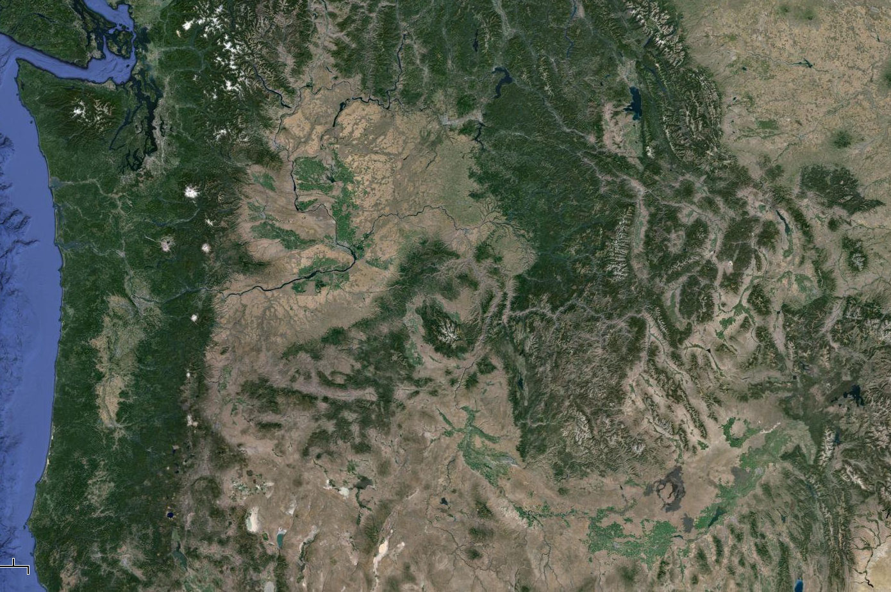
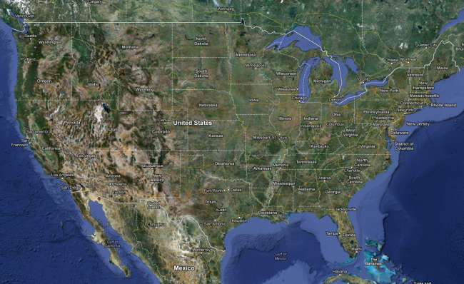
Diverse Environments
USA
Cascade Mountains
Pacific Northwest US

Slide 3
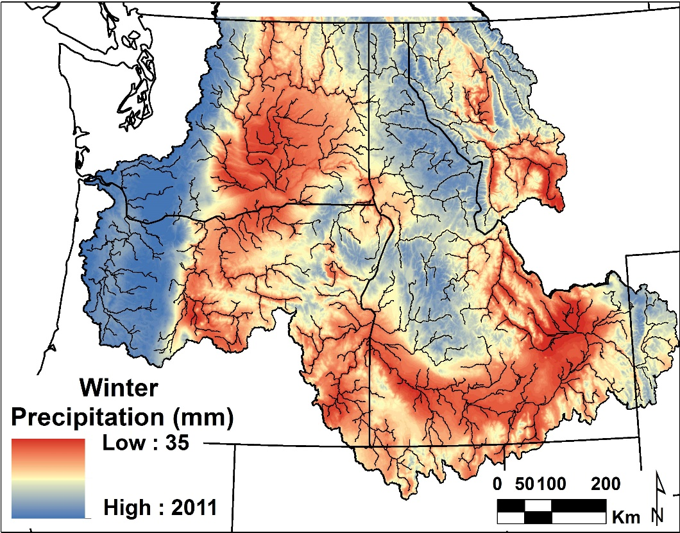
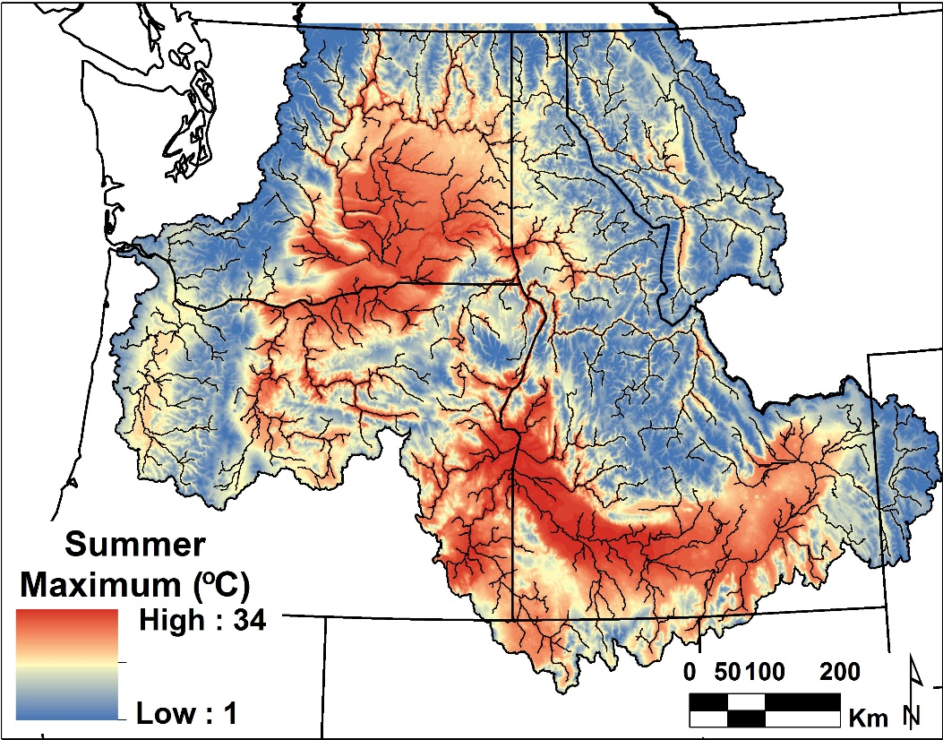
Climate
Precipitation
Temperature
Notes:
If we look at precip and temperature for this same region, we see that the high desert areas have much less precip and much warmer annual max temps than the montane regions.
3

Slide 4
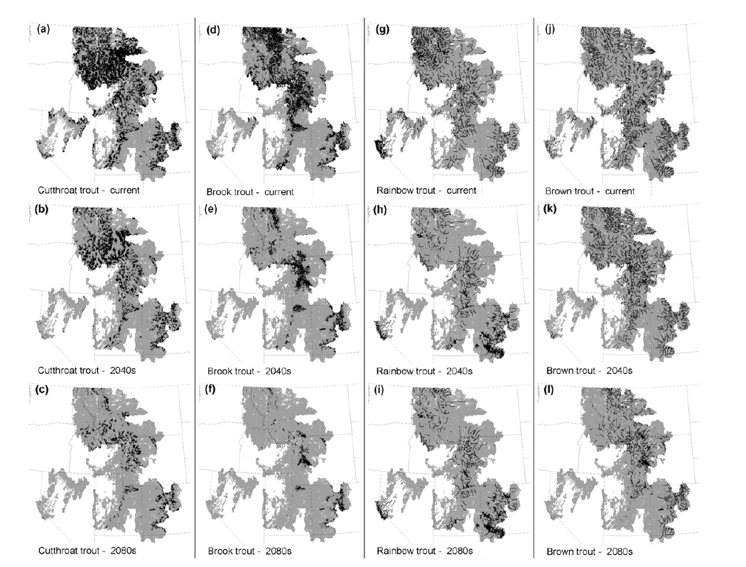
Climate Change and Impacts to Fish
Wenger et al. 2011
Habitat suitability for trout is expected to decline by ~50% in 2080 under climate change scenarios (Wenger et al. 2011)
Black = suitable habitat Gray = mostly unsuitable habitat

Slide 5
If habitat is unsuitable:
Fish have limited options:
Move (alter distribution)
Die (local extirpation)
Adapt (survive and evolve)

Slide 6
Potential for Adaptation within Species
Upper Thermal Tolerance
Broad Diversity
maximum water temperature
Performance
20°C
25°C
30°C
Temperature

Slide 7
Potential for Adaptation within Species
Upper Thermal Tolerance
Directional Selection
Warm
Performance
20°C
25°C
30°C
Temperature

Slide 8
Potential for Adaptation within Species
Upper Thermal Tolerance
Narrow Diversity
maximum water temperature
Extirpation
X
Performance
20°C
25°C
30°C
Temperature

Slide 9
Velocity of Climate Change vs. Rate of Evolution
Stream slope has a dominant influence on velocity of climate change (Isaak and Rieman (2012)
  Rapid velocity of climate change for lower slope streams
Fish populations in low gradient streams with thermal constraints are likely to be the first and most heavily impacted by climate warming
If limited dispersal opportunities, can fish evolve at a rate to keep up with velocity of climate change?

Slide 10
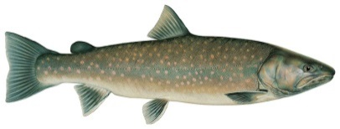

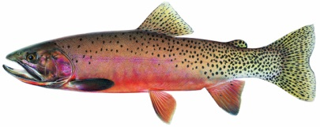
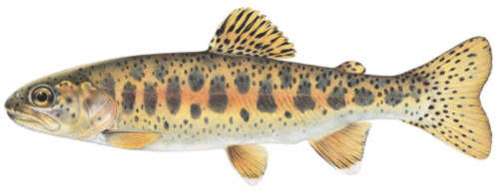
Native Trout Species of Concern
Bull trout concerns:
    no upstream thermal refuge
    fragmentation and isolation of populations
Cutthroat trout concerns:
    fragmentation and isolation of populations
    invading species & introgression (rainbow)
Redband trout concerns
    high velocity of climate change
    limited dispersal potential
Elevation

Slide 11
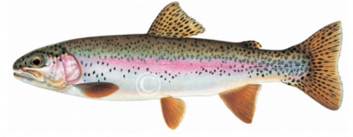
USA
Cascade Mountains
Rainbow trout
Redband trout
O. mykiss irideus
O. mykiss gairdneri

Slide 12
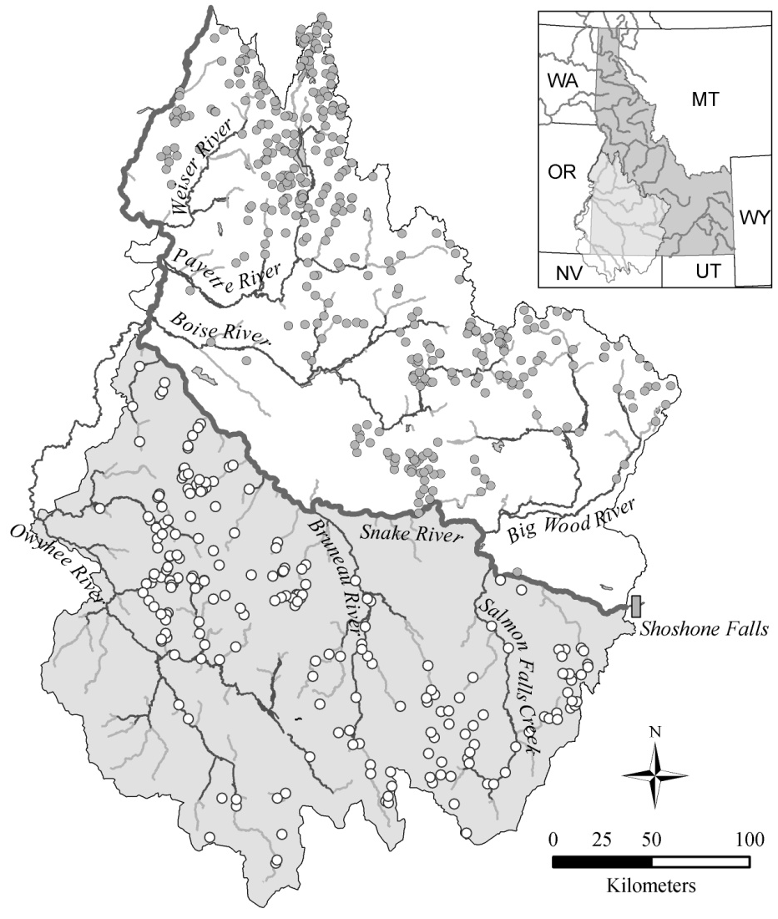
Redband Trout Environments
Oncorhynchus mykiss gairdneri
Found in both desert and montane streams
Desert stream temperatures up to 30°C
Pat Clayton
desert
Meyer et al. 2010
montane

Slide 13
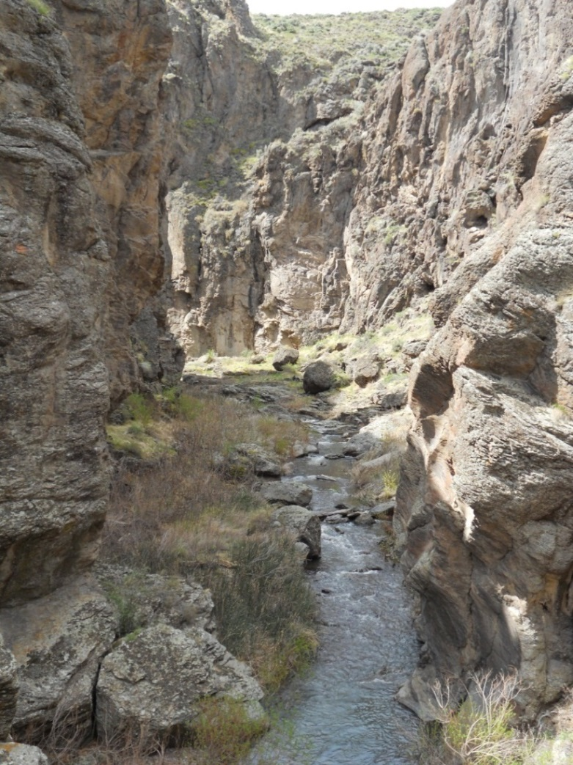
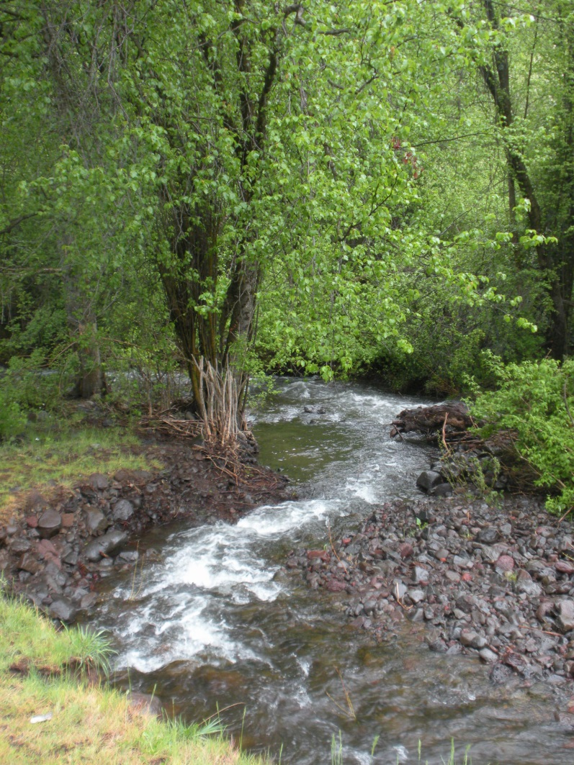
Habitat Differences
Desert vs. Montane
  Higher summer water temp
  Less shade
  Lower elevation
  Lower gradient
  Less large substrate
  (Meyer et al. 2010)

Slide 14
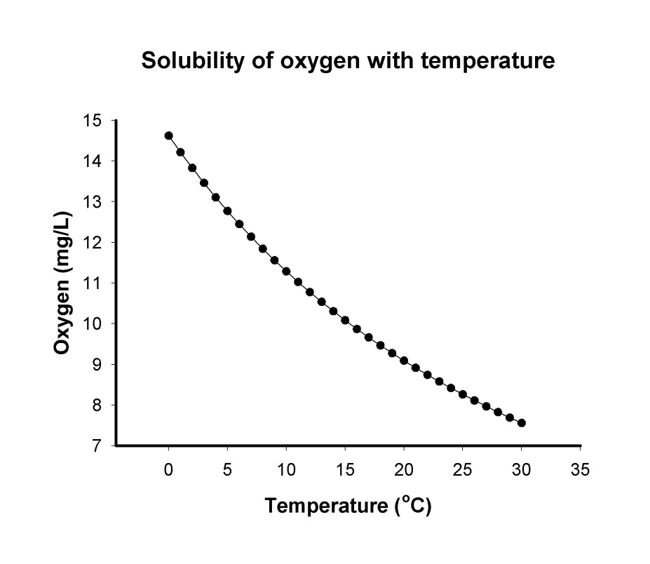
Less Oxygen in Warm Water
Temperature dependent oxygen limitation in aquatic environments

Slide 15
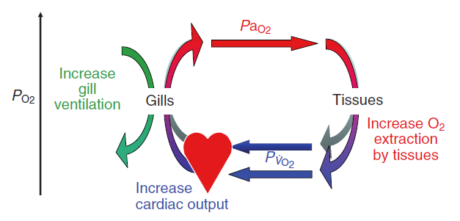
Evidence for Adaptation
Fish increase heart rate to deliver more oxygen to tissues (Eliason et al. 2011; Munoz et al. 2015)
Farrell 2009, J. Exp. Biol.

Slide 16
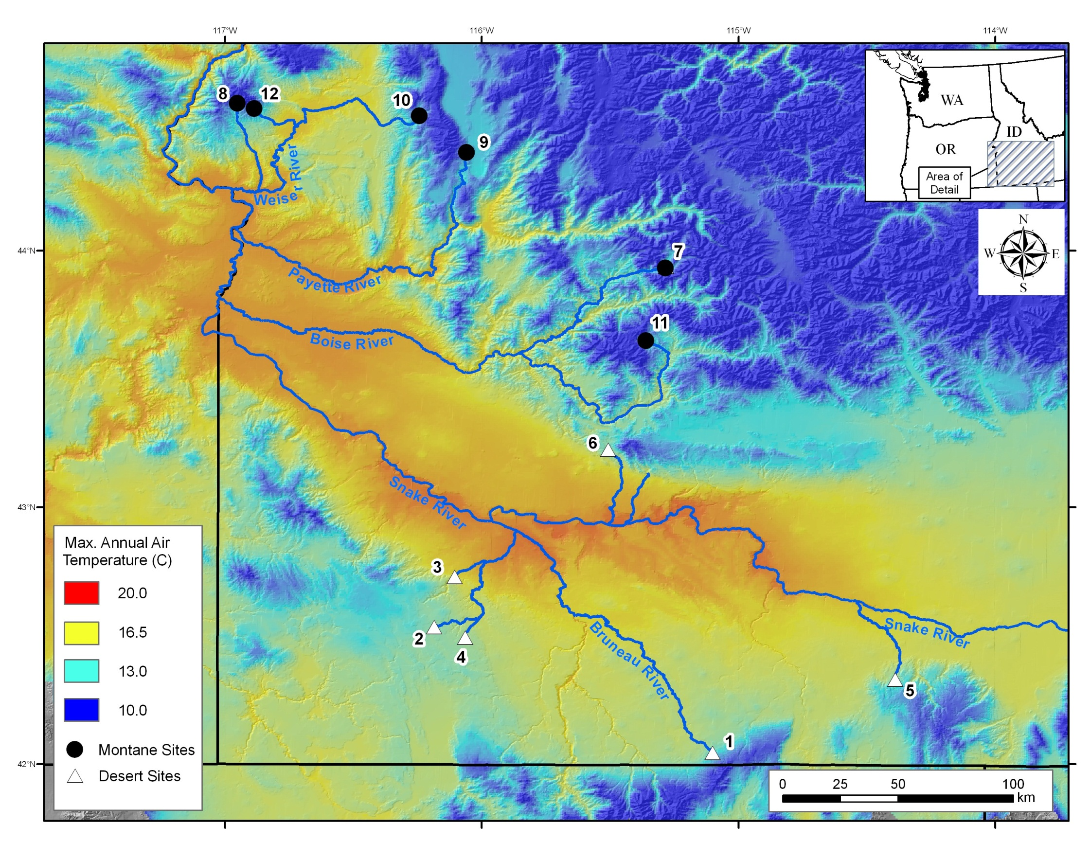
Keithley Cr.
Montane
Fawn Cr.
Redband Trout
Desert
Little Jacks Cr.
Narum et al. 2010, Molecular Ecology

Slide 17


Heart Rate in Redband Trout
a
a
b
a
b
a
b
Heart rate (bpm)
a
c
c
a
b
b
c
a
b
b
b
b
b
a
a
b
b
b
b
b
Chen et al. (in prep)
Temperature (ºC)
Fish in desert environments have evolved a higher heart rate in order to deliver more oxygen to tissues, but there is a limit

Slide 18
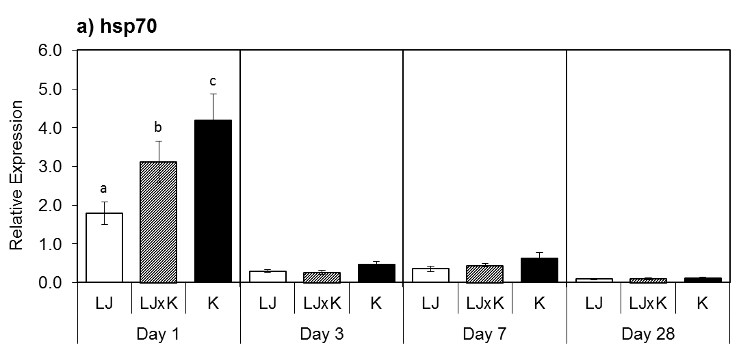
Heat Shock Protein (HSP)
Gene Expression
Narum et al. 2013, Molecular Ecology
no stress
LJ
K
LJ
LJ
LJ
LJxK
LJ
LJxK
K
LJ
LJxK
K
LJ
LJxK
K
Fish in desert environments have evolved an adaptive heat shock response (less stressed)

Slide 19
Overall Gene Expression
Distinct expression patterns across 24,000 genes
- provides long term survival advantage in desert fish
Day 1
LJ-trt
LJ-control
LJxK-trt
LJxK-control
30
K-trt
K-control
20
PC2
10
0
-10
-40
-20
0
20
40
PC1
Narum et al. 2015, BMC Genomics

Slide 20
DNA Markers Associated with Survival under Heat Stress
Narum et al. 2013, Molecular Ecology
~10,500 single nucleotide polymorphisms (SNPs)

Slide 21
Summary of Adaptation
Response to heat stress is heritable
  Fish from desert stream delivered more oxygen to tissues and were less stressed
  Evolutionary adaptation to heat stress in order to provide long term survival advantage
Adaptation from existing genetic variation is possible
  When adequate diversity is present
  There is a limit to adaptation

Slide 22
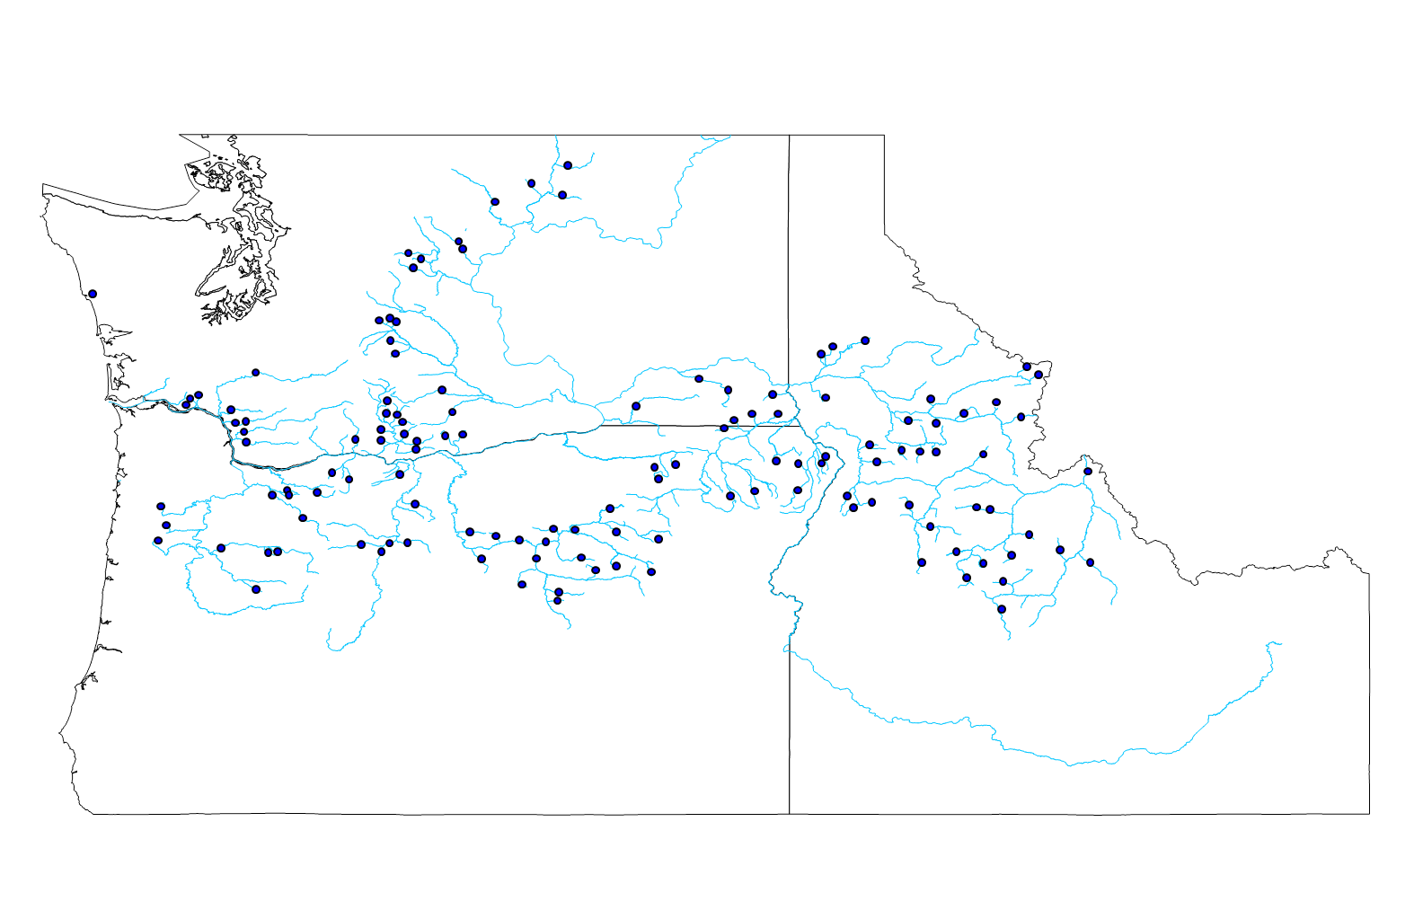
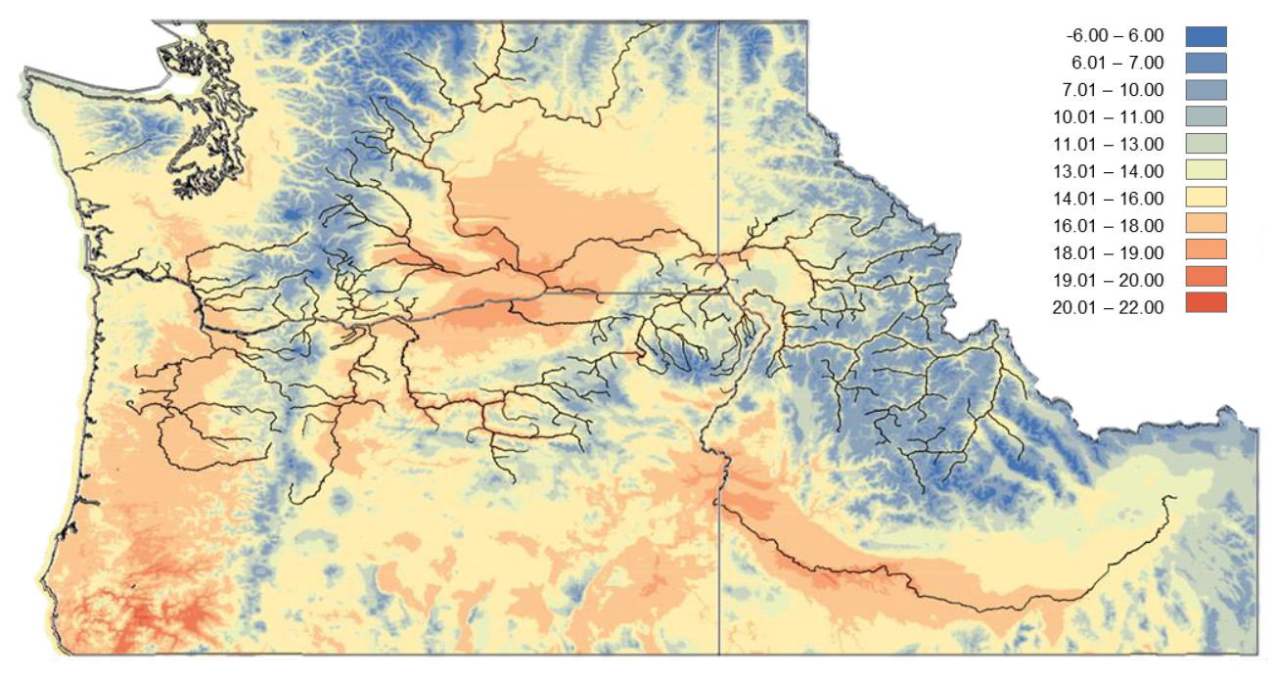
Long-term Objective
  DNA markers can be screened broadly to examine potential for adaptation and vulnerability of specific populations under scenarios of climate change
  Apply approach to other species in the Columbia R.
Mean annual max temperature (°C)

Slide 23
Acknowledgements
  Field sampling: Steve Elle, Liz Mamer, Chris Sullivan, Carson Watkins, Ben Hecht
  Fish culture/rearing: Eli Gough, Lindsay Maier, Landon Talbot
  Physiology: Zongqi Chen, Tony Farrell
  Genetics lab: Amanda Matala, Vanessa Morman, Stephanie Harmon, Jeff Stephenson
  Funding from Bonneville Power Administration

Slide 24
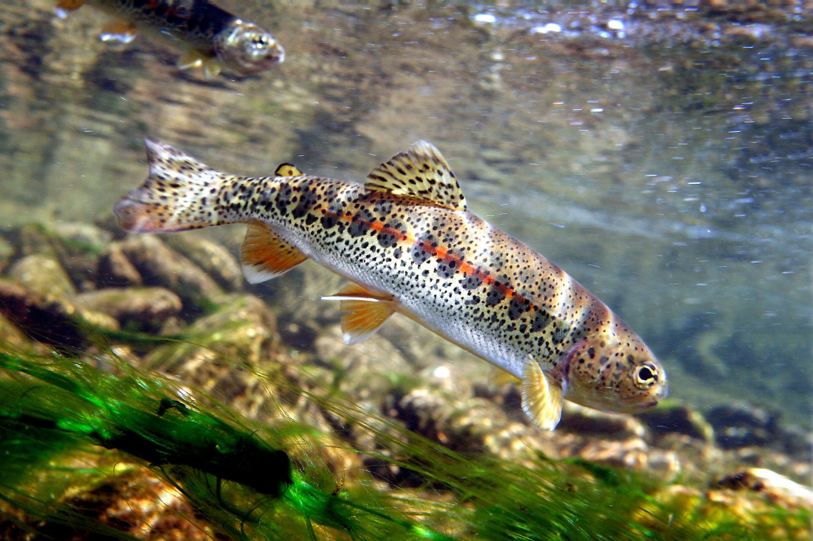
Questions?
Pat Clayton

