Slide 1
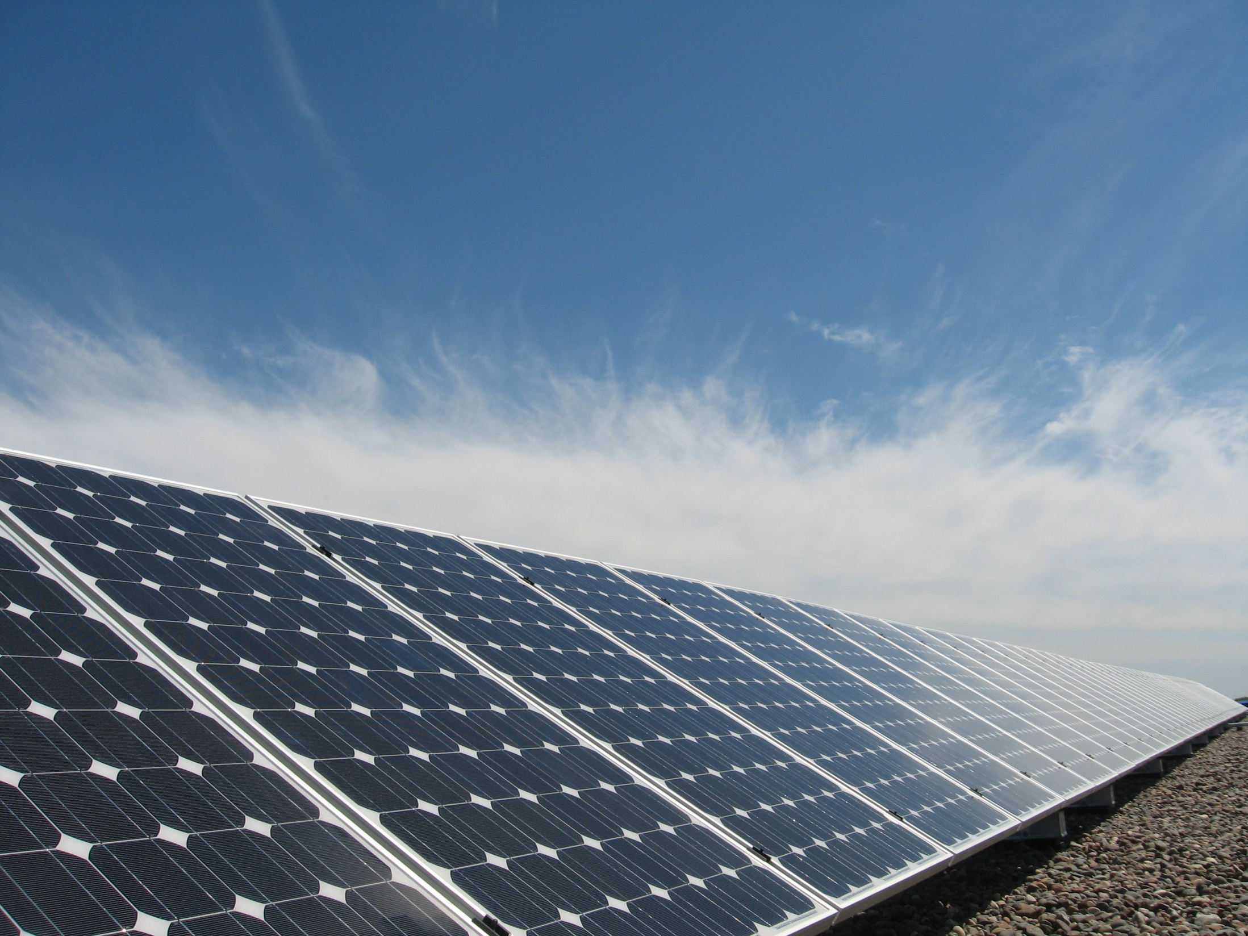

Red Lake Solar Project

Slide 2
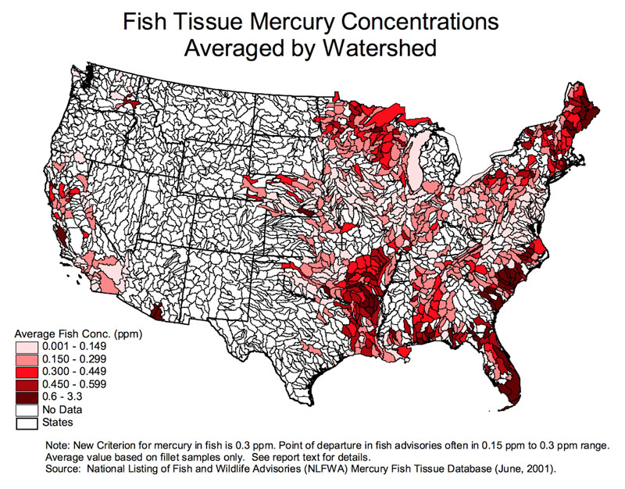

Slide 3
Goals of Phase One
Install solar at main buildings of Red Lake
Reduce dependence on coal
Reduce long-term operating expenses
Familiarize the community with solar:
  Explore business opportunities
  Training and job creation

Slide 4
Questions to be answered
Can we work with local utilities?
How much energy do buildings use?
What can solar deliver at buildings?
→ Do a feasibility study

Slide 5
Feasibility Study
1. What are utility requirements?
2. Are building roofs suitable?
  Review 12 months of billing history
  Google Earth array layouts
  Engineering review of roof structure
3. Financing considerations

Slide 6
What did We Find Out?
1. The electric coop cannot take solar power back into their system!
  →Antiquated net-metering tariffs
  →Too much unused capacity during daytime
2. All solar power must stay at buildings
  →Must be used behind the meter
  →Requires large-scale energy storage

Slide 7
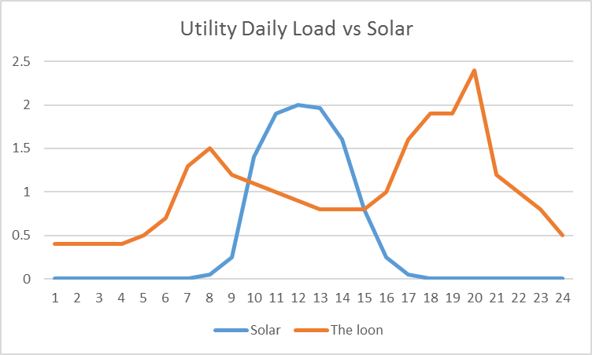
Solar
Evening Peak
Morning Peak

Slide 8
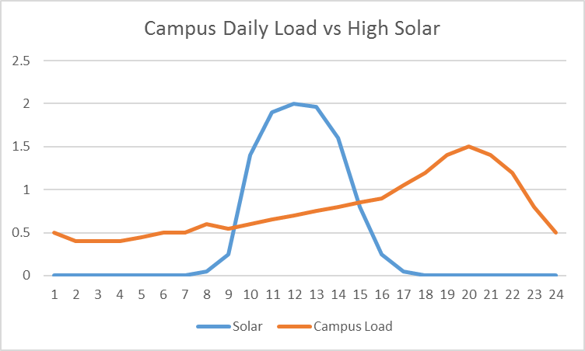

Slide 9
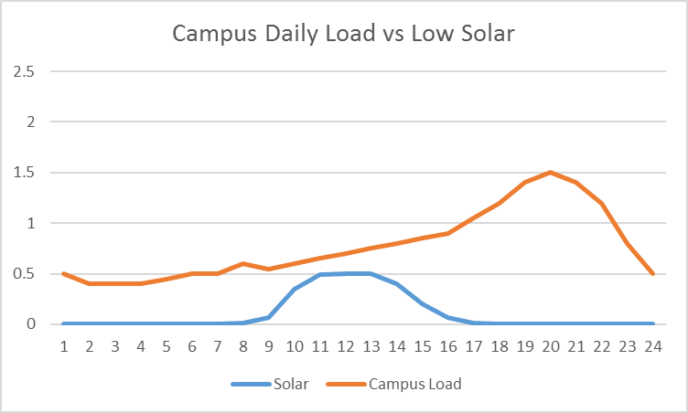

Slide 10
Peak Demand
Storage
Use immediately

Slide 13
Two Stages of Phase One
1. Rooftop solar power systems
  → Government Center in 2018
  → Tribal College in 2018/2019
2. Casino & Hotel Campuses
  → Must all be used behind the meter
  → Huge opportunity for solar + storage
  → Among the largest storage in Minnesota

Slide 14
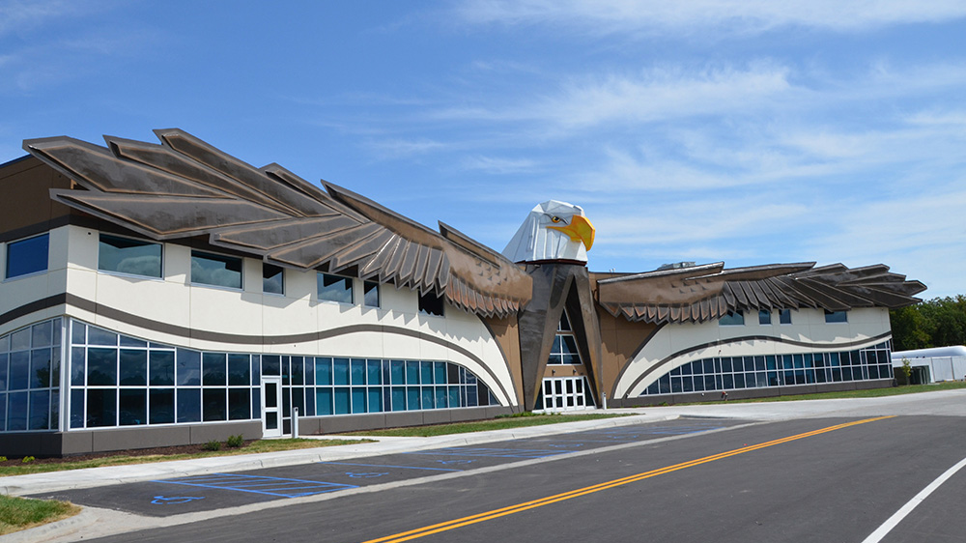
Red Lake Government Center

Slide 15
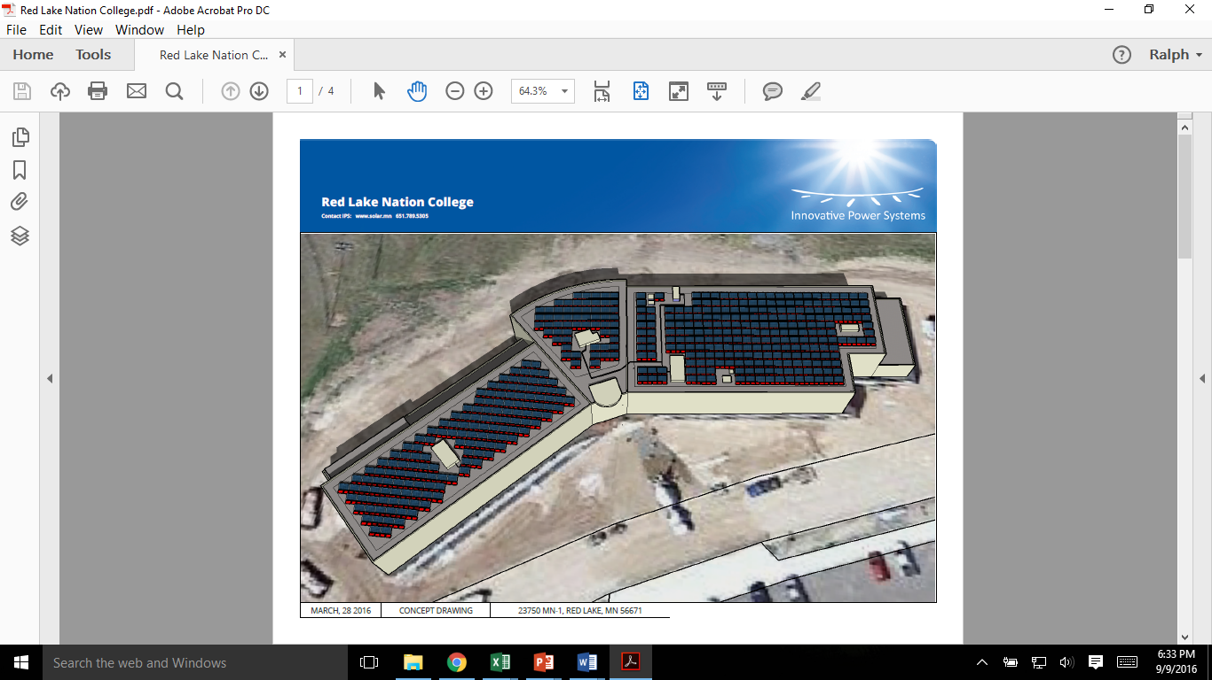

Slide 16
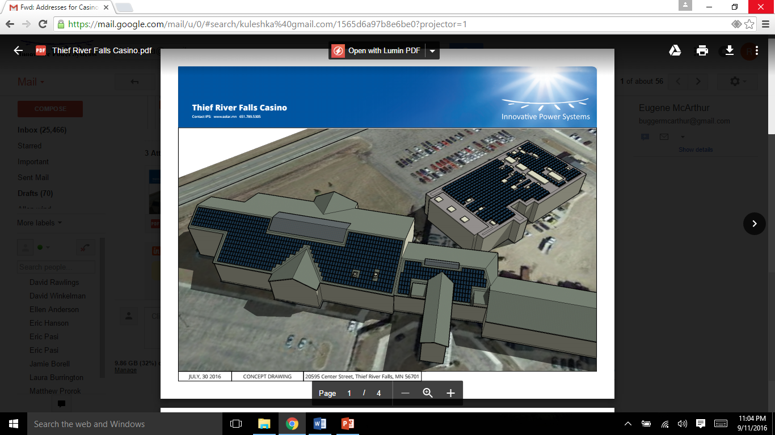

Slide 17
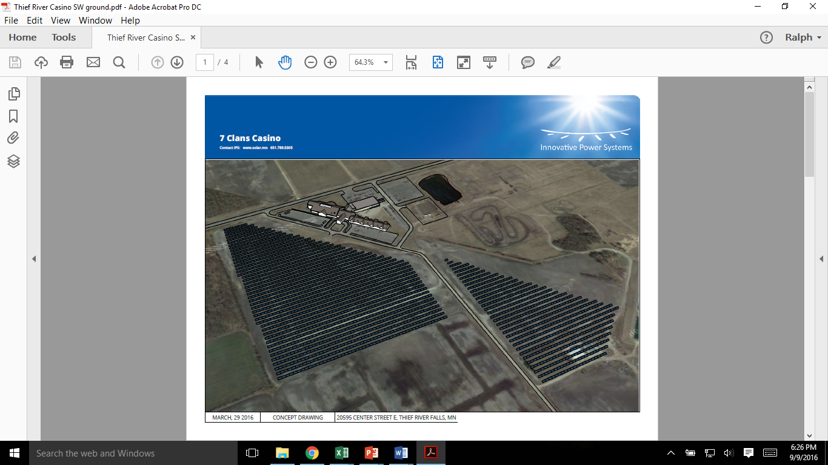

Slide 18
Red Lake Nation Solar Project |  | Stage 1 2018 | Stage 2 2019 | Stage 3 2020
Red Lake Government Center |  | Roof Top
 |  | No Storage
Red Lake Tribal College |  | Roof Top
 |  | Storage
Red Lake Casino & Hotel |  |  | Roof Top | Ground Mount
 |  |  | Storage
Warroad Casino & Hotel |  |  | Roof Top
 |  |  | Storage
Thief River Falls Casino & Hotel |  |  | Roof Top | Ground Mount
 |  |  | Storage
Ponema K – 8 School |  |  | Roof Top
 |  |  | Storage
Red Lake Early Childhood |  |  | Roof Top
 |  |  | Storage
Red Lake Elementary |  |  | Roof top
 |  |  | Storage
Criminal Justice Complex |  |  | Roof Top | Ground Mount
 |  |  | Storage
Red Lake Middle & High Schools |  |  | Roof Top | Ground Mount
 |  |  | Storage
Central PV System |  |  | Solar Farm | Solar Farm

Slide 19
Finance Model
Must pass Federal tax benefits through to Red Lake
Crowdfunding encourages local investment
→ better terms than banks give for savings accounts!
Flips ownership to Red Lake at 7th year
Must finance ‘energy storage’ also

Slide 20
Prototype for Government Center
Funding of $130,000 for 67 kilowatts on roof
$20,000 of tax equity investment
→ $110,000 in personal loans paid back with tax credits
→ Investor can claim all $130,000 for tax purposes
→ Plus sale of PV system to Red Lake at year 7

Slide 21
Contact Info
Robert Blake
Robert@solarbear.earth
Ralph Jacobson
ralphj@ips-solar.com

