Slide 1
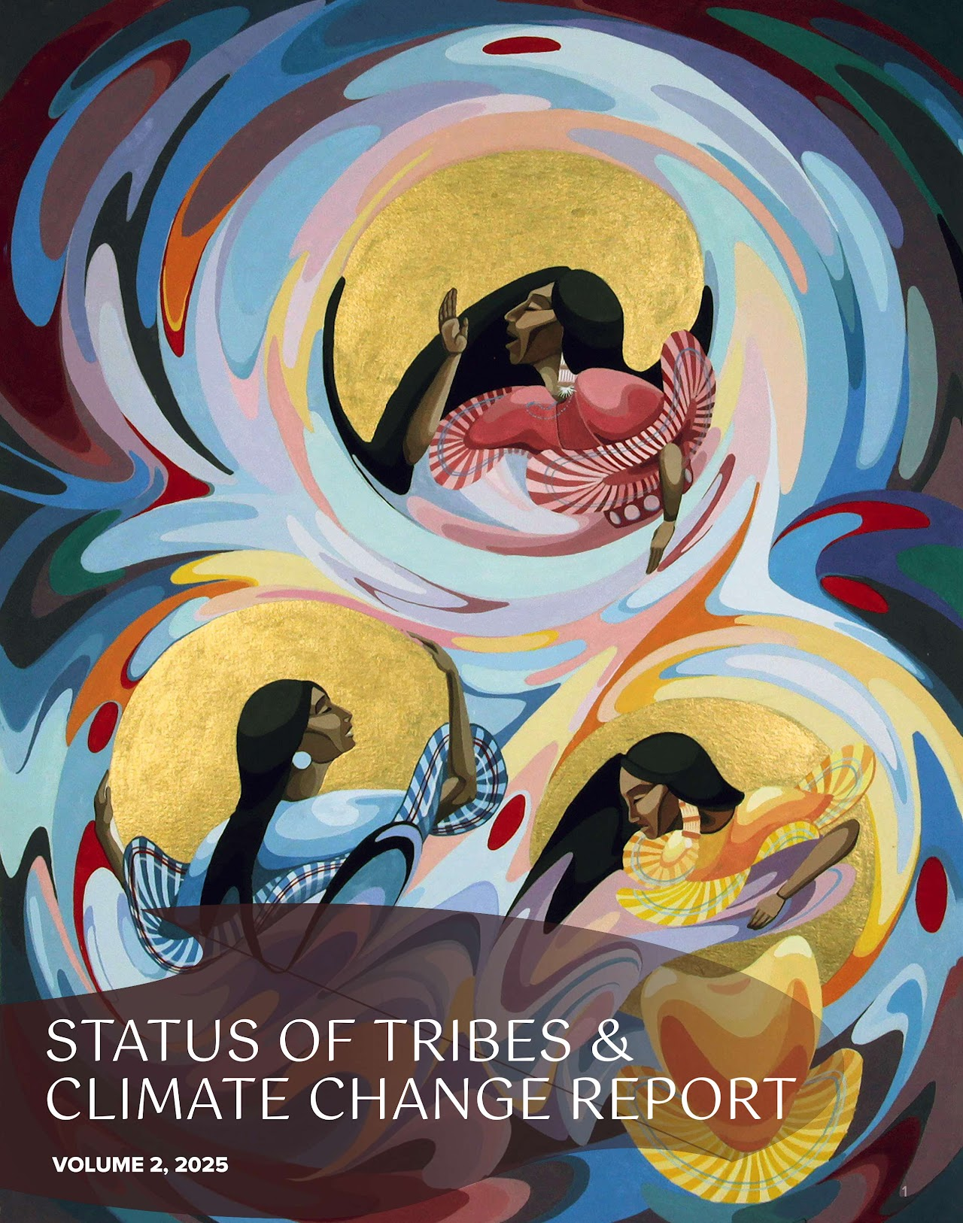

Slide 2
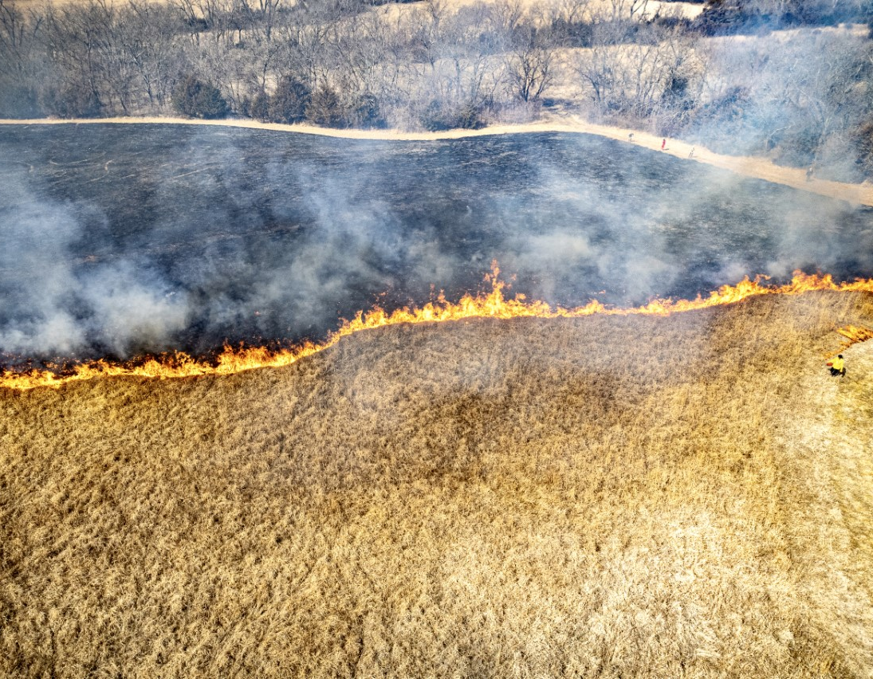
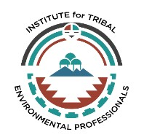
STACC V2 WEBINAR SERIES GOOD FIRE CHAPTER

Slide 3
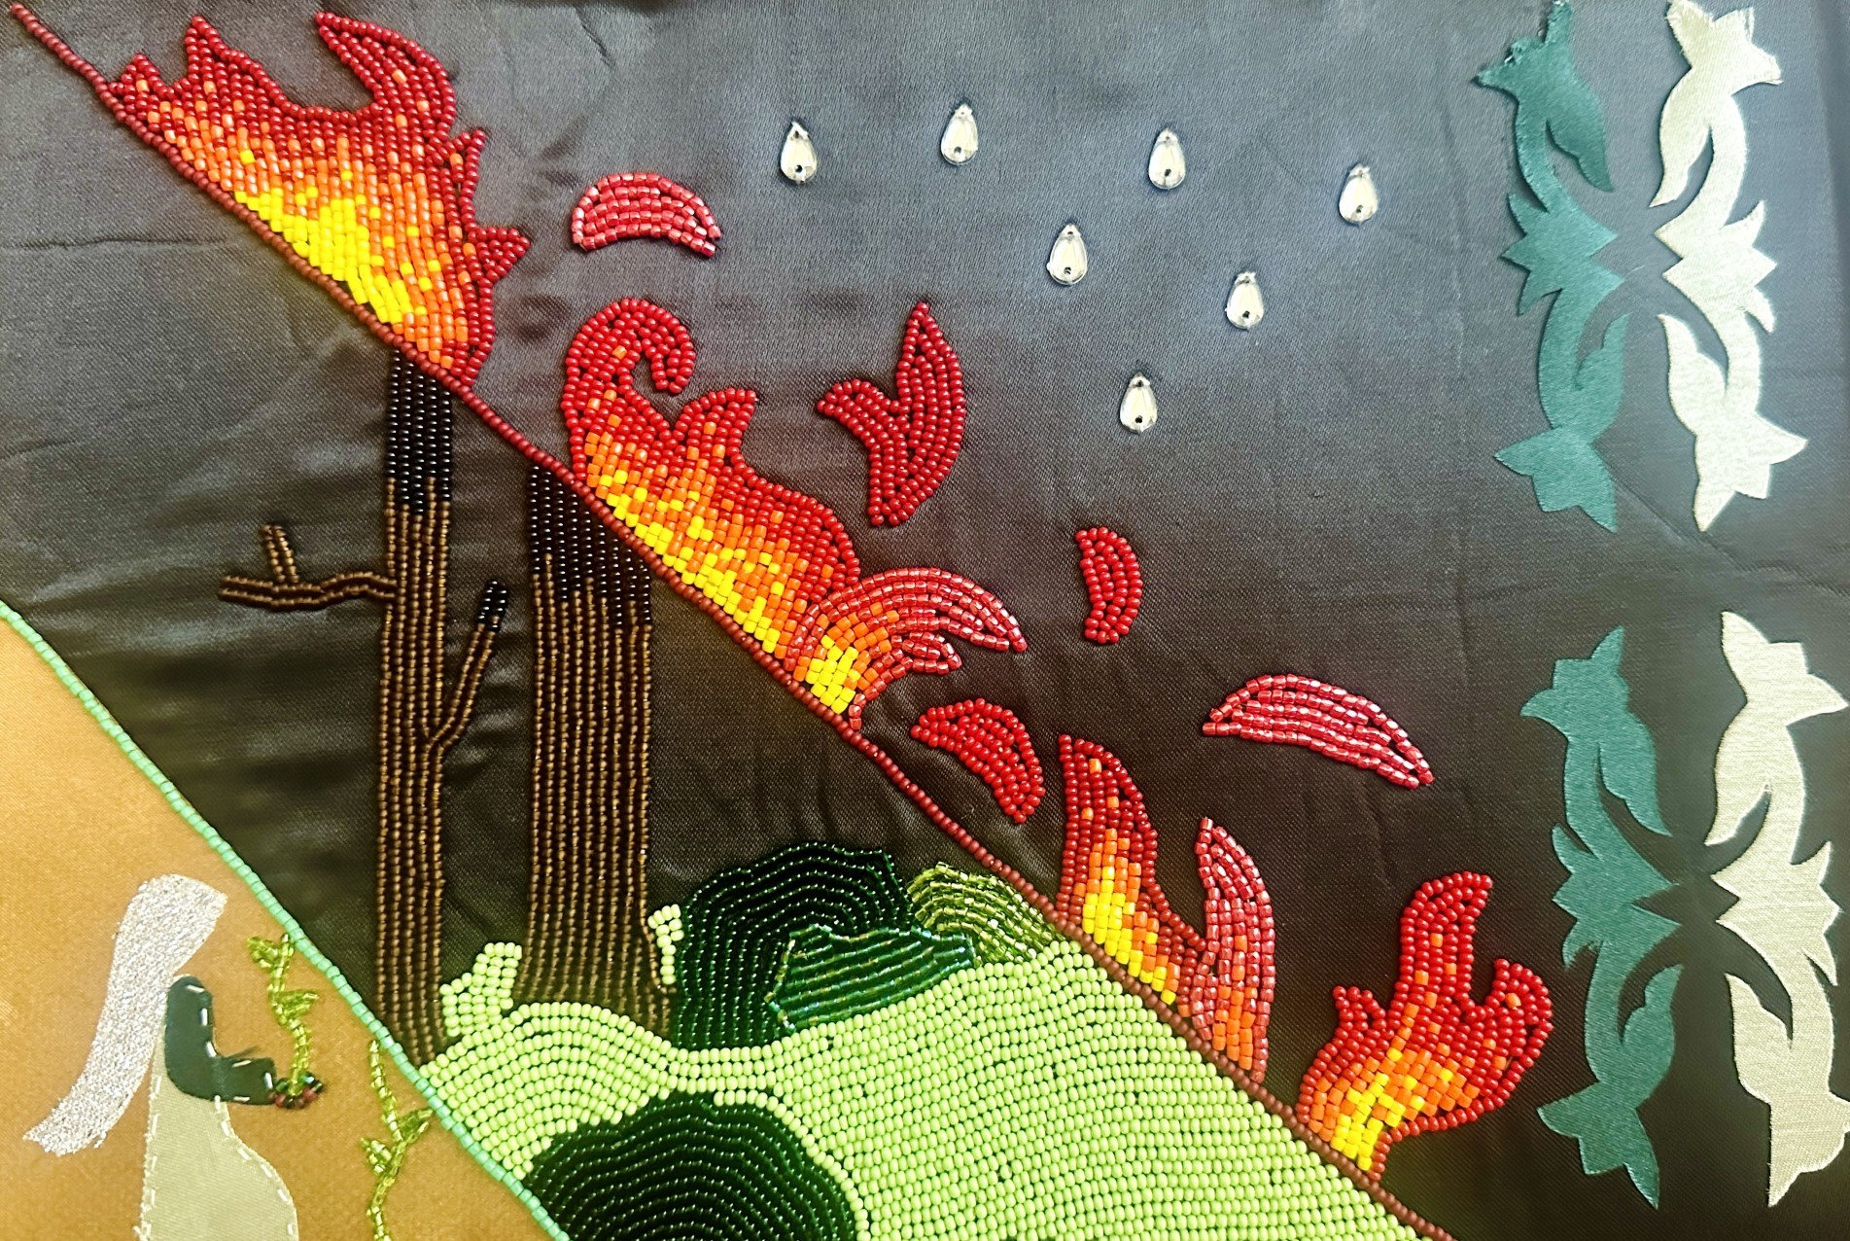
MELINDA M. ADAMS, PH.D.
Introduction of our panelists
Topics, case studies, and community
What we hope the report will do
“Cultural Fire Sovereignty” by Celina Hall
(Ho Chunk and Narragansett), Spencer Fellow, Environmental Studies, University of Kansas.
Notes:
scholarmelinda.com
https://geog.ku.edu/people/melinda-adams
https://cachecreekconservancy.org/tending-gathering-garden/
https://northforkrancheria-nsn.gov/
https://www.firegencollab.org/
https://www.culturalfire.org/
https://www.tribalecorestoration.org/
https://fireecology.org/cultural-fire
https://www.fness.bc.ca/
https://www.ilinationhood.ca/fire-stewardship
https://firesticks.org.au/

Slide 4
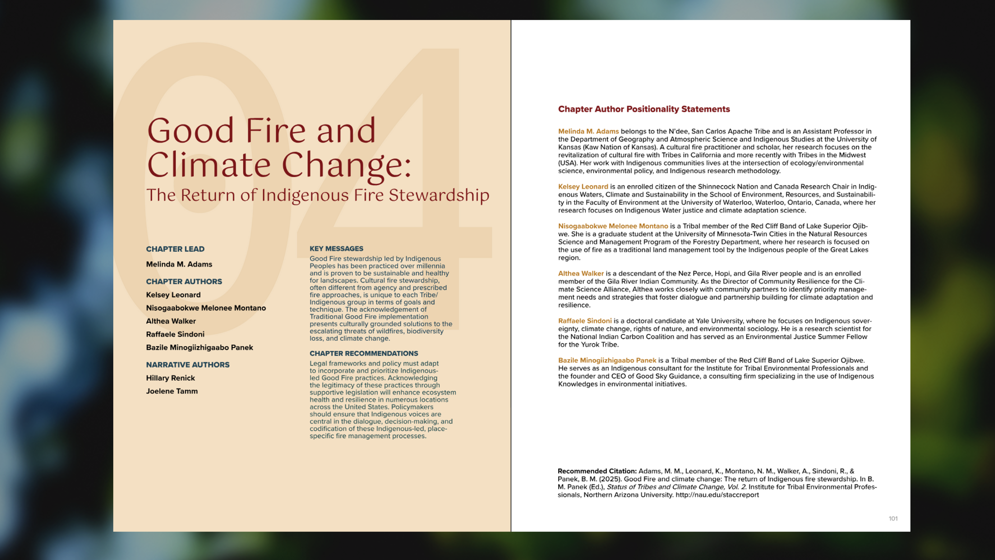

Slide 5
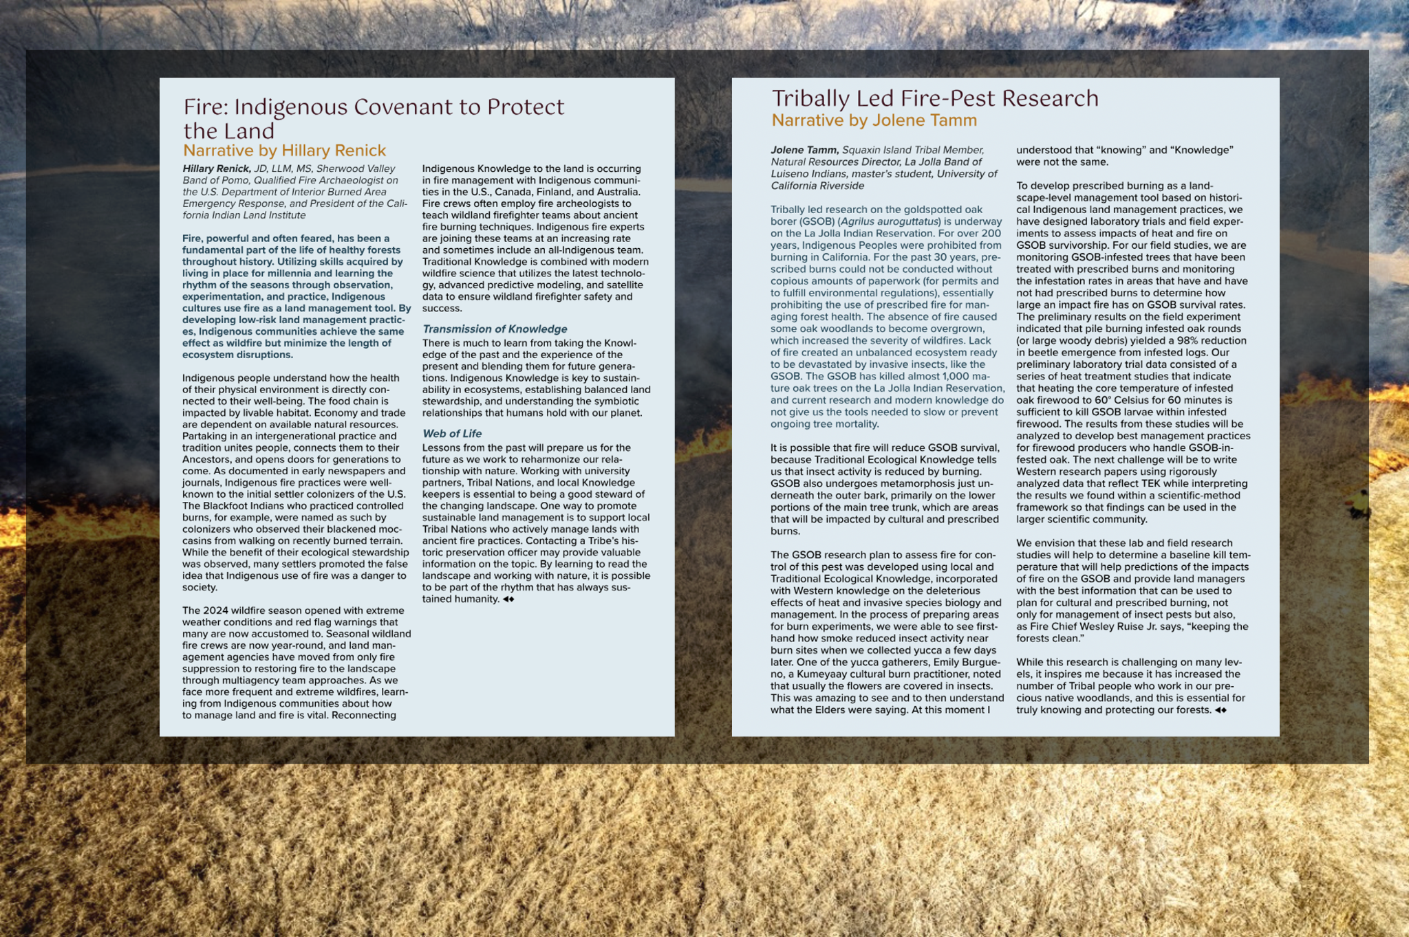

Slide 6
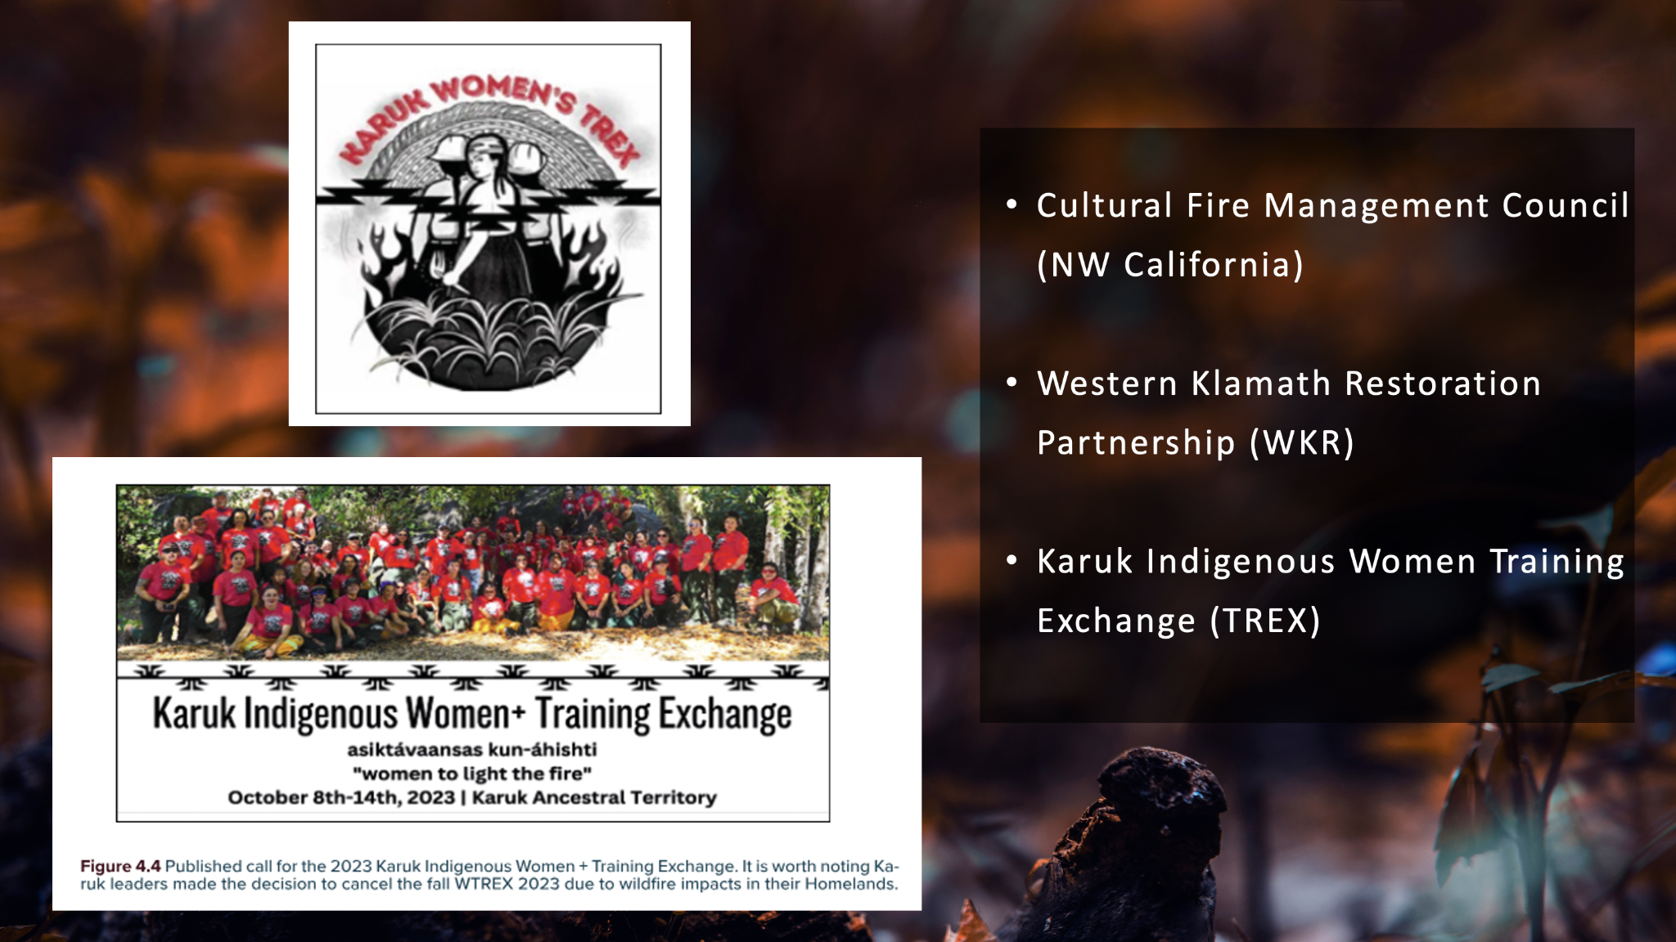

Slide 7
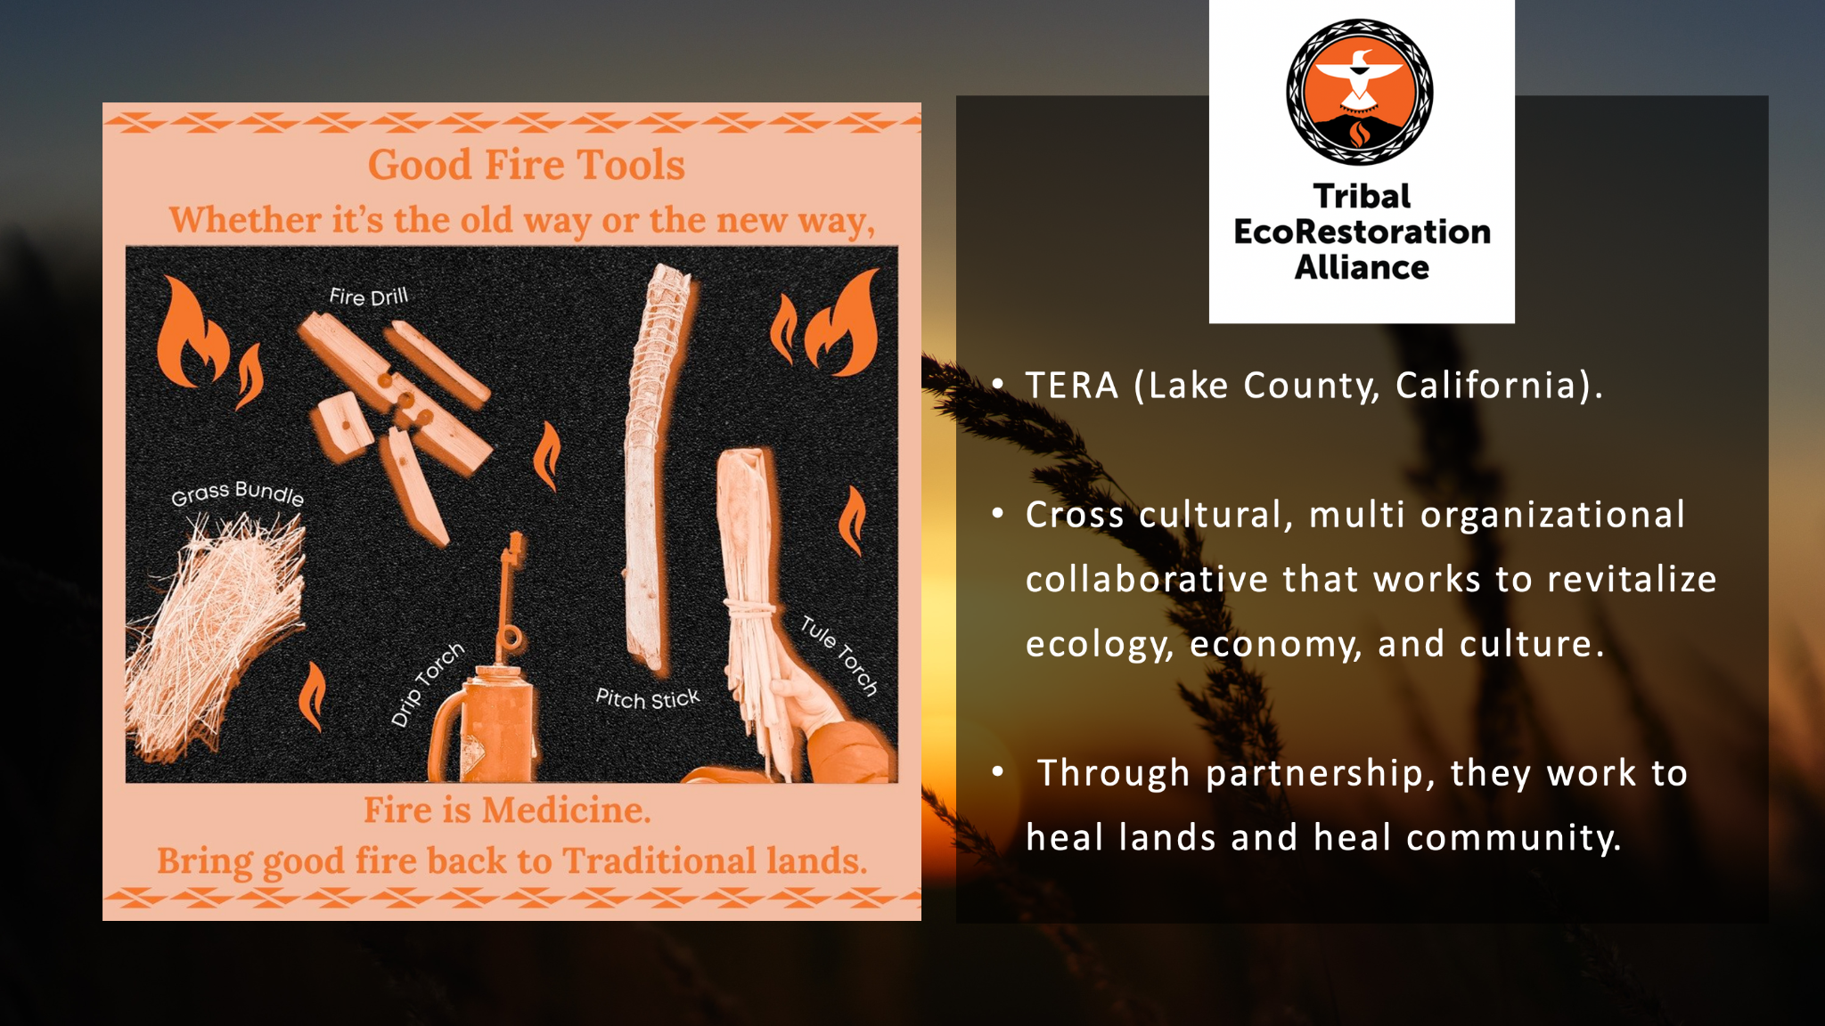

Slide 8
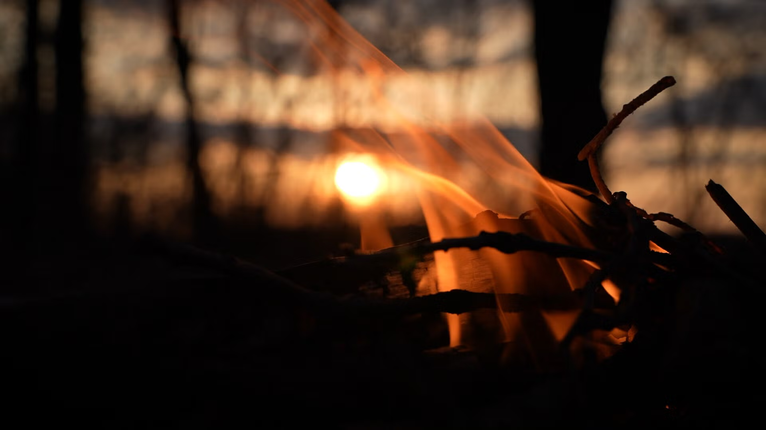
BAZILE MINOGIIZHIGAABO PANEK
STACC Process
Great Lakes Region
Fire as a more than human relative

Slide 9
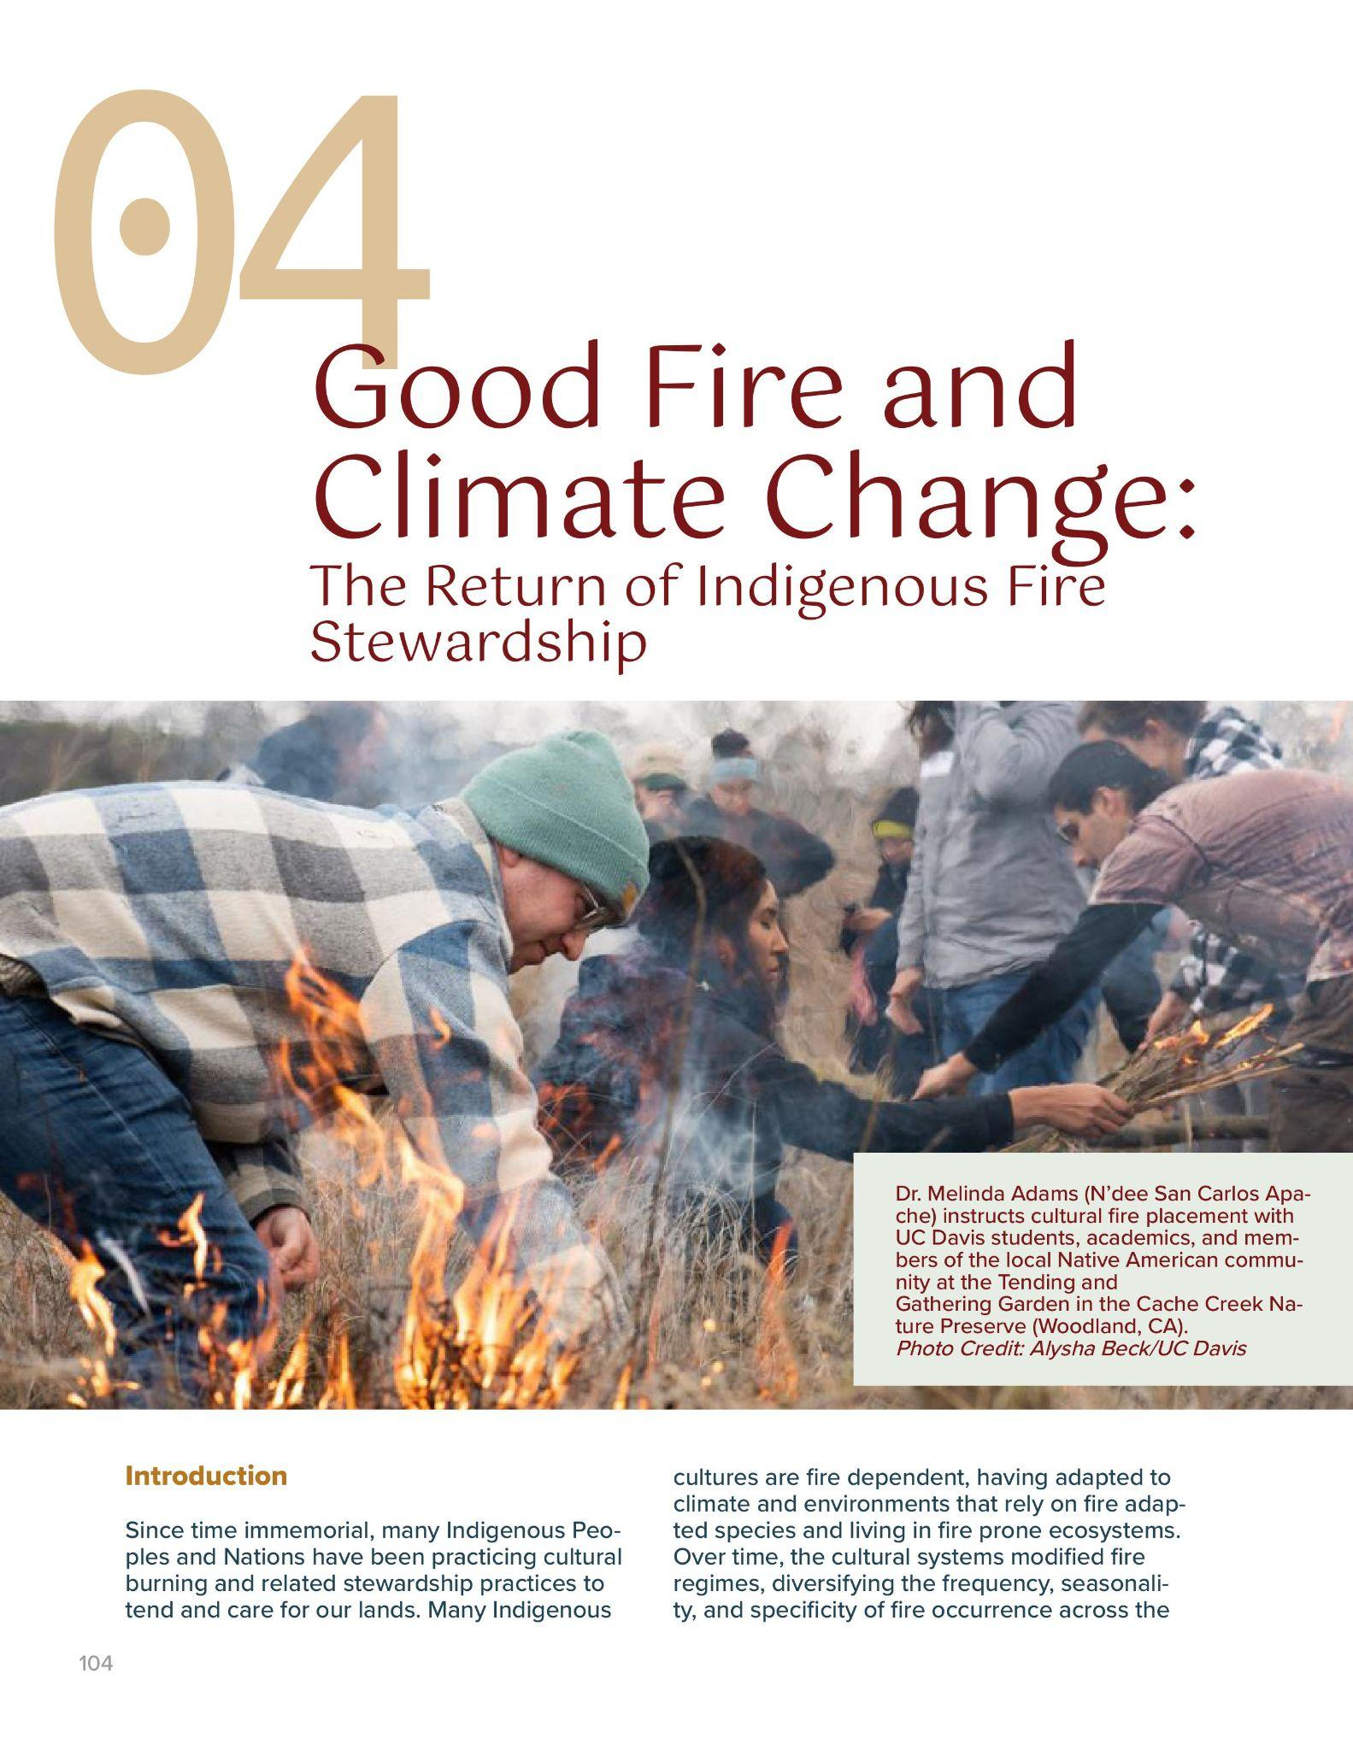
Good Fire Chapter
Six authors representing N’dee, San Carlos Apache Tribe, Shinnecock Nation, Red Cliff Band of Lake Superior Chippewa, Nez Perce, Hopi, and Gila River, and non-native identity
Diverse geographies
“Fire suppression is cultural suppression.” —Althea Walker, Nez Perce/Hopi/Gila River
Notes:
Representation, diverse geographies all contributing to the return of fire across the nation. Fire suppression is cultural suppression. Uplifting fire means uplifting culture.

Slide 10
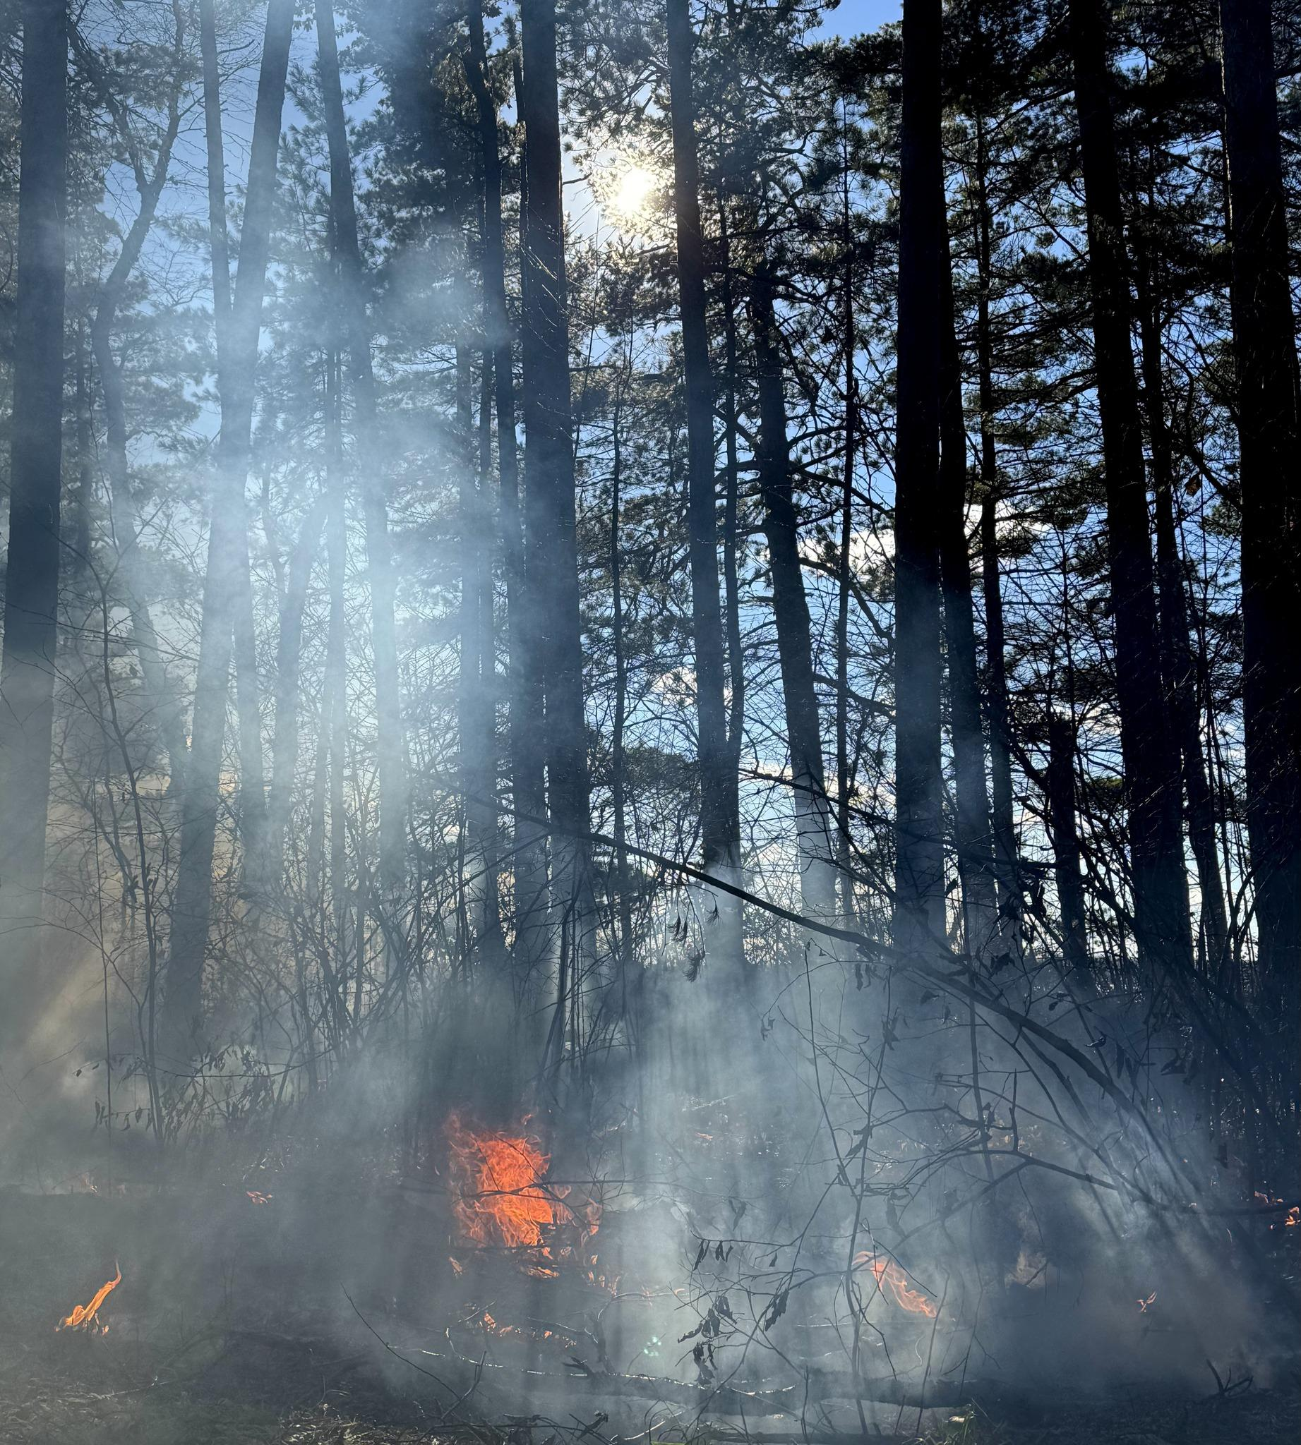
Wisconsin Point
Superior, Wisconsin
22 acre burn on November 5
First light was conducted with a pitch stick by an elder
Oral knowledge and dendrochronology demonstrated that the last fire was in 1866
Oshkigin: New growth
Photo credit: Great Lakes Indian Fish & Wildlife Commission
Notes:
New growth, fire is a spirit that has the power to foster new growth

Slide 11
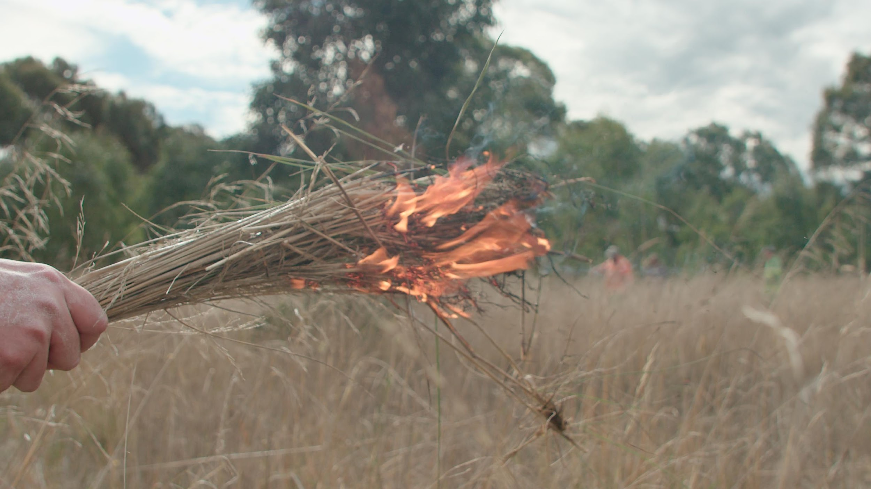
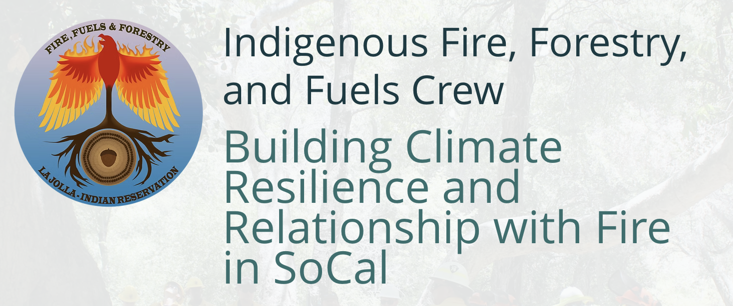
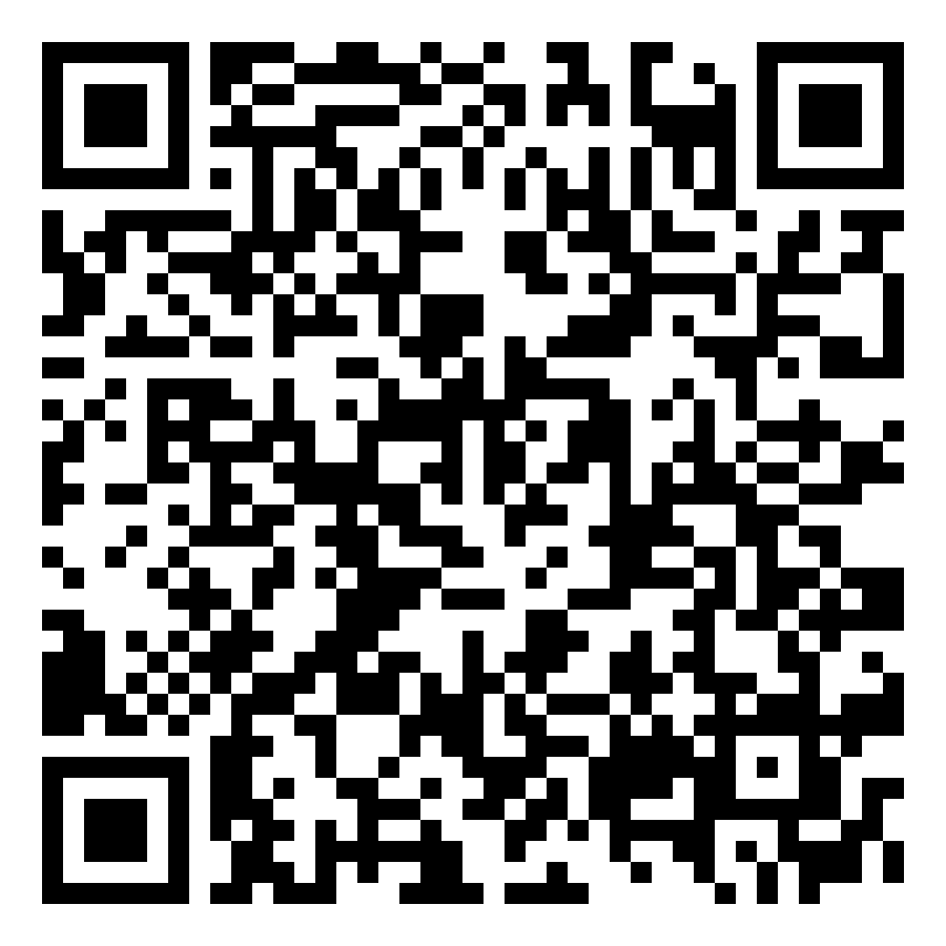

ALTHEA WALKER
Brief Overview of the Climate Science Alliance
Power in Bringing People Together
Tribal Working Group
SoCal Interagency Fire & Fuels Cadre
Stewardship Pathways Program - Economic & Workforce Development
Giving Program
Subscribe to our newsletter!
www.climatesciencealliance.org
Notes:
SP - getting people on the land, strengthening relationships with the one another, the land, plant & animal relatives

Slide 12
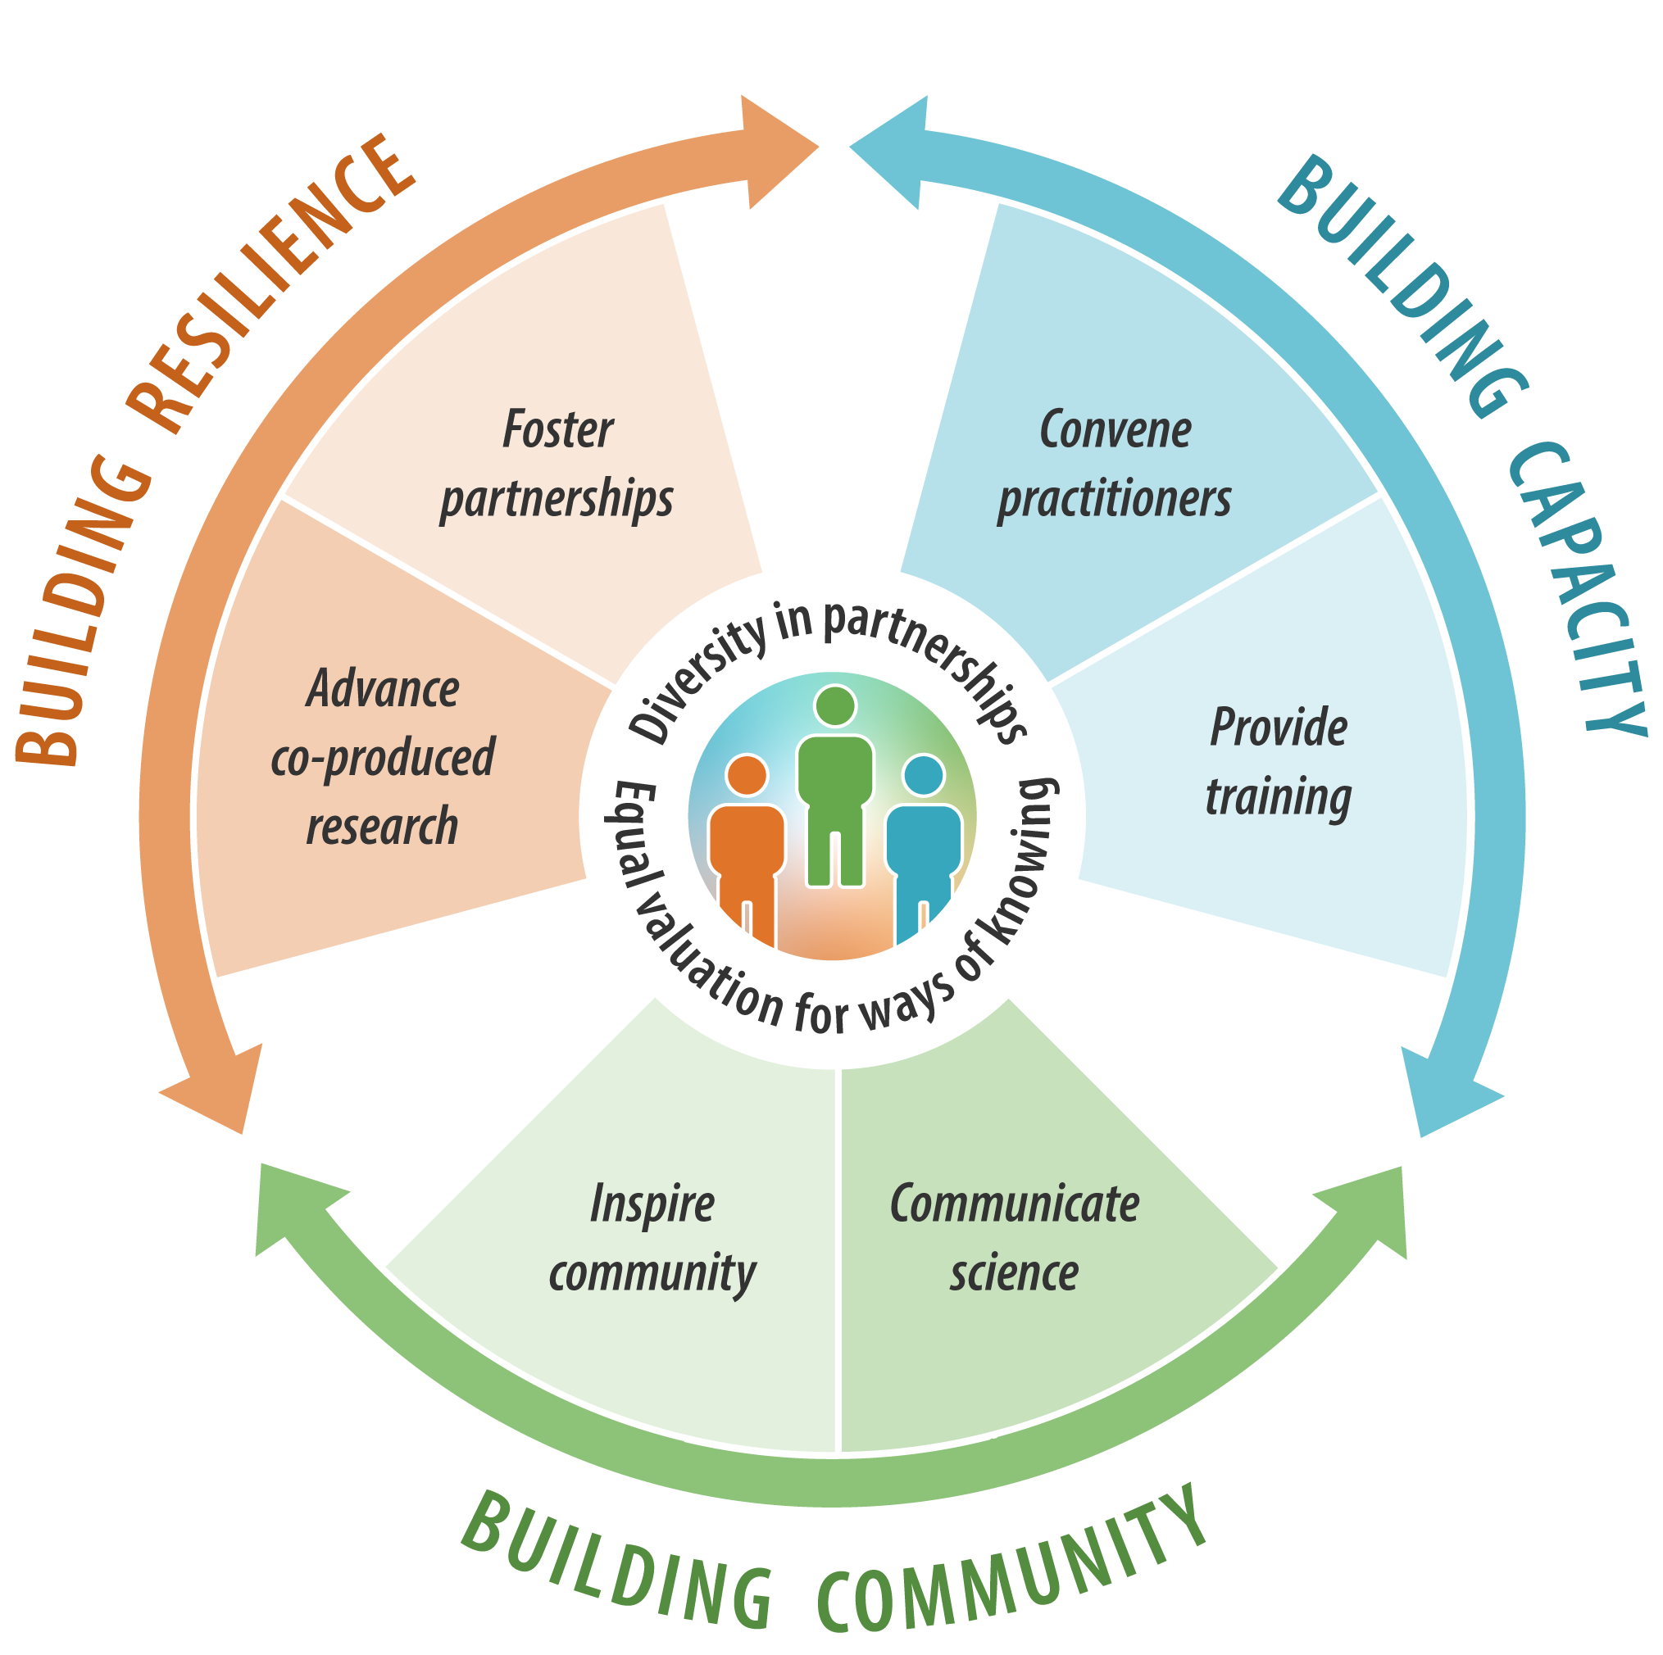
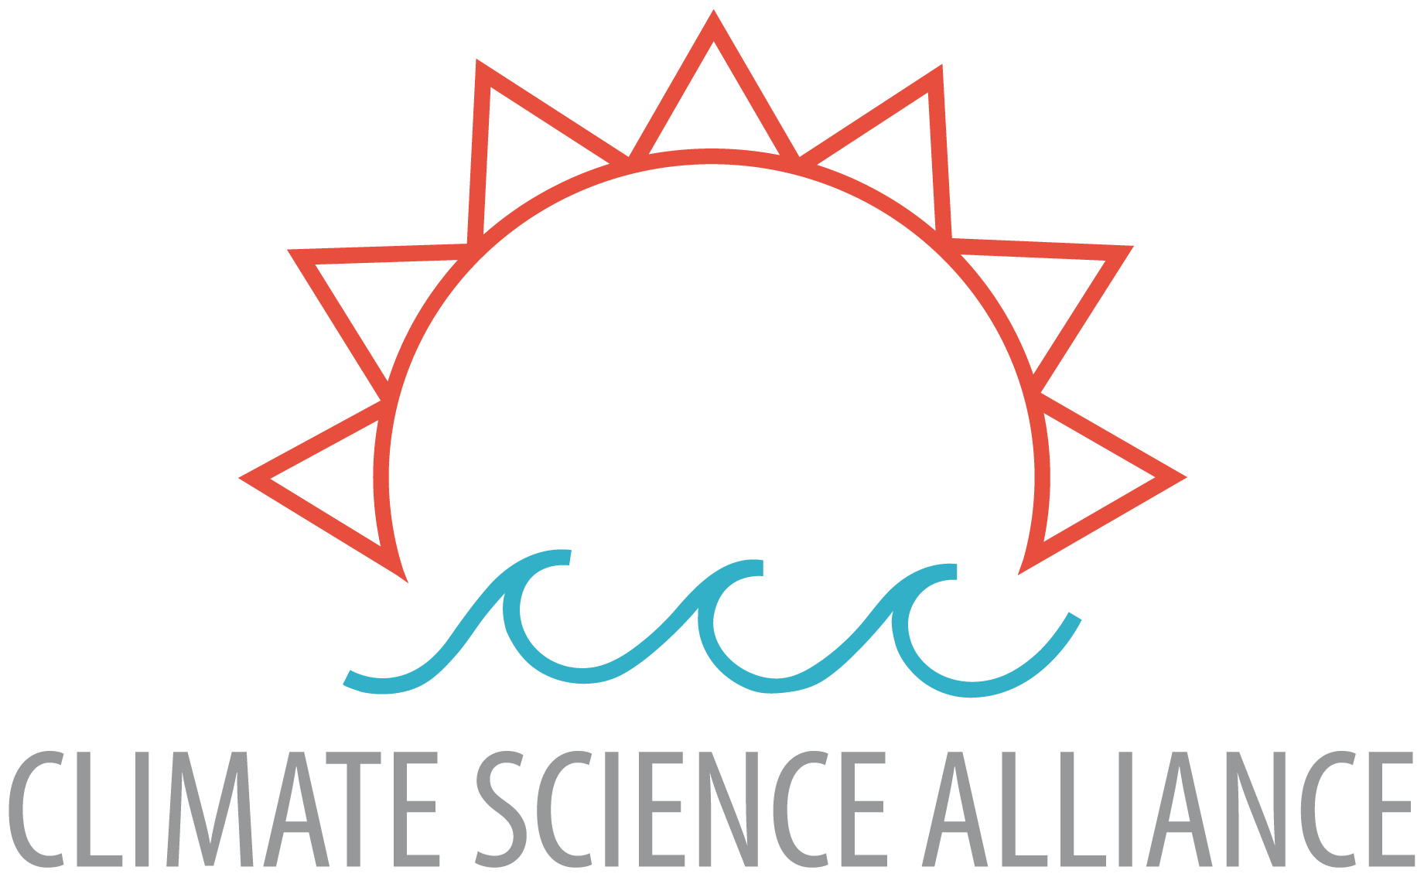
Our Model
Subscribe to our newsletter!
www.climatesciencealliance.org
www.climatesciencealliance.org
Notes:
IN the report - we share our work as a partnership model and framework in getting fire back on the land
Non profit organization; Kumeyaay lands
Founded in 2015; celebrating our 10 year anniversary
Working closely with community partners, Tribal partners to advance community led climate adaptation
in our focus on building resilience, capacity, and community - we center ourselves in relationships and the power in bringing people together
Relationship with ourselves, one another, the land, plant and animal relatives - to build up strong support systems to advance community led climate adaptation

Slide 13
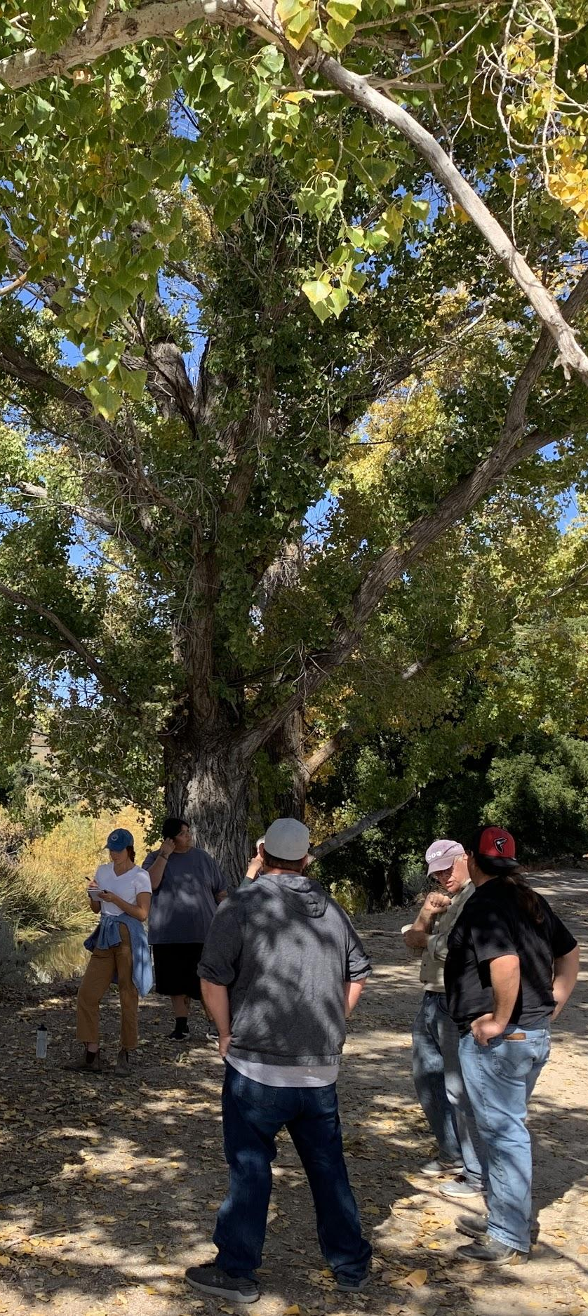
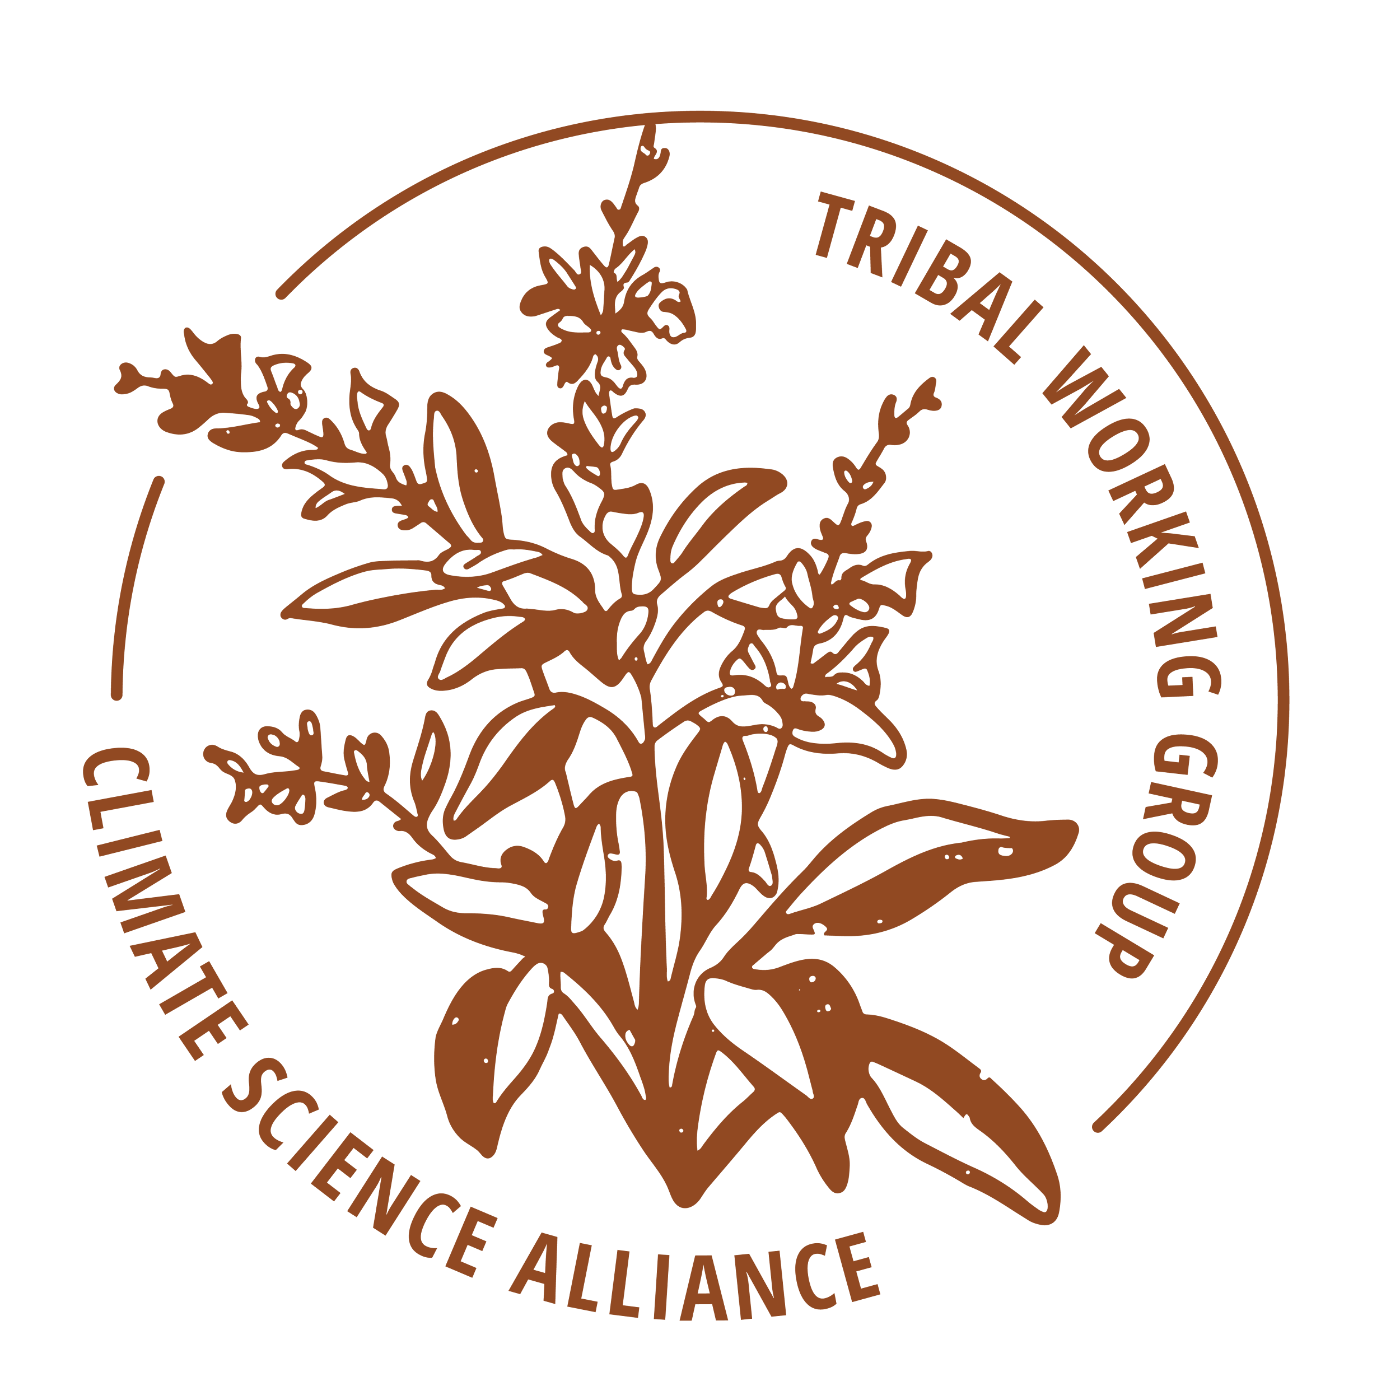
Power in Bringing People Together
Tribal Working Group
Southern California Interagency Fire & Fuels Cadre
Stewardship Pathways Program
Giving Program
Subscribe to our newsletter!
www.climatesciencealliance.org
Notes:
How we bring people together - is so significant to building relationship with ourselves, with one another, with plant & animal relatives
Convene a TWG established in 2017; allowed the network to align priorities/needs and have inspired what our efforts and intentions look like today
Cadre established shortly after at the request of La Jolla Tribal Fire Chief and Chairman Wesley Ruise Jr. -
-A powerful and supportive informal collective of Tribal knowledge holders, fire practitioners, fire researchers, and other allies/accomplices to get fire back on the land
-an informal Prescribed Burn Association
-share resources/reduce barriers to getting fire back on the land
-who needs to burn, who needs training, who is looking for partnerships for funding opportunities (talk all things needed to put fire on the land)

Slide 14

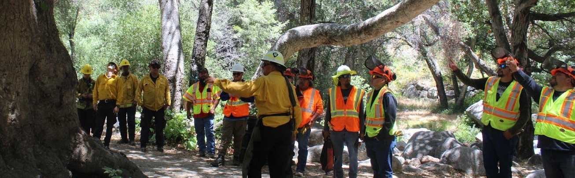
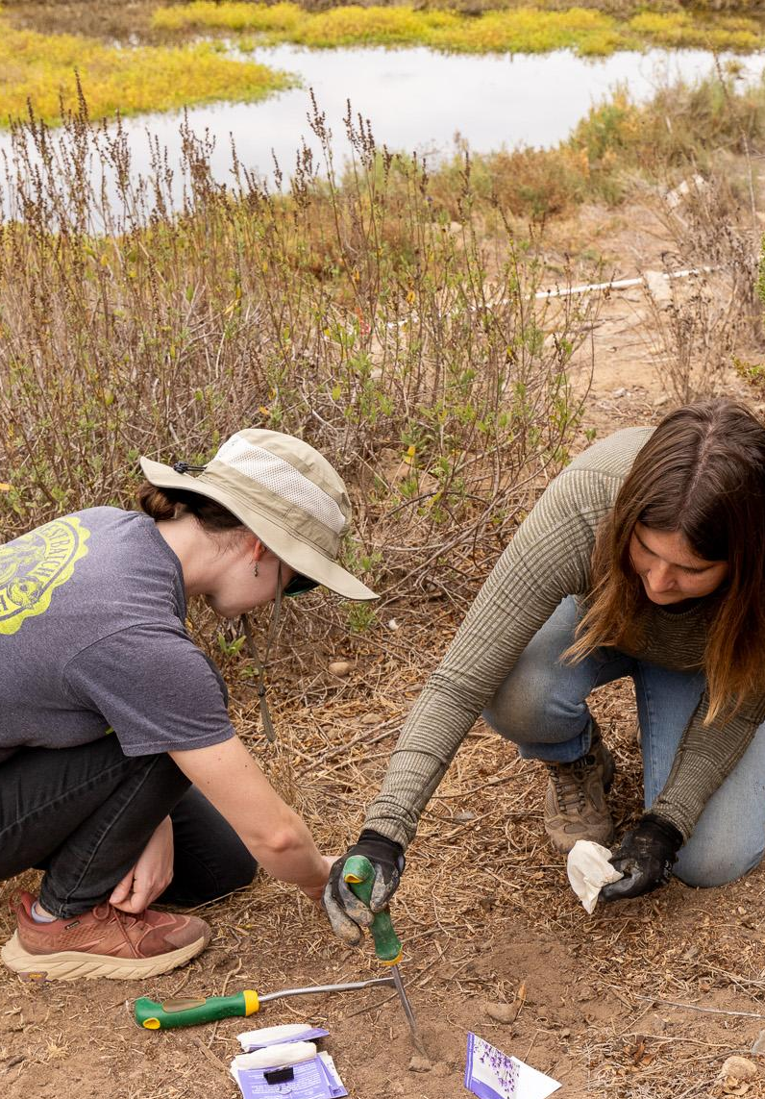
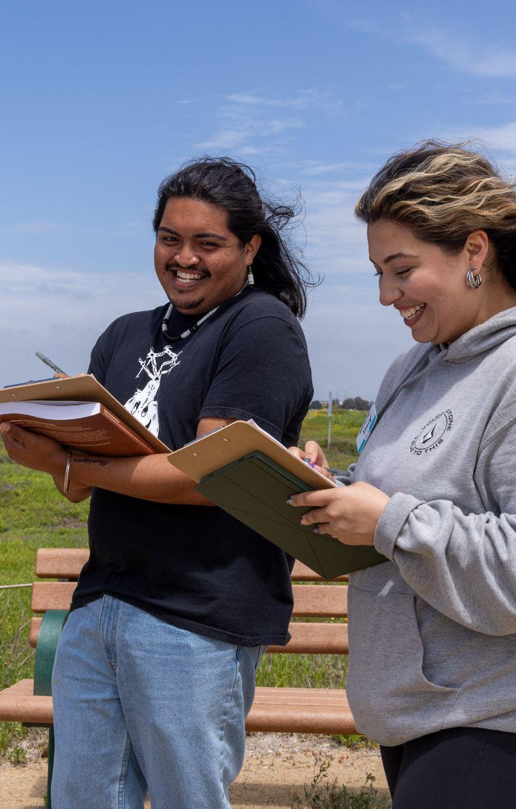
Workforce development and training
Fire Stewardship
The Stewardship Pathways program is rooted in the equal valuation of ways of knowing with an emphasis on the integration of western and Indigenous science. The intent of the program is to build capacity, support economic and workforce development, and advance co-stewardship of all ancestral lands through various training pathways.
Learn more:
www.climatesciencealliance.org/ stewardship-pathways
Native Plant Restoration
Technical Training & Tools
Subscribe to our newsletter!
www.climatesciencealliance.org
Notes:
Stewardship Pathways - TWG & Cadre feed into; Indigenous Fire Stewardship Pathway
-supports and sustains multiple Tribal fire & fuels crews; provide economic and workforce development opportunities, overall continued opportunity to get out on the land together/learn from one another

Slide 15
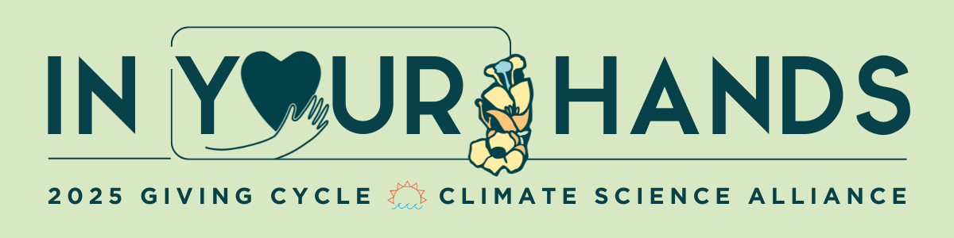
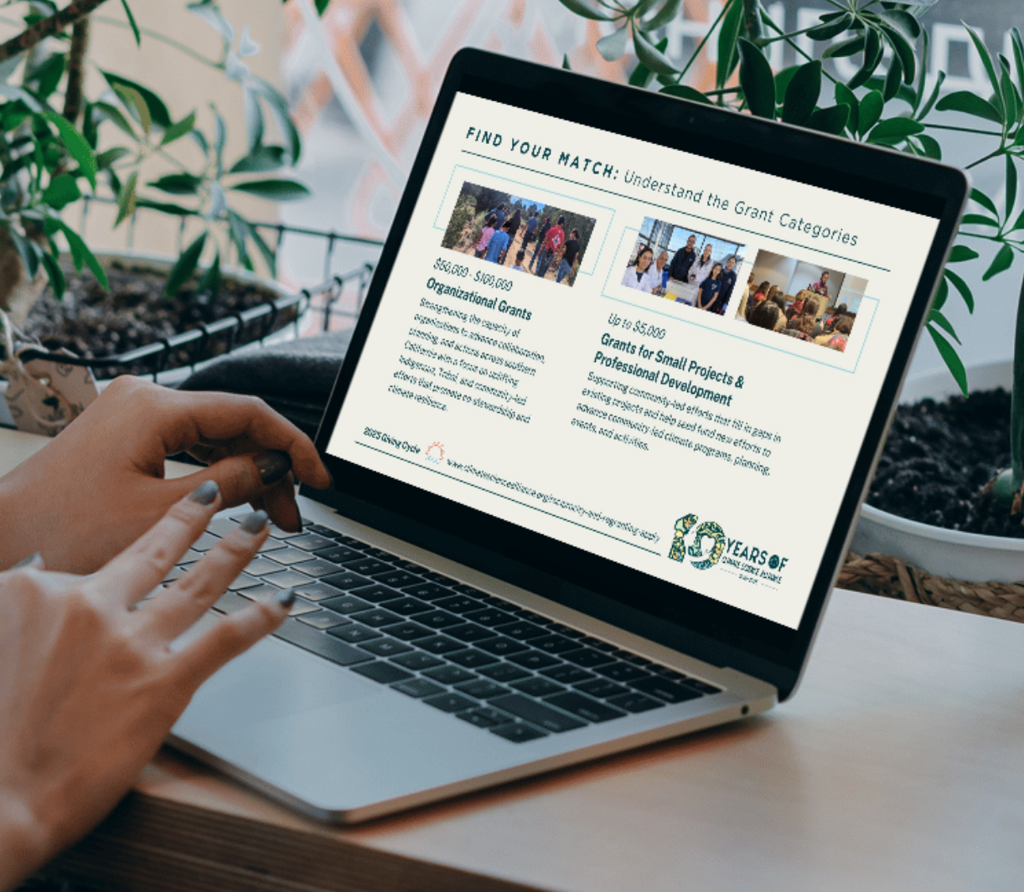
Regranting
Through our Reciprocity & Regranting Program, we will directly invest in Tribal Nations and Tribal Serving Organizations to increase their capacity and support their involvement in advancing fire preparedness.
Re-granting process has been created and deployed utilizing robust framework for soliciting applications, reviewing and ranking to determine best fit for available funding.
Contracts in place with 50% of funds upfront, followed by 2nd and final payment in June.
Final reports September-October from participants.
Total ask of $1.3 million—awarded 300K to 5 proposals
Subscribe to our newsletter!
www.climatesciencealliance.org
Notes:
Giving Program - funding community led climate adaptation like La Jolla’s GSOB work shared in the chapter; multiple examples of fire work we’ve been able to fund over the last few years and will continue to invest in

Slide 16
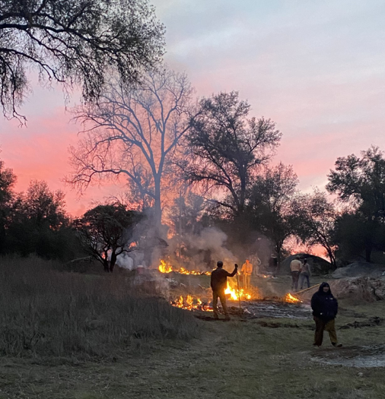
Question for our panelists:
In your experience, how does cultural fire differ from western fire management and why is this important?

Slide 17
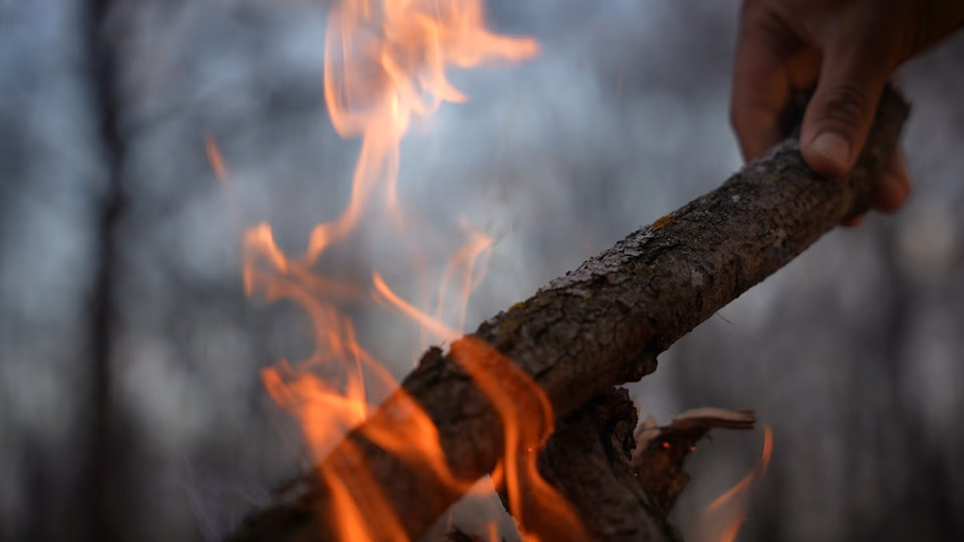
Question for our panelists:
What are the biggest barriers preventing the revitalization of cultural burning and what changes would make the greatest difference?

Slide 18
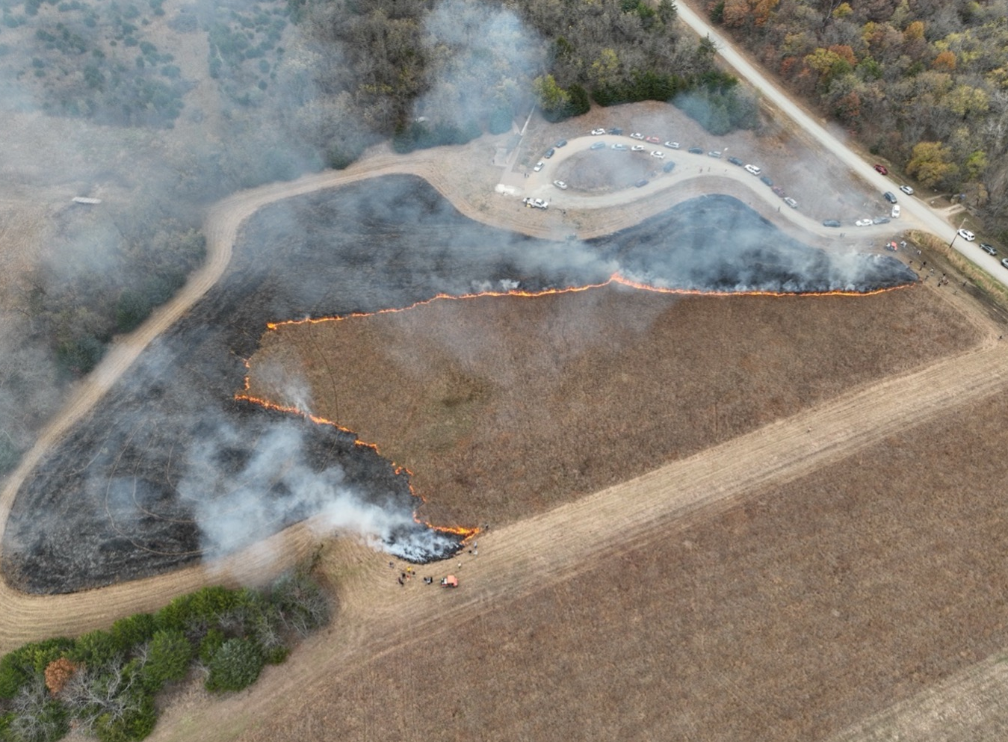
Question for our panelists:
In what ways is climate change altering cultural fire and how might fire practices adapt or lead adaptation?

Slide 19
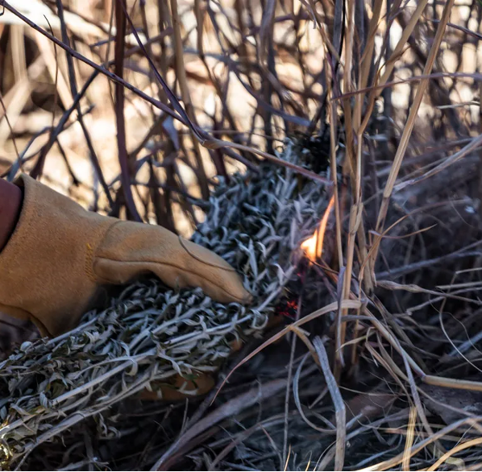
Last questions for our panelists:
What do you hope to see for the future of cultural fire return?
What is one action or something you’d like for our participants to take away?

Slide 20
THANK YOU
Institute for Tribal Environmental Professionals
https://itep.nau.edu
www.nau.edu/staccreport

Slide 21
