Slide 1
Tribal Workforce Development:
A New Decision-Framing Toolkit for Tribal
Leaders and Workforce Developers (Version 2.0)

Slide 2
Tribal Workforce Development: A New Decision-Framing Toolkit
for Tribal Leaders and Workforce Developers
Overview
What is the NCAI Workforce Development Toolkit 2.0?
What is the purpose of the Toolkit?
Why does workforce development matter?
What is inside the Toolkit?
How should Tribal Nations use the Toolkit?
What are the key takeaways for Tribal Nations?

Slide 3
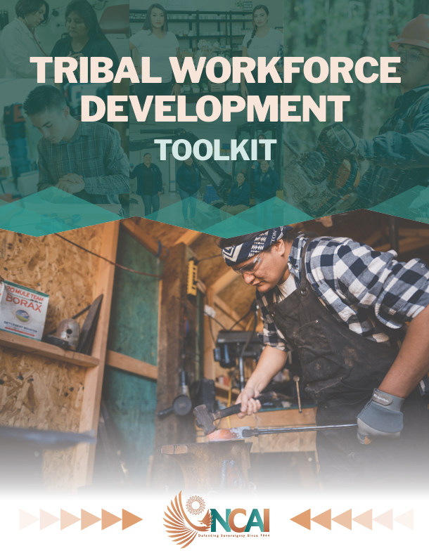

Tribal Workforce Development: A New Decision-Framing Toolkit
for Tribal Leaders and Workforce Developers
Tribal Workforce Development Toolkit (Version 2.0)
https://www.ncai.org/workforcedevtoolkit

Slide 4
Tribal Workforce Development: A New Decision-Framing Toolkit
for Tribal Leaders and Workforce Developers
What is the Toolkit?
The NCAI Workforce Development Toolkit (Version 2.0) is:
A decision-framing resource for Tribal workforce development that functions as a “nation-building checklist.”
Based on multi-year research across Indian Country — built by and for Tribal Nations.
Designed for:
Tribal Leaders
Workforce Practitioners
Policymakers

Slide 5
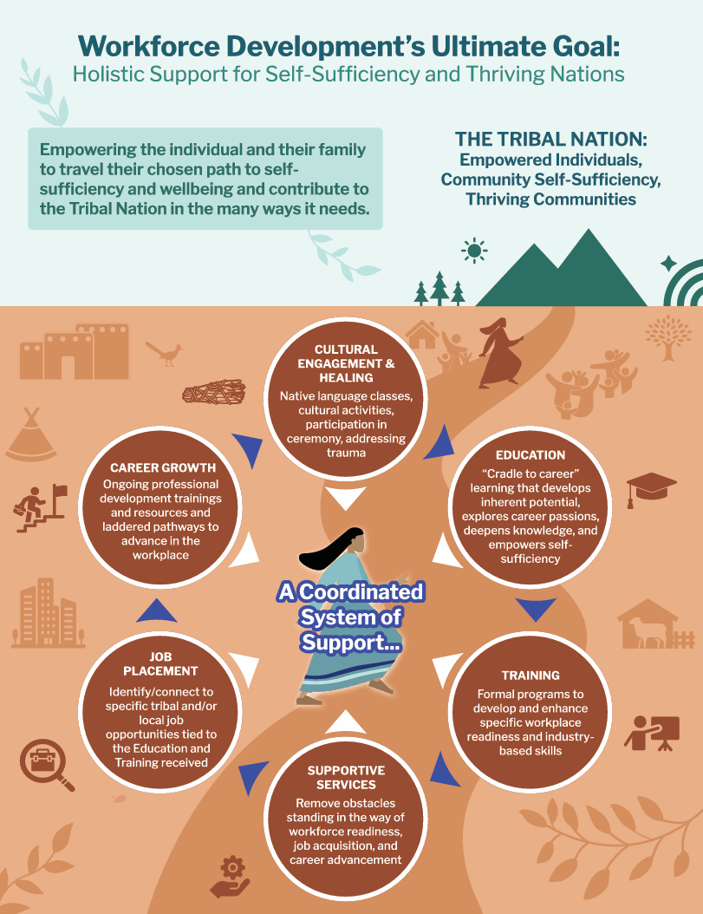
Tribal Workforce Development: A New Decision-Framing Toolkit
for Tribal Leaders and Workforce Developers
What is the Purpose?
The NCAI Workforce Development Toolkit 2.0 helps Tribal Nations:
Build sustainable career pathways — not just jobs.
Align workforce systems with long-term Tribal Nation goals.
Strengthen self-determination and self-governance by putting workforce development goals in the hands of Tribal Nations, not the federal government.
Focuses on developing and maintaining human capacity as a foundation for Tribal nation-building.

Slide 6
Tribal Workforce Development: A New Decision-Framing Toolkit
for Tribal Leaders and Workforce Developers
Why is does it matter?
Workforce development matters because:
A robust, sustained workforce = Tribal economic sovereignty supporting:
  Tribal governance capacity
  Community well-being
  Cultural competency and continuity
It moves beyond employment to self-sufficiency and Tribal nation-building.

Slide 7
Tribal Workforce Development: A New Decision-Framing Toolkit
for Tribal Leaders and Workforce Developers
What is the problem?
Indian Country faces common challenges to workforce development and economic sovereignty, such as:
Fragmented programs
Misaligned education and job pathways
Limited funding flexibility
Infrastructure gaps
“Brain drain”
These are all symptoms of a larger problem Tribal Nations face:
LACK OF STRATEGIC COORDINATION ACROSS SYSTEMS AND FUNCTIONS

Slide 8
Tribal Workforce Development: A New Decision-Framing Toolkit
for Tribal Leaders and Workforce Developers
How does the Toolkit help?
The NCAI Tribal Workforce Development Toolkit (Version 2.0):
IS NOT a program manual.
IS a strategic framework rooted in Tribal success stories and cultural values.
EMPHASIZES Tribal systems thinking, self-governance, and long-term outcomes.

Slide 9
Tribal Workforce Development: A New Decision-Framing Toolkit
for Tribal Leaders and Workforce Developers
Practical Applications
Use the Toolkit to:
Develop workforce strategic plans
Align 477/workforce funding streams
Improve education-to-career pipelines
Strengthen Tribal Nation enterprises
Inform policy advocacy

Slide 10
Tribal Workforce Development: A New Decision-Framing Toolkit
for Tribal Leaders and Workforce Developers
What’s inside the Toolkit?
15
100+
Strategic Considerations
Self-assessment questions
30
80+
Tribal “snapshot” case studies
Policy tips

Slide 11
Tribal Workforce Development: A New Decision-Framing Toolkit
for Tribal Leaders and Workforce Developers
Strategic Considerations
15 mission-critical considerations that Tribal Nations must strategically address to design, implement, and grow self-determined, innovative approaches to building Native workforces in accordance with
their cultural values and economy-building priorities:
Self-Governance
Culture
Citizen Engagement
Strategic Vision
Integration
Institutions
Leadership
Funding
Data
Removing Obstacles
Targeted Solutions
Closing the Loop
Career Advancement
Partnerships
Sustainability

Slide 12
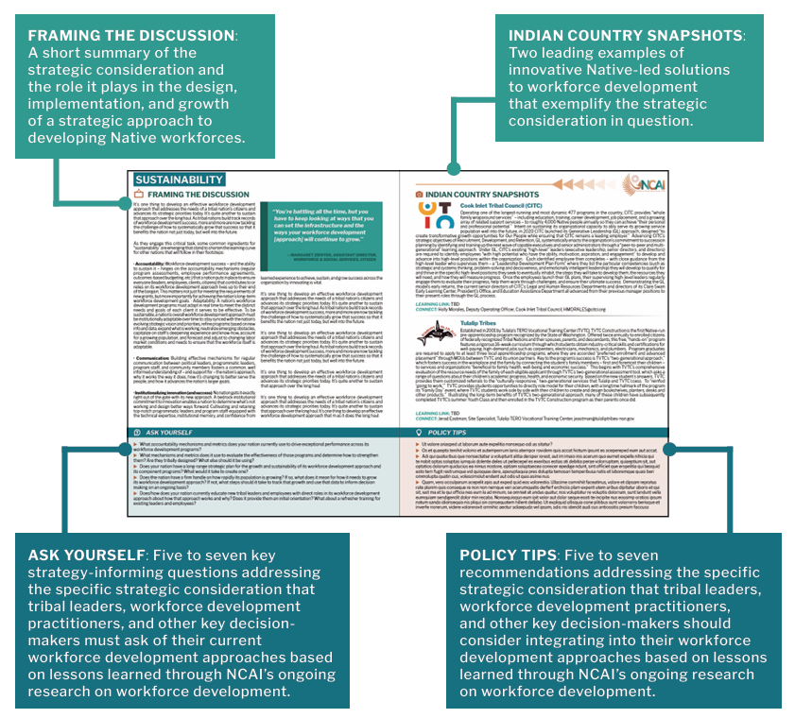
Tribal Workforce Development: A New Decision-Framing Toolkit
for Tribal Leaders and Workforce Developers
Strategic Considerations
Provides a deep-dive approach to each of the 15 Strategic Considerations, including:
Key framing questions
Practical strategies
Real world examples
Action-oriented insights
Users can look at sections to focus on individual Tribal priority areas.

Slide 13
Tribal Workforce Development: A New Decision-Framing Toolkit
for Tribal Leaders and Workforce Developers
Tribal “Snapshots”
Two examples of innovative Native-led solutions to workforce development that exemplify each strategic consideration.
The snapshots show:
  What works
  Why it works
  How it can be replicated

Slide 14
Tribal Workforce Development: A New Decision-Framing Toolkit
for Tribal Leaders and Workforce Developers
Using the Toolkit
The Toolkit can be used in three ways:
Full strategic planning guide
Targeted issue-solving tool
Training and facilitation resource

Slide 15
Tribal Workforce Development: A New Decision-Framing Toolkit
for Tribal Leaders and Workforce Developers
Questions to Consider
What are our biggest workforce gaps?
What strategic consideration is our most urgent?
What existing assets can we build on?

Slide 16
Tribal Workforce Development: A New Decision-Framing Toolkit
for Tribal Leaders and Workforce Developers
Step-by-step use
Step 1: Asses the Tribal Nation’s current workforce system.
Step 2: Identify the gaps in the system using the 15 strategic considerations.
Step 3: Prioritize key focus areas.
Step 4: Review and incorporate the Tribal “snapshots” for solutions.
Step 5: Develop, refine, and implement the Tribal Nation’s workforce development strategy.

Slide 17
Tribal Workforce Development: A New Decision-Framing Toolkit
for Tribal Leaders and Workforce Developers
Key Takeaways
Workforce development IS a Tribal nation-building strategy.
Successful workforce development REQUIRES alignment across systems.
Workforce development MUST BE Tribally defined and driven.

Slide 18
Tribal Workforce Development: A New Decision-Framing Toolkit
for Tribal Leaders and Workforce Developers
Tribal Workforce Development Toolkit (Version 2.0)
https://www.ncai.org/workforcedevtoolkit

